Slide 1
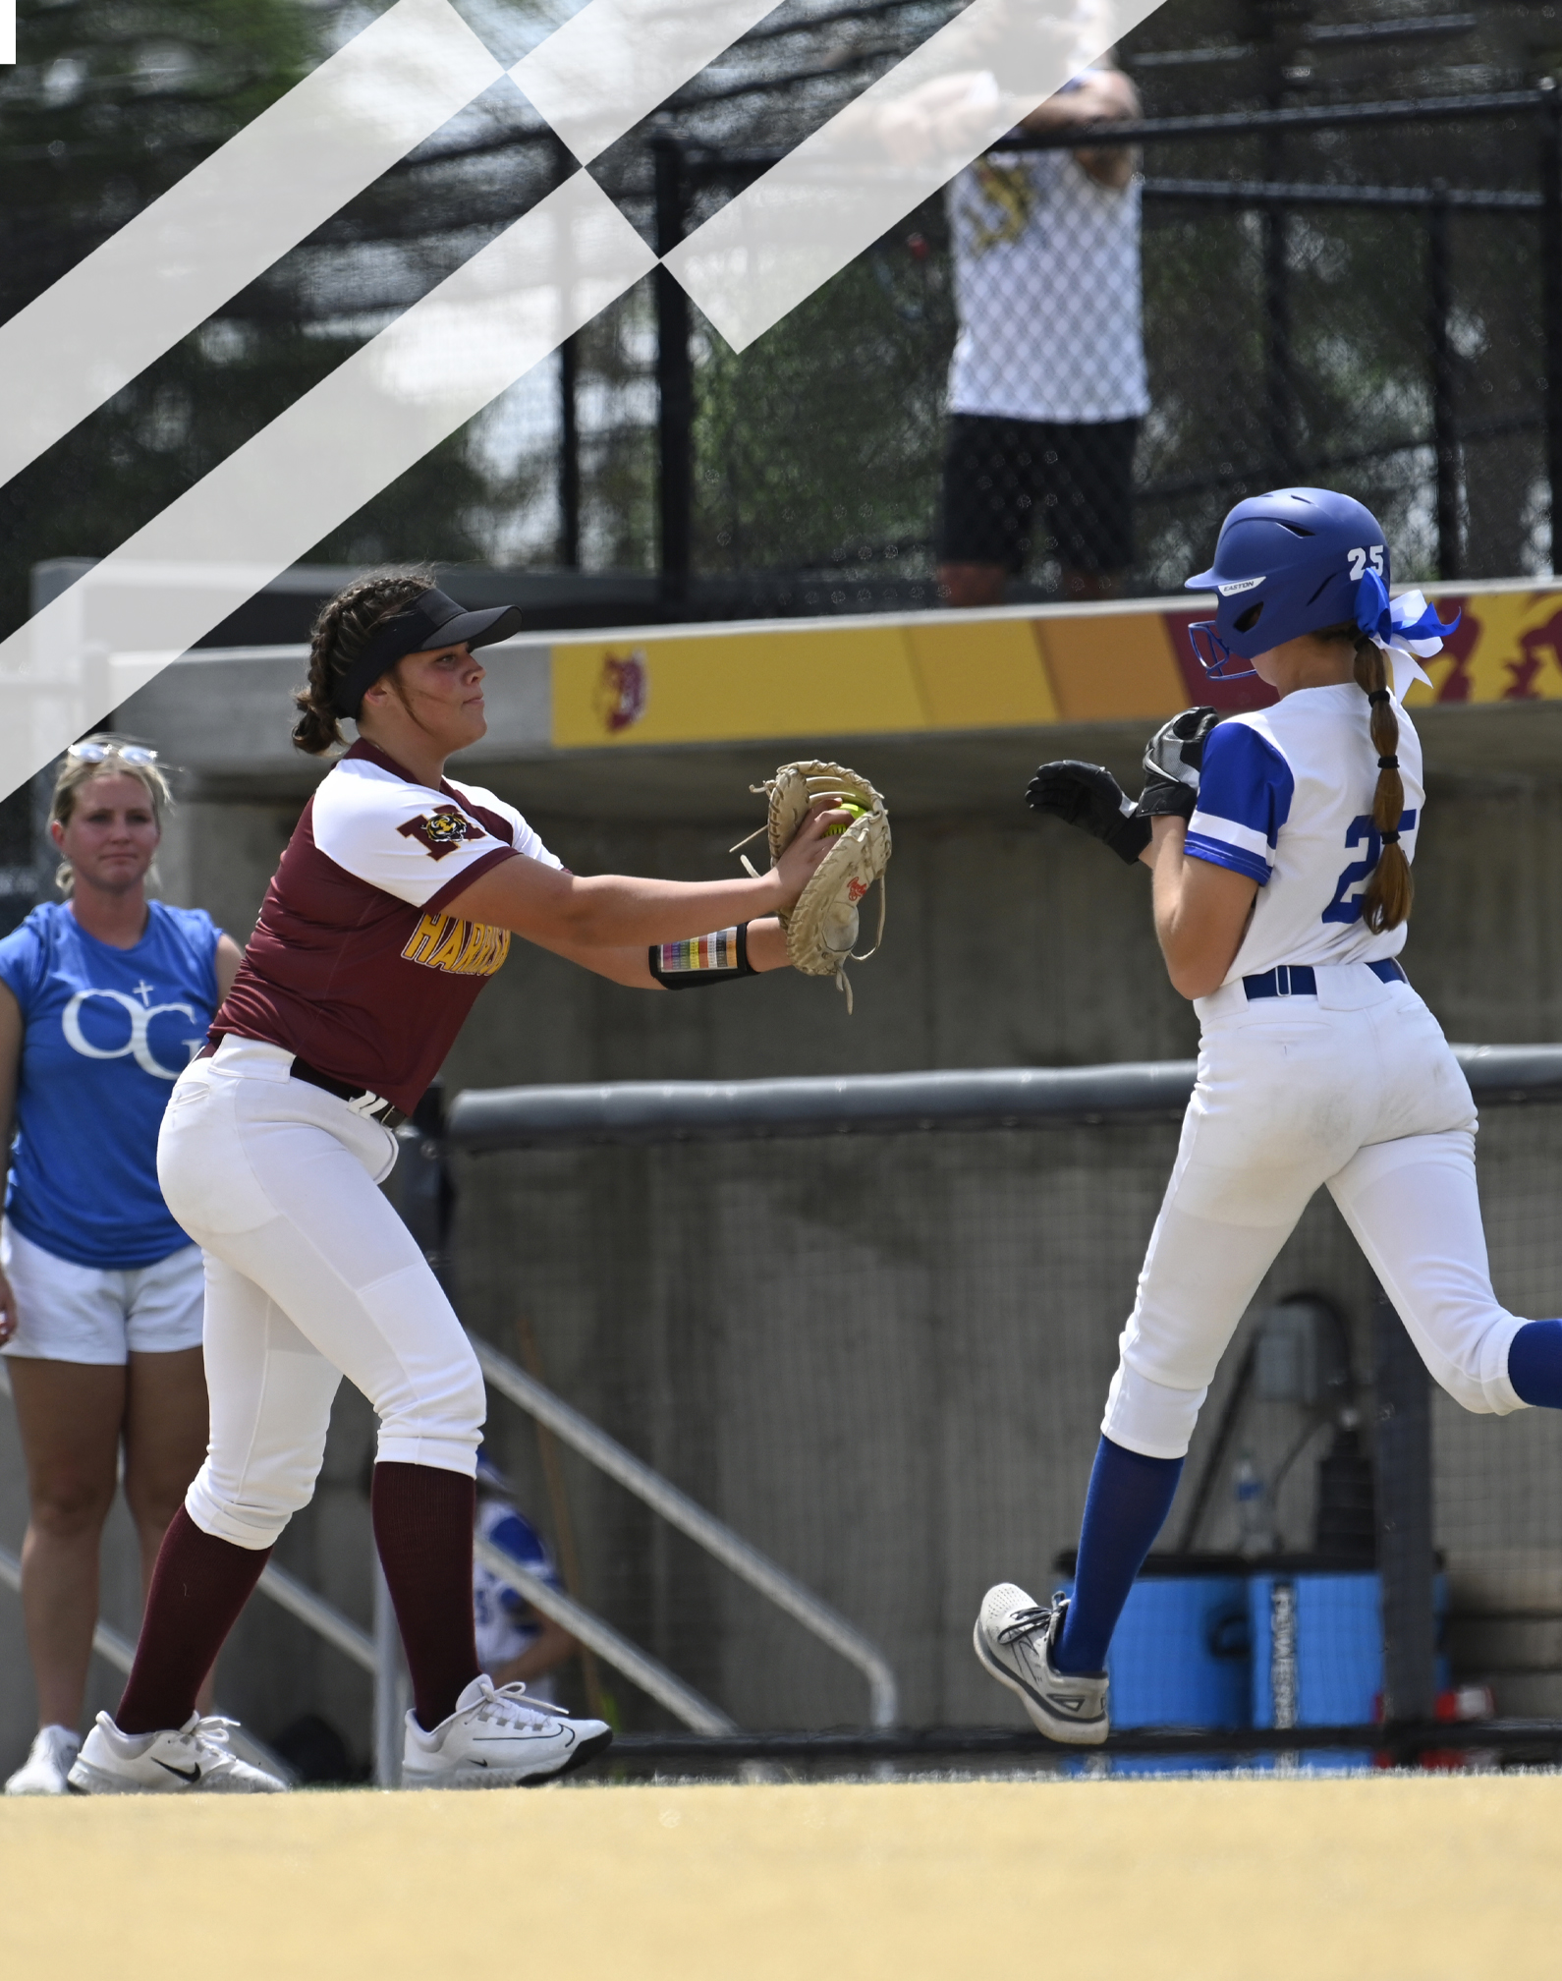
2026 NFHS Softball Rules PowerPoint
Rule Changes
Editorial Changes
Points of Emphasis

Slide 2
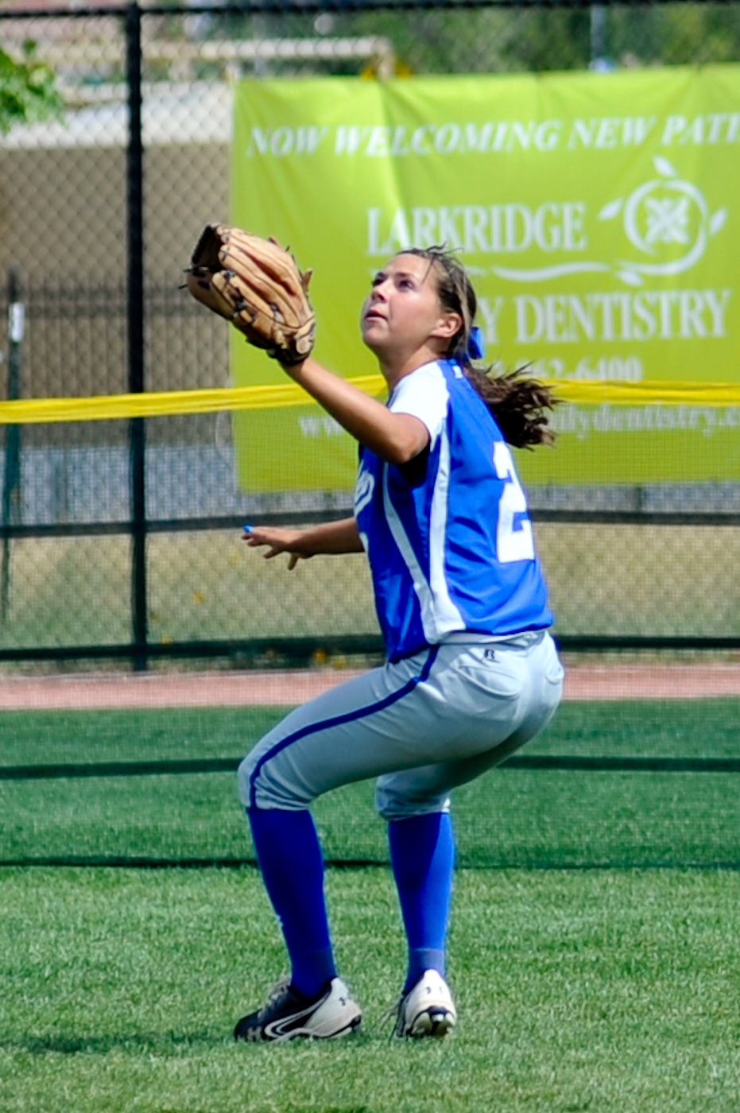
NFHS INFORMATION

Slide 3
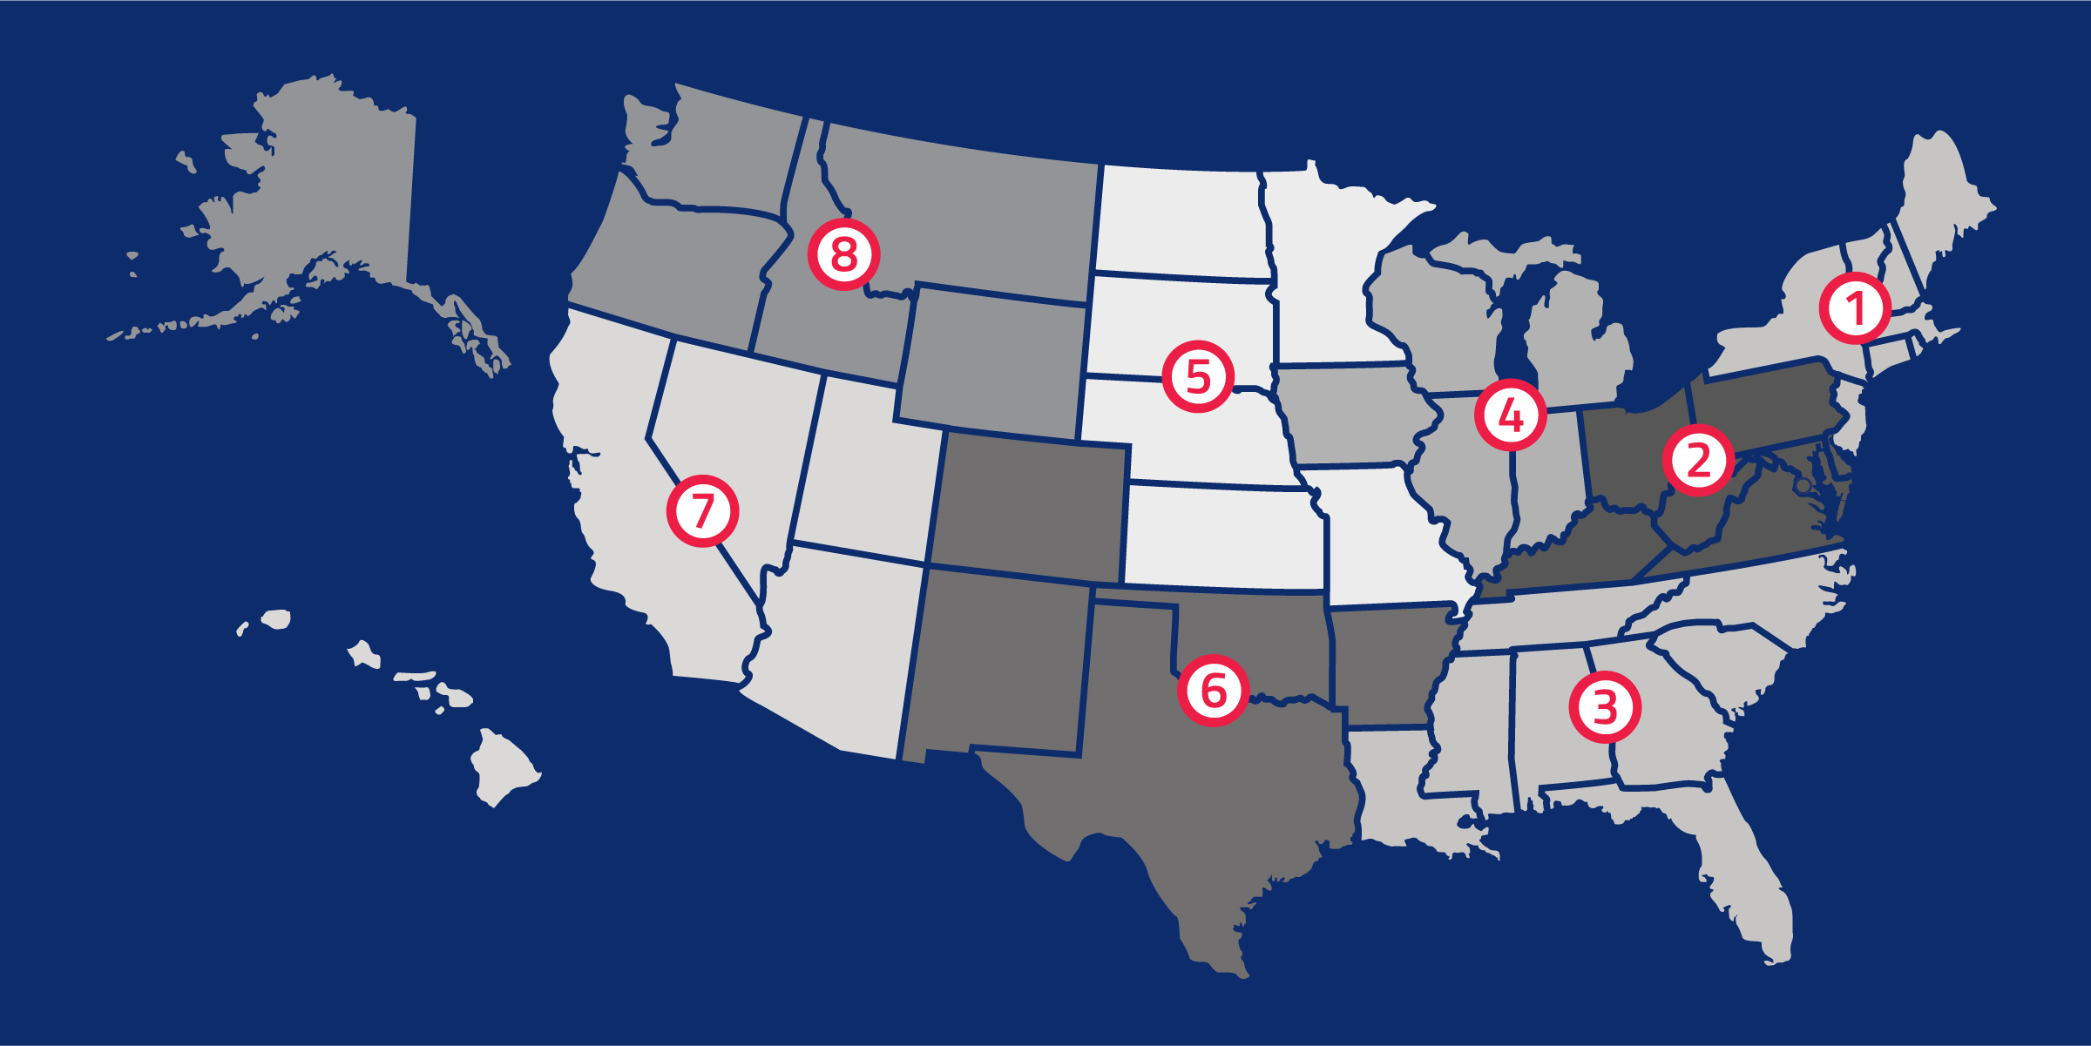
National Federation of State High School Associations
NFHS (located in Indianapolis, IN – Est. 1920):
National leader and advocate for high school athletics and performing arts programs.
Serves 51 state associations, 19,800 high schools and 12 million student participants.
Writes playing rules for 18 high school sports for boys and girls.
Offers online education courses for high school coaches, officials, parents, students and others.
Ensures that students have opportunity to enjoy healthy participation, achievement and good sportsmanship in education-based activities.
Notes:
The NFHS is the national leader and advocate for high school athletics and performing arts programs. Services of the NFHS reach more than 19,500 high schools and 12 million participants throughout the eight NFHS sections across the U.S.
A significant responsibility of the NFHS is the commitment to writing quality playing rules for 18 high school sports for boys and girls, in addition to providing educational resources for high school coaches, officials, parents and students.
It is the vision of the NFHS to help prepare tomorrow’s leaders for the next level of life through the many program offerings in education-based athletics and activities.

Slide 4





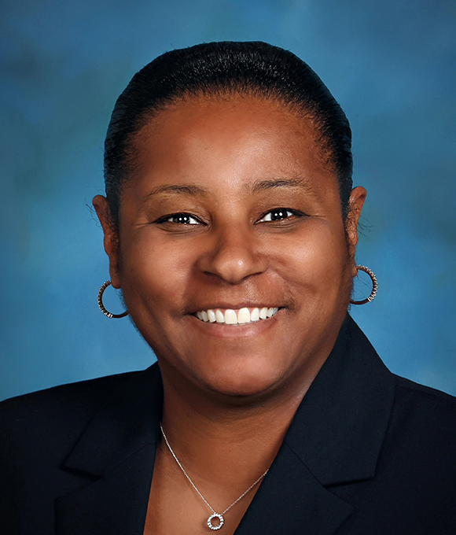

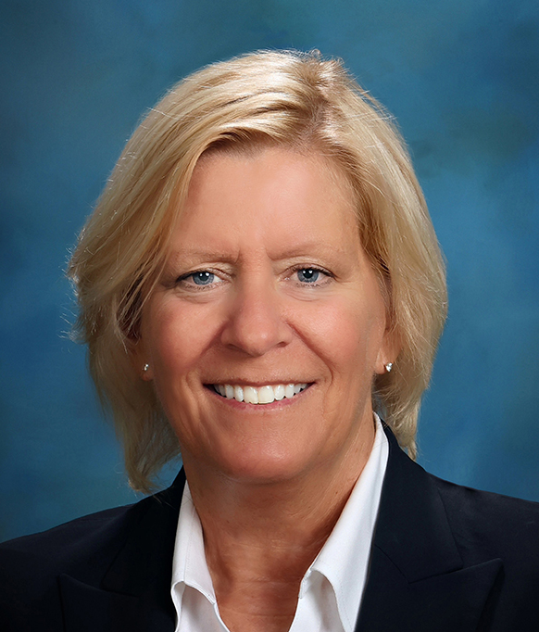

NFHS Rules Review Committee
The NFHS Rules Review Committee is chaired by the chief operating officer and composed of all rules editors. After each committee concludes its deliberations and has adopted its recommended changes for the subsequent year, such revisions will be evaluated by the Rules Review Committee.
Davis Whitfield
Chief Operating Officer
Lindsey Atkinson
Boys & Girls Lacrosse and Volleyball
Julie Cochran
Cross Country, Soccer and Track & Field
Bob Colgate
Flag Football, Football and Sports
Medicine
Elliot Hopkins
Baseball and Wrestling
Monica Maxwell
Basketball, Field Hockey and Girls Gymnastics
Dan Schuster
Ice Hockey
Sandy Searcy
Softball, Swimming & Diving and Water Polo
Chris Paulson
Spirit
Notes:
All rules committee recommended rules changes are vetted through the NFHS Rules Review Committee before advancing to the NFHS Board of Directors for final action. The committee, as you see, is comprised of all NFHS Director of Sports and chaired by the NFHS Chief Operating Officer.
The rules writing process is multi-tiered. Each year, specific committee meets to deliberate rules proposals submitted by state associations and committee members. After each committee concludes its deliberations and has adopted its recommended changes for the subsequent year, proposals are sent to the Rules Review Committee, who then evaluates the proposals and then forwards the to the NFHS Board of Directors for their consideration. The NFHS Rules Review Committee is chaired by the chief operating officer and consists of all NFHS rules editors.

Slide 5




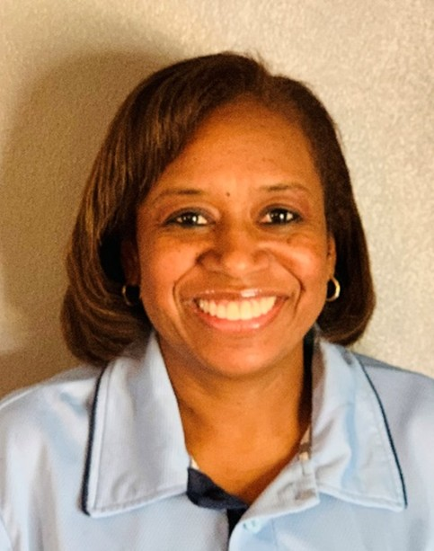




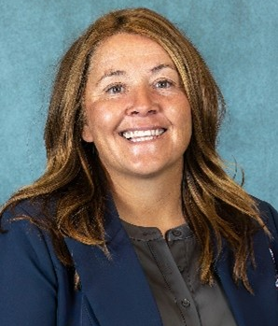
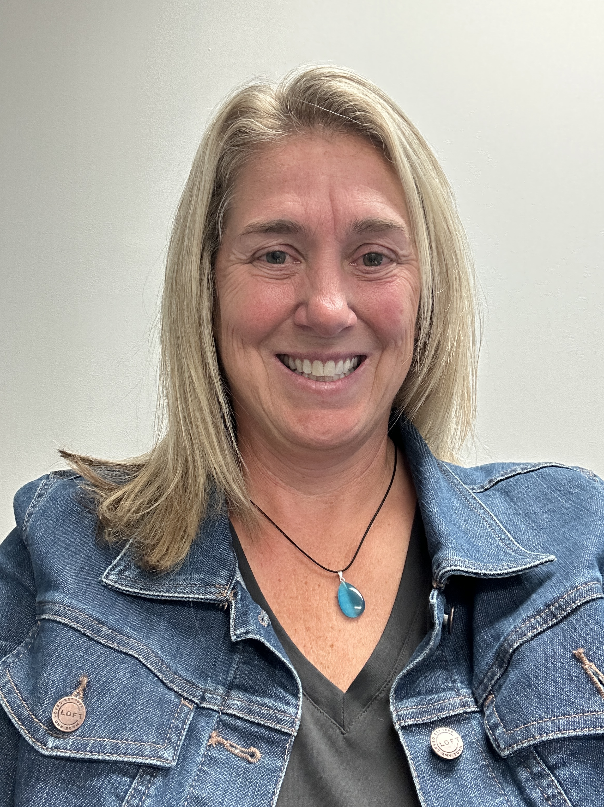
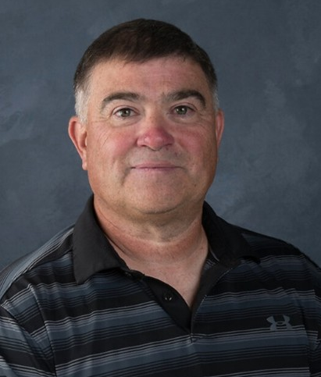

NFHS Softball Rules Committee
Andi OstersEast Lansing, MI Chair - 2026
Sherry Bryant Franklin, MA Section 1 - 2028
Sarah Bridenbaugh Lexington, KY Section 2 - 2025
Michelle Yeater Prosperity, SC Section 3 - 2026
Kim Williams Swansea, IL Section 4 - 2028
Kerrie Rosati Indianapolis, IN Section 4 - 2027
Lisa Quednow Brooklyn Center, MN Section 5 - 2028
Steve Roberts North Little Rock, AR Section 6 - 2025
Laura Traeger Reno, NV Section 7 - 2026
Tonia Burk Twin Falls , ID Section 8 - 2027
Missy Smith Wilsonville, OR Section 8 - 2027
Eli Field Frenchtown, MT NFHS Coaches 2025
Michiael Shannon Bloomington, IN NFHS Officials 2026
Notes:
Photos of the 2025 NFHS Softball Rules Committee members include the representation of eight sections, the NFHS Officials Association, the NFHS Coaches Association, and Rules Committee Chair.

Slide 6








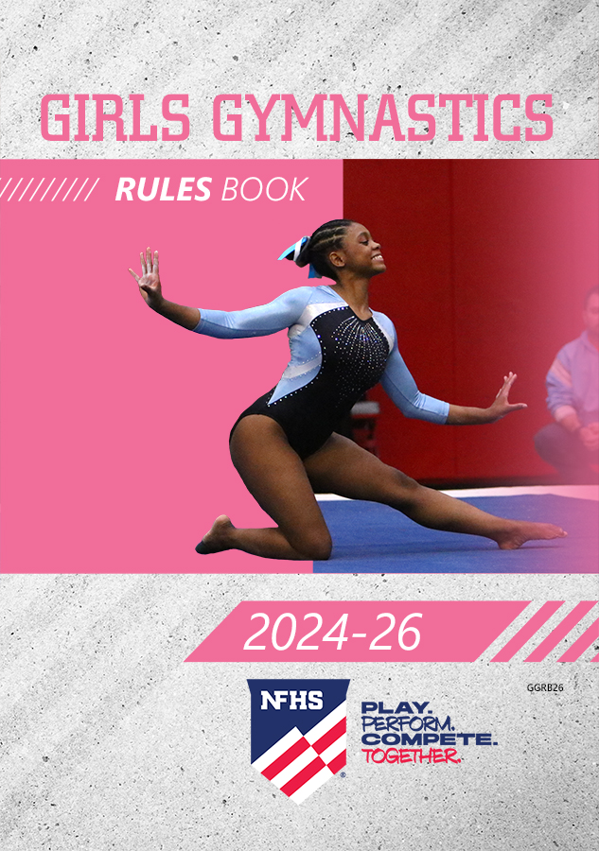








NFHS Publications
The NFHS writes playing rules for 18 sports for boys and girls at the high school level and publishes 2 million pieces of materials annually.
Notes:
The NFHS writes playing rules for 18 sports for boys and girls at the high school level and publishes 4 million pieces of materials annually.

Slide 7


NFHS Digital
NFHS Digital is the New Publications Platform that includes:
Rules Books
Case Books
Officials Manuals
Policy Debate Quarterly
Other NFHS Publications
Visit nfhs.org/NFHSDigital
Notes:
NFHS Digital is the New Publications Platform that includes:
Rules Books
Case Books
Officials Manuals
Policy Debate Quarterly
Other NFHS Publications
Visit nfhs.org/NFHSDigital

Slide 8
NFHS Digital – Mobile App
Access via Mobile App:
View available publications for sale
View publications assigned to you
Create comments and save notes
Highlight important content to review later
Available on App Store and Google Play
Notes:
Access via Mobile App:
View available publications for sale
View publications assigned to you
Create comments and save notes
Highlight important content to review later
Available on App Store and Google Play

Slide 9
Guidelines for schools and state associations for consideration of accommodations
Request of Accommodation by School
State Association Review
Written Determination from State Association
Competition with Approval of Accommodation
Notes:
To assist state associations in working with schools for the inclusion of students with disabilities the following guide prepared by the NFHS Task Force on the Inclusion of Students with Disabilities is being provided for your review.
Following these guidelines will assist in the individual student assessment by the student and the school.
When requesting a possible accommodation, coaches should work with their school and the state association as early as possible in the sport season.
Contest officials shall defer decisions on rule accommodations to the respective state association.
This information serves as a guide. Each state association may develop its own process.
Language addressing accommodations is contained in Rule 1-6-12 NOTE and includes the state association's responsibilities with respect to accommodation of uniform modifications.

Slide 10
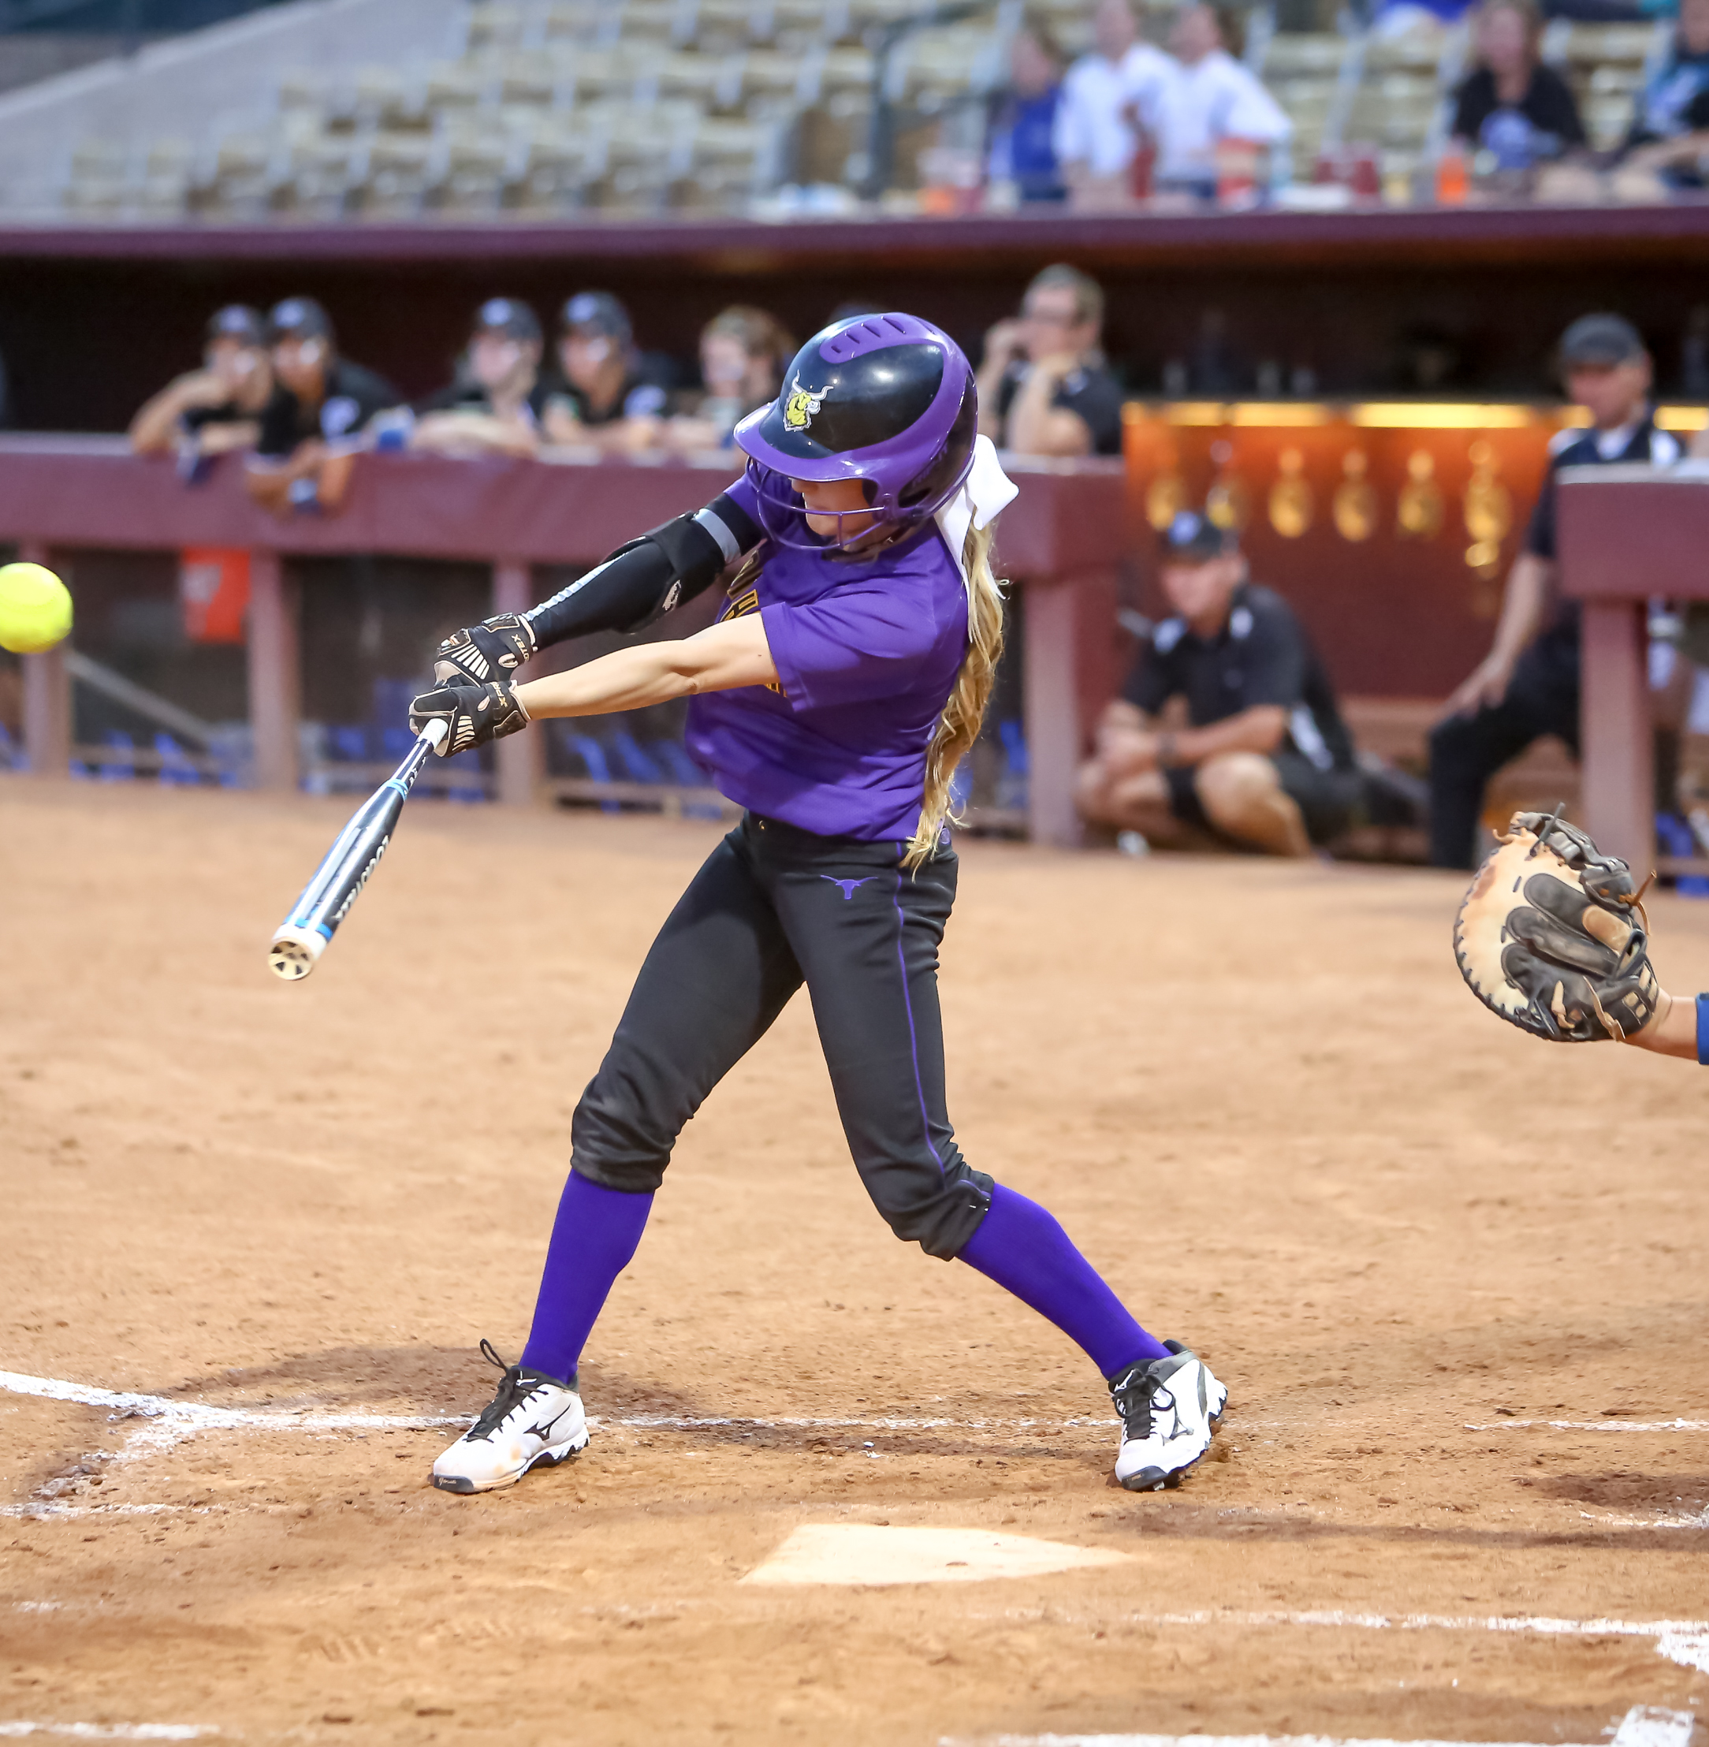
2026 NFHS SOFTBALL RULES CHANGES

Slide 11
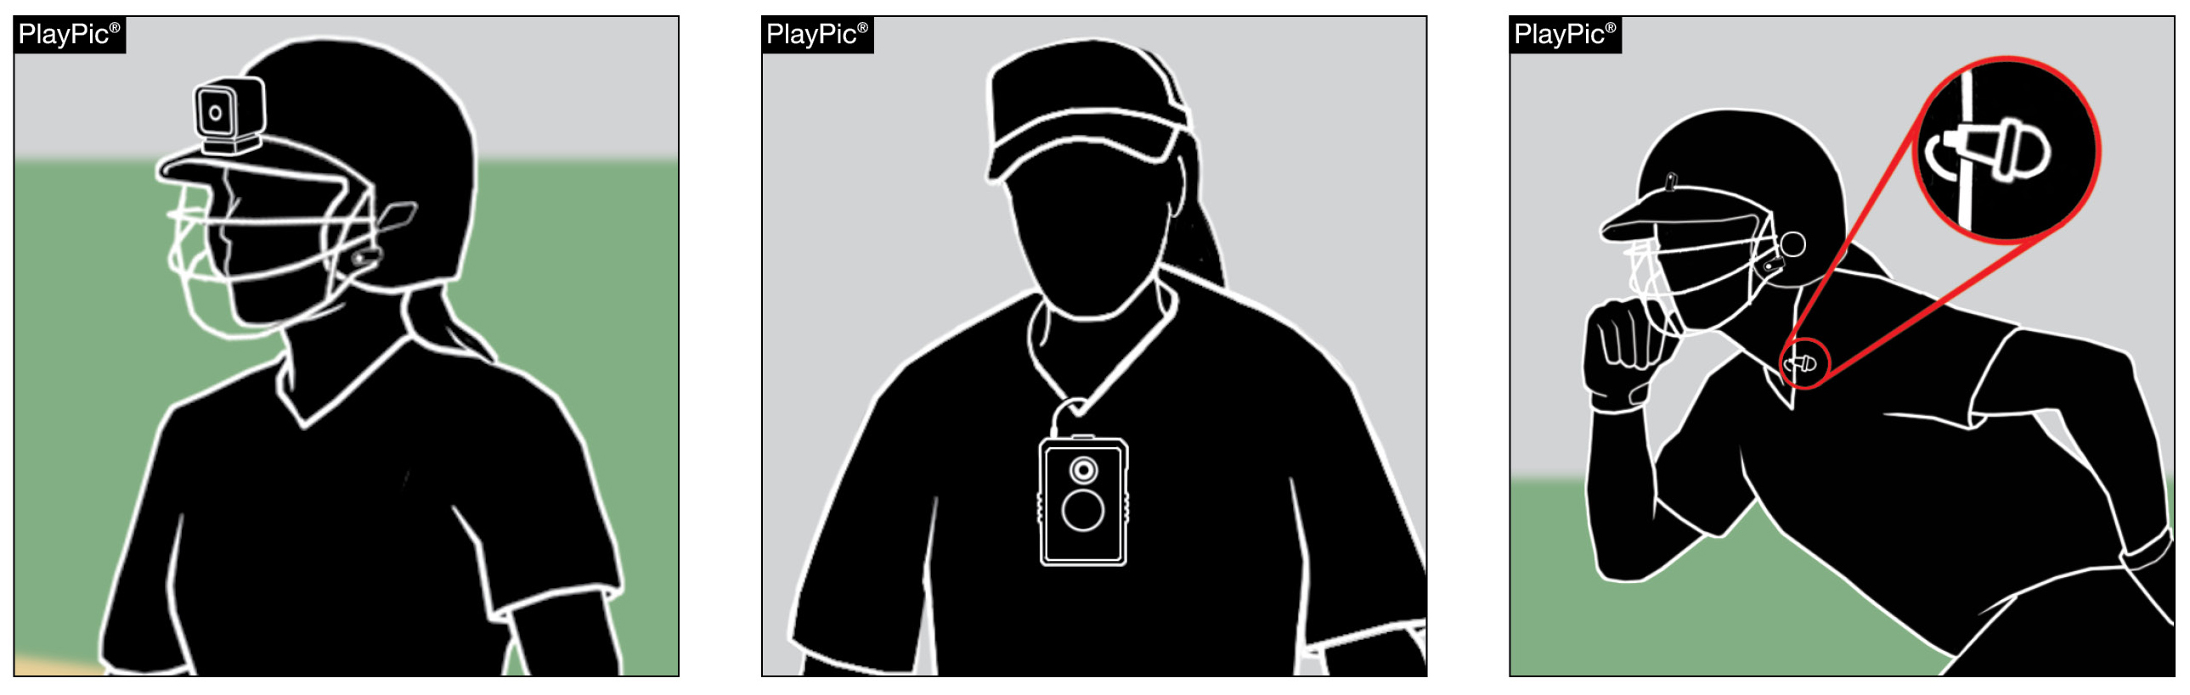
OTHER EQUIPMENT 1-9-6
Players shall not transmit or record audio or video from the playing surface.
Penalty: Ejection of the offender from the game, unless the offense is judged to be of a minor nature. If minor, the umpire may warn the offender and eject if the offense is repeated.
Notes:
OTHER EQUIPMENT 1-9-6:
Players shall not transmit or record audio or video from the playing surface.
Penalty: ejection of the offender from the game, unless the offense is judged to be of a minor nature. If minor, the umpire may warn the offender and eject if the offense is repeated.
Rationale: This change clearly defines the types of electronic devices prohibited by the rule.
Comments: With the increasing accessibility and use of electronic devices, it is important to establish clear boundaries for their use in competitive softball. Players shall not record audio or video while on the playing surface, as doing so presents significant safety risks and potential distractions that can compromise the integrity of the game. Movement and recording during live play—whether with handheld devices, wearable cameras, or phones—can interfere with a player's ability to perform safely and effectively. Handheld equipment may limit a player's capacity to catch or throw a ball, while wearable devices can become entanglement hazards or create impact risks during high-speed plays or collisions. Additionally, extra foot traffic or positioning for the sake of capturing footage can unintentionally place individuals in the path of play, leading to unnecessary contact or disruption. Beyond safety, the use of recording equipment on the field raises concerns around focus and liability. Players distracted by filming may not respond as quickly to the ball or to their teammates, and their inattention could increase the chance of injury. Moreover, audio recordings introduce privacy and liability considerations, especially when capturing conversations during competition. For these reasons, no player is permitted to record while on the field of play. The emphasis must remain on maintaining a safe, focused, and fair playing environment for all participants.

Slide 12
BATTER-RUNNER AND RUNNER RULE 8
NFHS Rule 8 has been reformatted for clarity and consistency.
Section 4 was separated into two sections addressing runners entitled to advance with and without liability to be put out.
Remaining sections were renumbered.
Notes:
BATTER-RUNNER AND RUNNER Rule 8:
NFHS Rule 8 has been reformatted for clarity and consistency.
Section 4 was separated into two sections addressing runners entitled to advance with and without liability to be put out.
Remaining sections were renumbered.
Rationale: Added article references to PENALTIES and EFFECTS, and Section 4 was separated into two sections addressing runners entitled to advance with and without liability to be put out to delineate differences.
Comments: To improve clarity and enhance the overall usability of the rules, the existing content was reorganized into a structured outline format. This new layout allows for easier navigation and better comprehension of key concepts by clearly separating topics and presenting information in a logical, accessible sequence. One significant change involved dividing the original Section 8-4 into two distinct sections. This split more clearly distinguishes between situations in which runners are entitled to advance without liability to be put out and those where they advance with liability. By isolating these scenarios, officials, coaches, and players can more readily understand the conditions under which runners are protected or at risk during play. Additionally, article references were added to corresponding PENALTIES and EFFECTS. This change provides direct links between specific rule violations and their consequences, eliminating ambiguity and helping users quickly identify the appropriate rulings and applications. The result is a cleaner, more intuitive rule structure that supports accurate rule enforcement and improved learning.

Slide 13
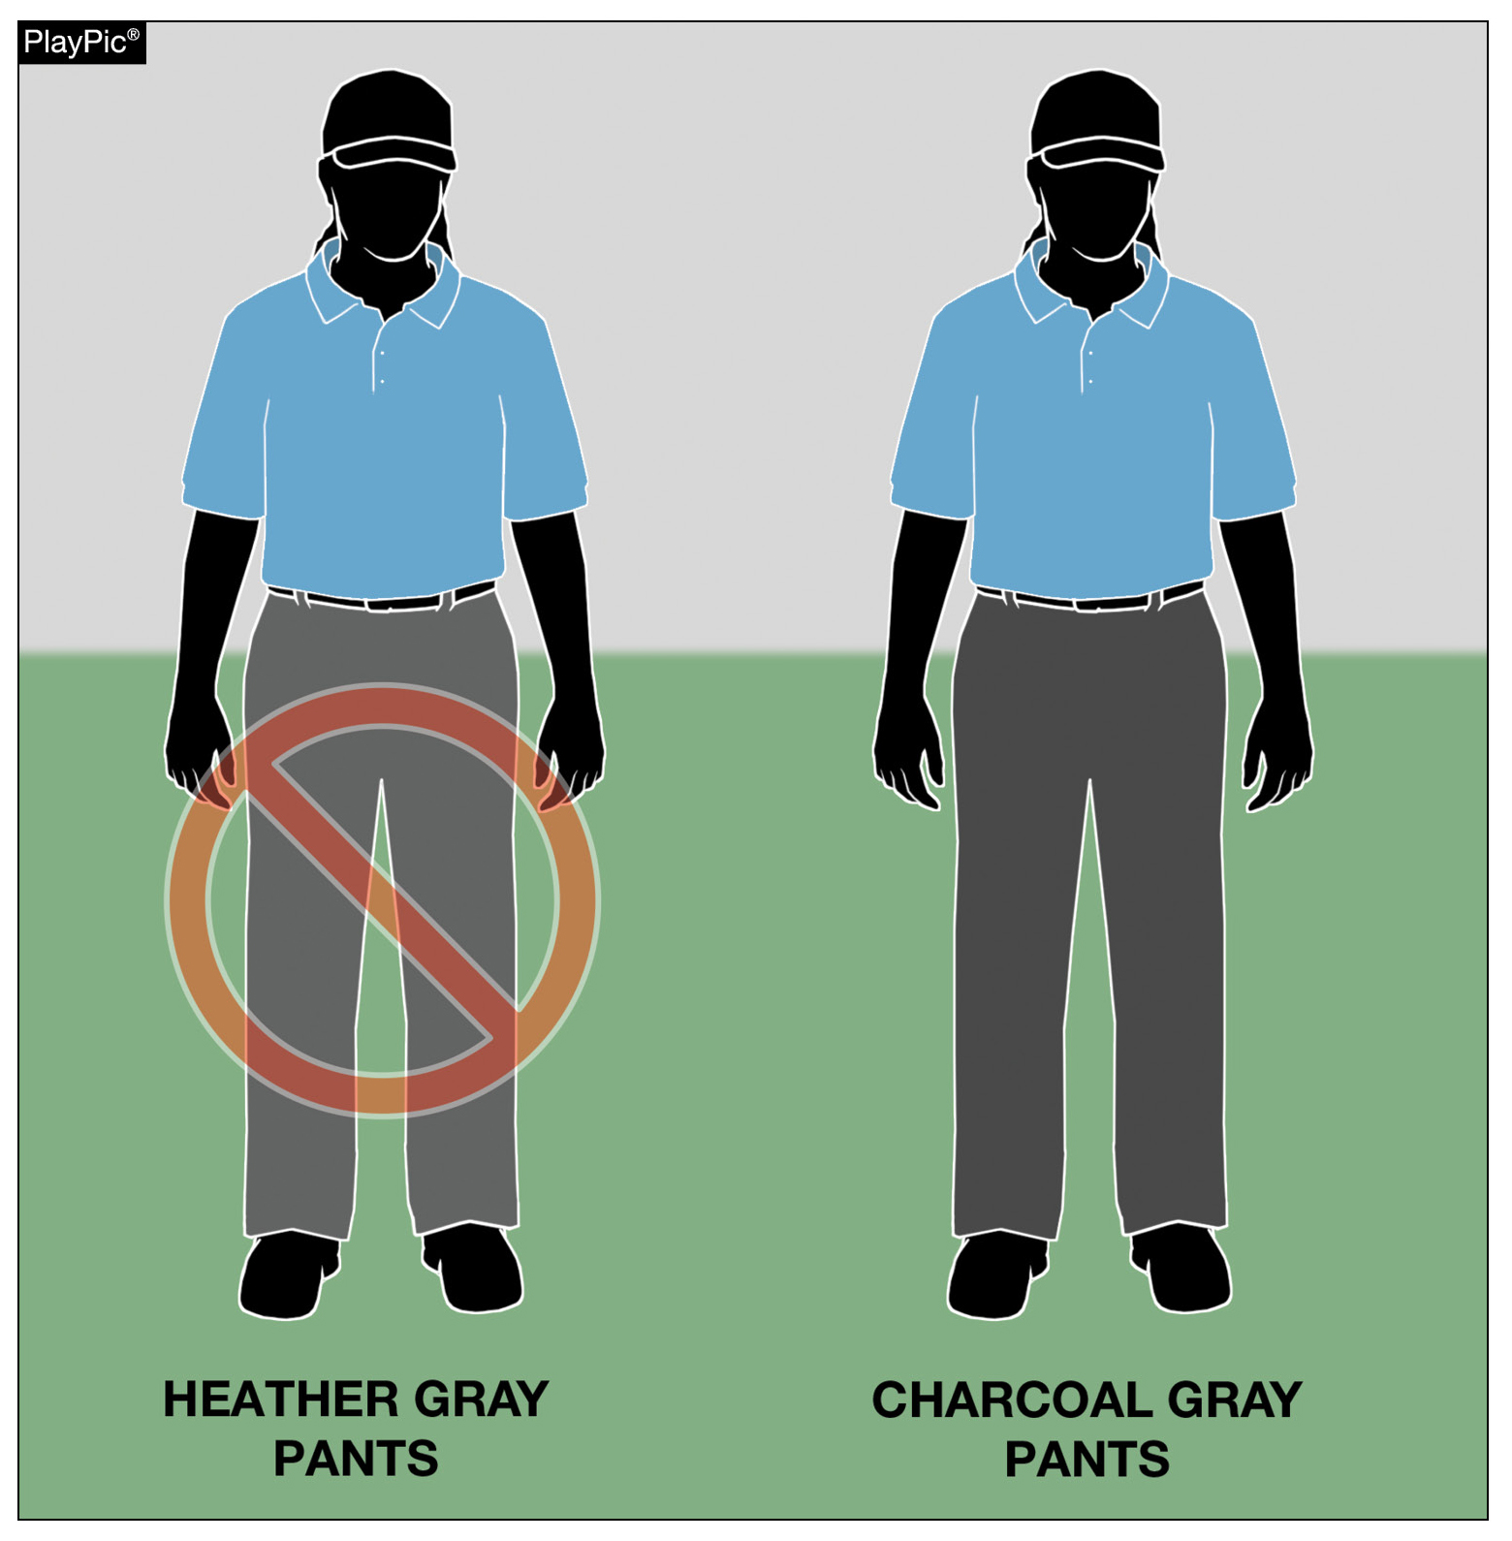
EQUIPMENT AND APPAREL 10-4-2
Umpires have the option of wearing heather gray, charcoal gray or navy blue slacks.
Effective January 1, 2027, heather gray slacks will no longer be permitted as part of the umpire's uniform.
Notes:
EQUIPMENT AND APPAREL 10-4-2:
Umpires have the option of wearing heather gray, charcoal gray or navy blue slacks.
Effective January 1, 2027, heather gray slacks will no longer be permitted as part of the umpire's uniform.
Rationale: Manufacturers have discontinued producing heather gray umpire pants. This change will assist umpires in the purchase of pants that are currently being manufactured.
Comments: Effective January 1, 2027, heather gray umpire pants will no longer be permitted for use, as manufacturers have discontinued their production. This update reflects a practical shift to ensure that umpires can purchase and wear uniform pants that are currently being manufactured and readily available through suppliers. Moving forward, umpires will be expected to wear pants in either charcoal gray or navy, both of which are actively produced and supported by major manufacturers. The transition to these colors—particularly charcoal gray—provides consistency in appearance while allowing state associations and officials to align with what is accessible in the current marketplace. This change comes in response to ongoing feedback from state associations, which emphasized the challenges officials face in locating heather gray pants and the need for standardized, available uniform options. By establishing a clear implementation date and aligning with existing production trends, this adjustment supports both uniformity and ease of compliance across all levels of competition. Pants in either heather or charcoal gray will be legal until January 1, 2027, when charcoal pants will be required.

Slide 14
2026 NFHS SOFTBALL EDITORIAL CHANGES

Slide 15
UNIFORMS, PLAYER EQUIPMENT 1-6 (NEW)
Uniform language from Rule 3-2 has been moved to Rule 1-6 to align with other NFHS rules book language on equipment and uniform.
Rule 1 Sections 6 through 8 have been renumbered to reflect this change.
Rule 3 has been renumbered.
Notes:
UNIFORMS, PLAYER EQUIPMENT 1-6 (NEW):
Uniform language from Rule 3-2 has been moved to Rule 1-6 to align with other NFHS rules books.
Rule 1 Sections 6 through 8 have been renumbered to reflect this change.
Rule 3 has been renumbered.
Rationale: Placing uniform language in Rule 1 is consistent with other NFHS rule language.

Slide 16
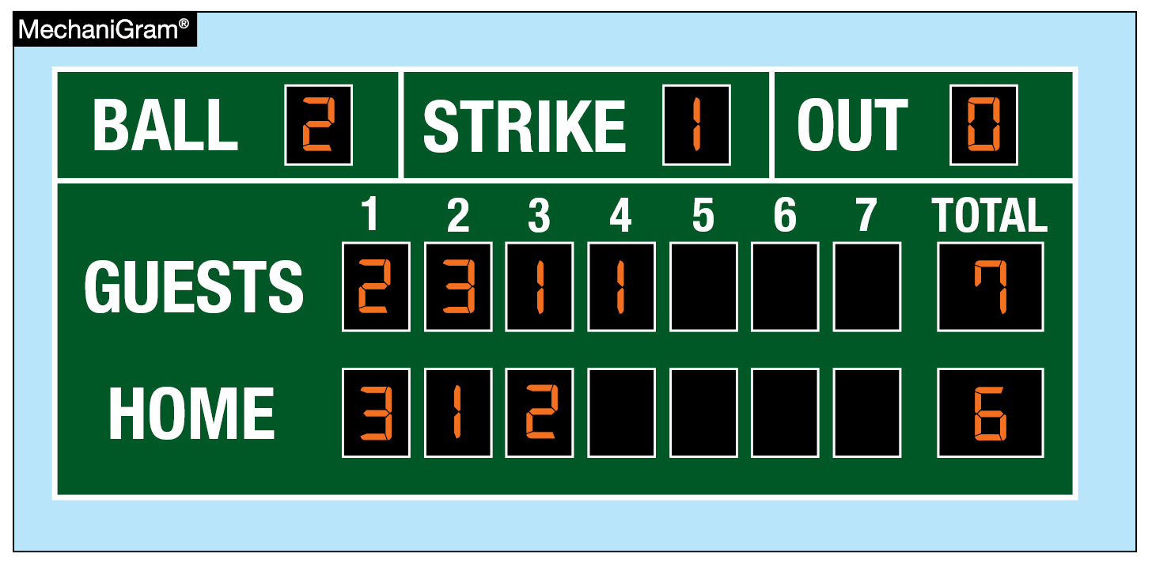
FORFEITED GAME 4-3-2
If a game is forfeited after the number of innings required for a regulation game and the offending team is behind the score remains as recorded.
Notes:
FORFEITED GAME 4-3-2:
If a game is forfeited after the number of innings required for a regulation game and the offending team is behind the score remains as recorded.
Rationale: Language was reworded for clarity.

Slide 17
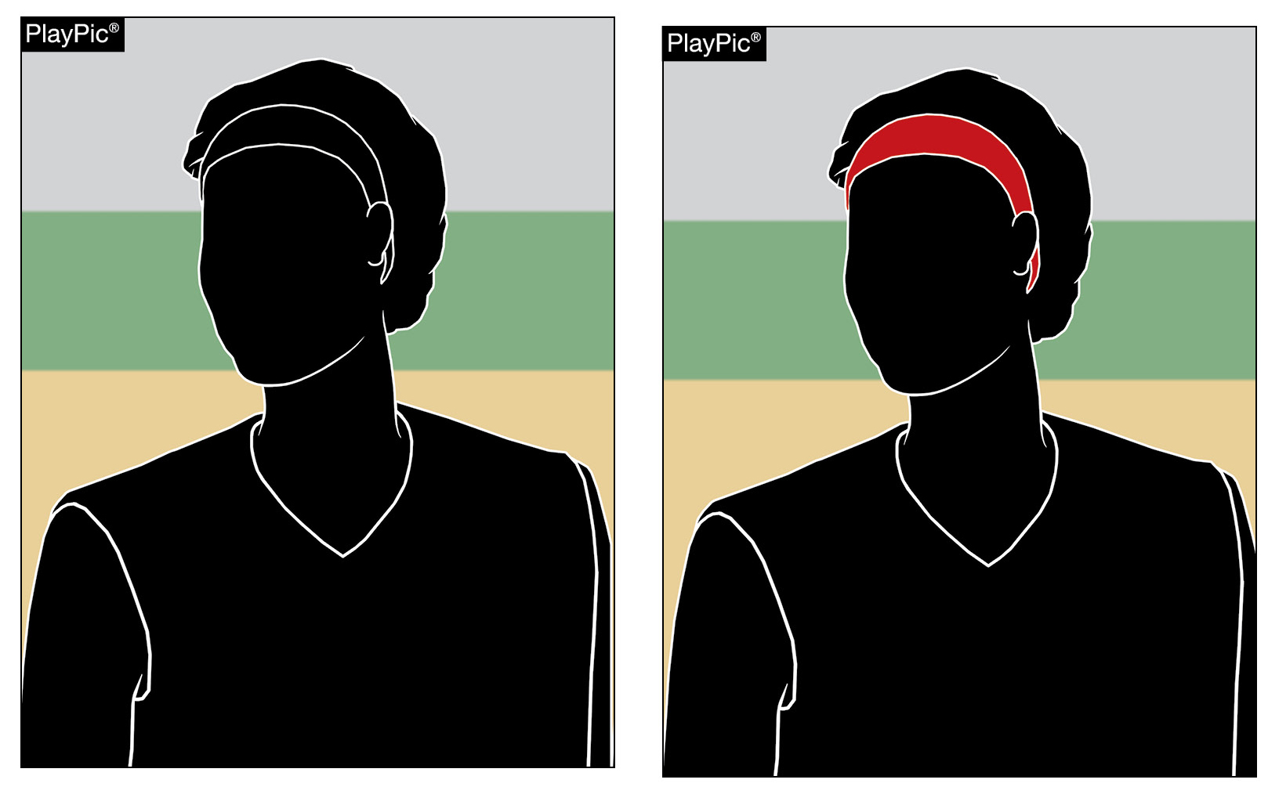
UNIFORMS, PLAYER EQUIPMENT 3-2-5 CASE BOOK
Edits to 3.2.5 Situations B & C reflect rule change for 2025.
There are no color restrictions for headbands.
Notes:
UNIFORMS, PLAYER EQUIPMENT 3-2-5 CASE BOOK:
Edits to 3.2.5 Situations B & C reflect the 2025 rule change.
There are no color restrictions for headbands.
Rationale: Correction to reflect a rule change in the 2025 rules book.

Slide 18
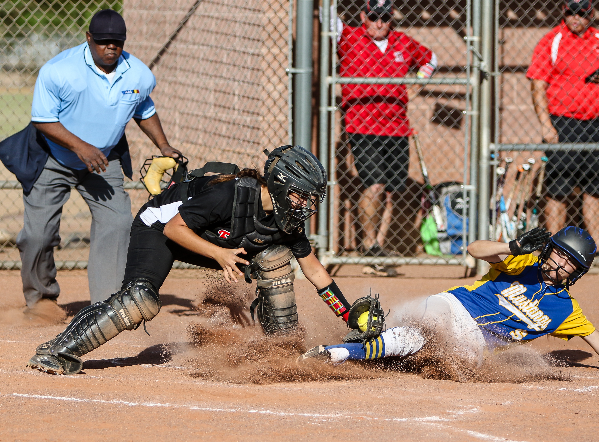
2026 NFHS SOFTBALL POINTS OF EMPHASIS

Slide 19
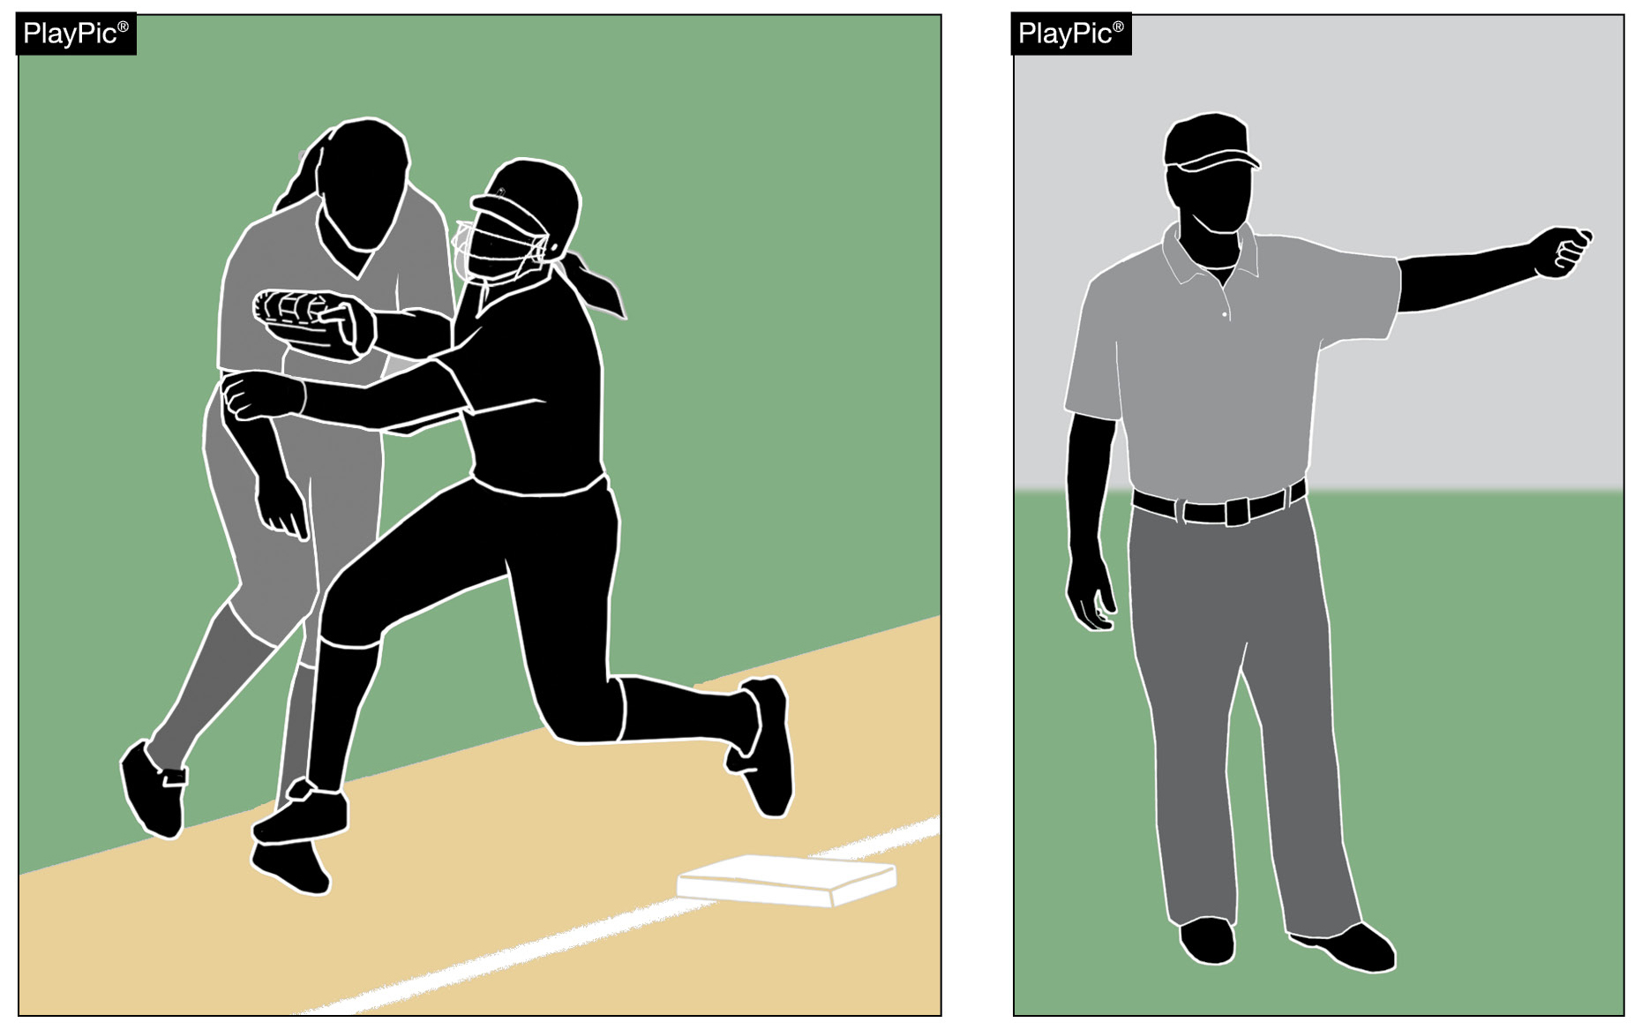
OBSTRUCTION
Obstruction is the act of a defensive team member that:
hinders or impedes a batter’s attempt to make contact with a pitched ball, or
impedes the progress of a runner or batter-runner legally running the bases.
Notes:
Obstruction Obstruction is defined as the act of a defensive player who hinders or impedes a batter’s attempt to make contact with a pitch or interferes with the legal progress of a runner or batter-runner advancing on the bases. This interference may be intentional or unintentional, and it can be either physical or verbal. However, obstruction does not apply if the defensive player is in possession of the ball or is making the initial play on a batted ball.

Slide 20
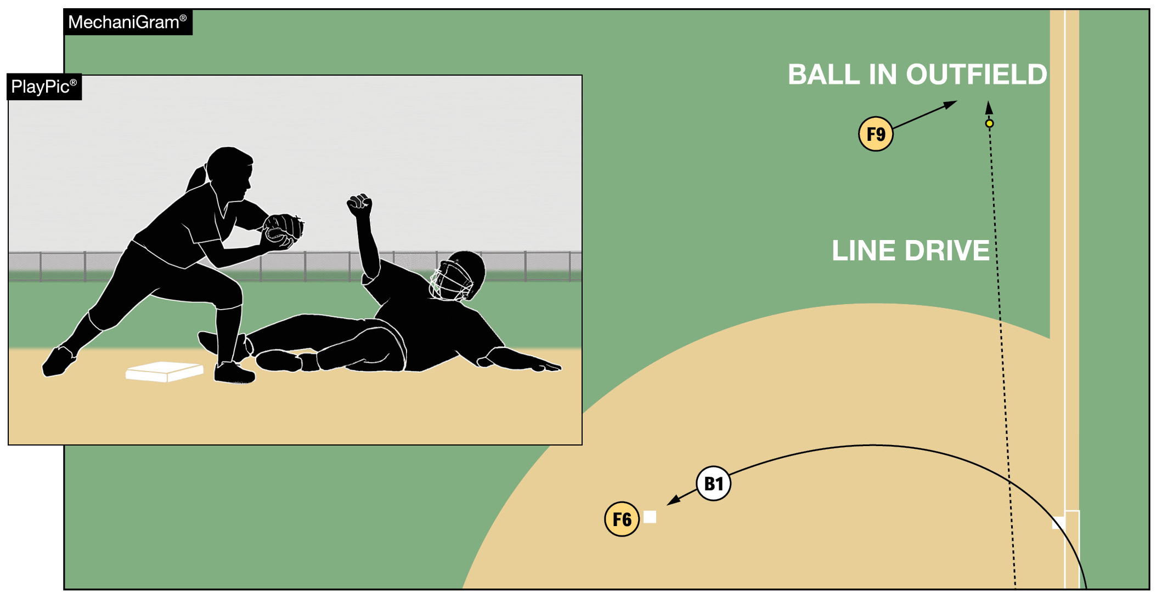
OBSTRUCTION
If the runner or batter-runner is not impeded, there is no obstruction.
With the exception of a fake tag, as shown, a fielder’s actions or positioning alone can never result in an obstruction ruling.
Notes:
Obstruction Impeding a runner means creating a negative effect on their ability to run the bases. This might include a runner slowing down, altering their intended path, stopping altogether, retreating to the previous base, or making contact with a fielder that disrupts their movement. These examples underscore that the umpire must rely on judgment to determine both whether the runner was impeded and to what extent their progress was affected.

Slide 21
OBSTRUCTION
Impeding a runner means creating a negative effect on their ability to run the bases. This might include:
a runner slowing down
altering their intended path
stopping altogether
retreating to the previous base, or
making contact with a fielder that disrupts their movement
The umpire must rely on judgment to determine both whether the runner was impeded and to what extent their progress was affected.
Notes:
Obstruction Unlike many rule violations in softball that carry standardized penalties—such as awarding two bases for a thrown ball that goes out of play or one base for a pitched ball entering dead ball territory—obstruction rulings are situational and vary based on the specifics of each play. The purpose of the obstruction award is not to penalize the defensive team arbitrarily, but to nullify the negative effect of the obstruction. The runner is not being granted an advantage; rather, they are being restored to the position they would have achieved had the obstruction not occurred. This could mean advancing the runner or, in some cases, returning them to a previous base—whatever is necessary to correct the disruption caused by the obstruction, based on the umpire’s judgment.

Slide 22
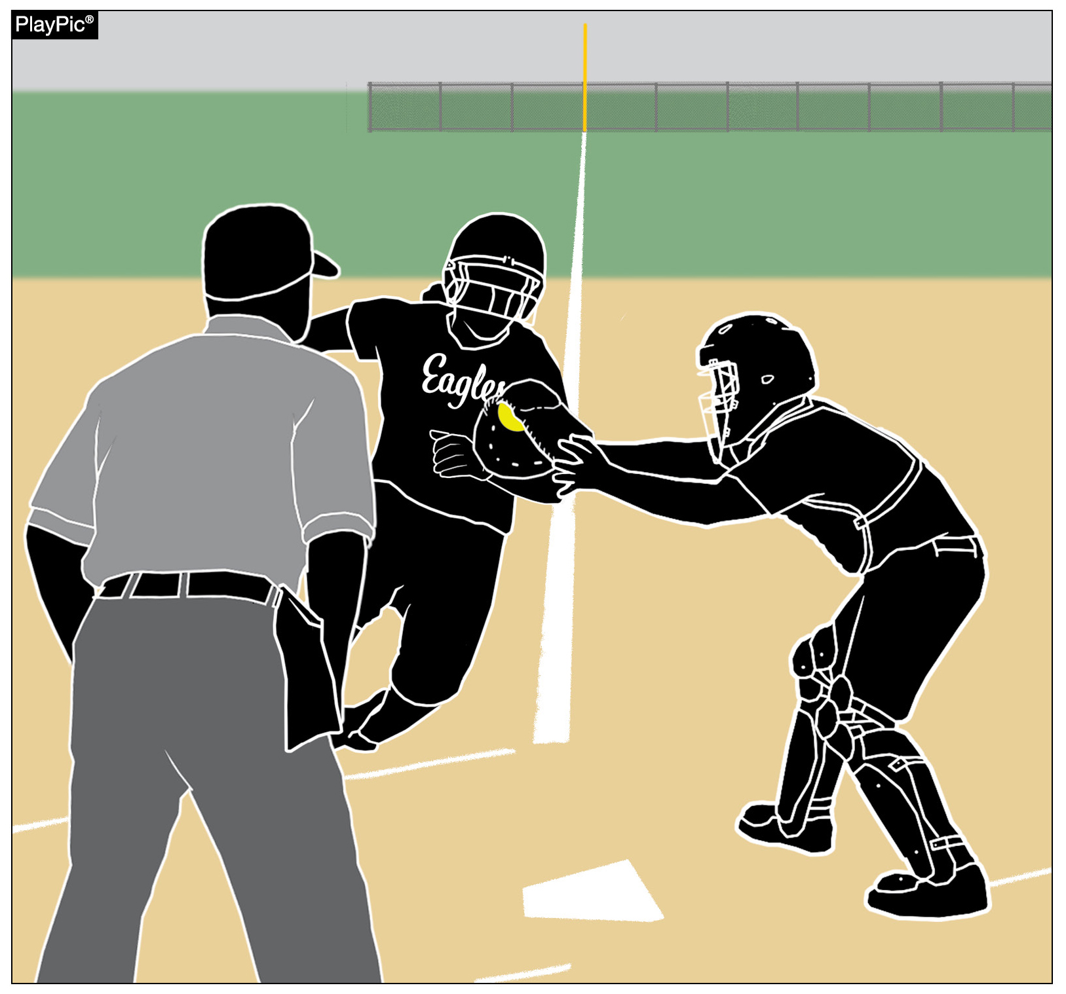
MAINTAINING AN UNOBSTRUCTED VIEW
Verbiage has been added to the 2026-28 NFHS Softball Umpire Manual to provide guidance to umpires when it is necessary to move from the primary position during a play.
This movement allows umpires to keep the following items in view:
Defense contacting offense with the ball (tagging the runner).
Defense maintaining control of the ball during the tag.
Offense contacting the base.
Notes:
Maintaining an Unobstructed View of the Play There are times when an umpire must move from their primary position to maintain an unobstructed view of a play. This is mentioned several times in the NFHS Softball Umpire Manual but, until now, there has not been any guidance for the umpire in the manual. Information has been added to the Umpire Manual to explain aspects of the play that should be considered when moving from the primary position to maintain an unobstructed view of the play.
There are key interactions of the four elements (offense, defense, ball, and base) on each play that need to be viewed clearly in order to make a judgment call. On tag plays:
Defense contacting the offense with the ball (tagging the runner).
Defense controlling the ball through the process of applying the tag.
Offense contacting the base.

Slide 23
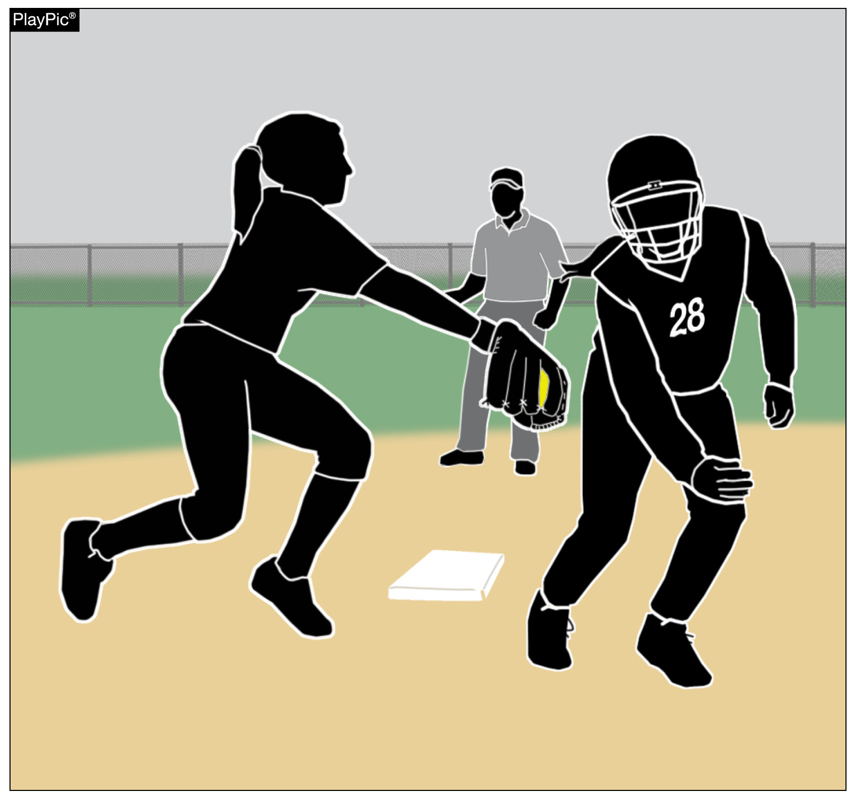
MAINTAINING AN UNOBSTRUCTED VIEW
Umpires must maintain proper distance while adjusting to keep all three interactions in view. Prior to umpires moving from their primary position, key elements of the play need to be understood. These include:
Fielder positioning.
Location, direction and height of the incoming throw.
Runner’s path.
Timing of the throw and the runner arriving near the base.
Notes:
Maintaining an Unobstructed View of the Play All three of these key interactions must remain within the umpire’s view in order to make an accurate judgment call on the play. Also, when adjusting an umpire needs to maintain proper distance as to ensure no key interactions of the play are missed.
Details of each play like:
Defensive positioning.
Direction, height and timing of the throw.
Path of the runner.
Timing of the ball and runner arriving near the base.

Slide 24
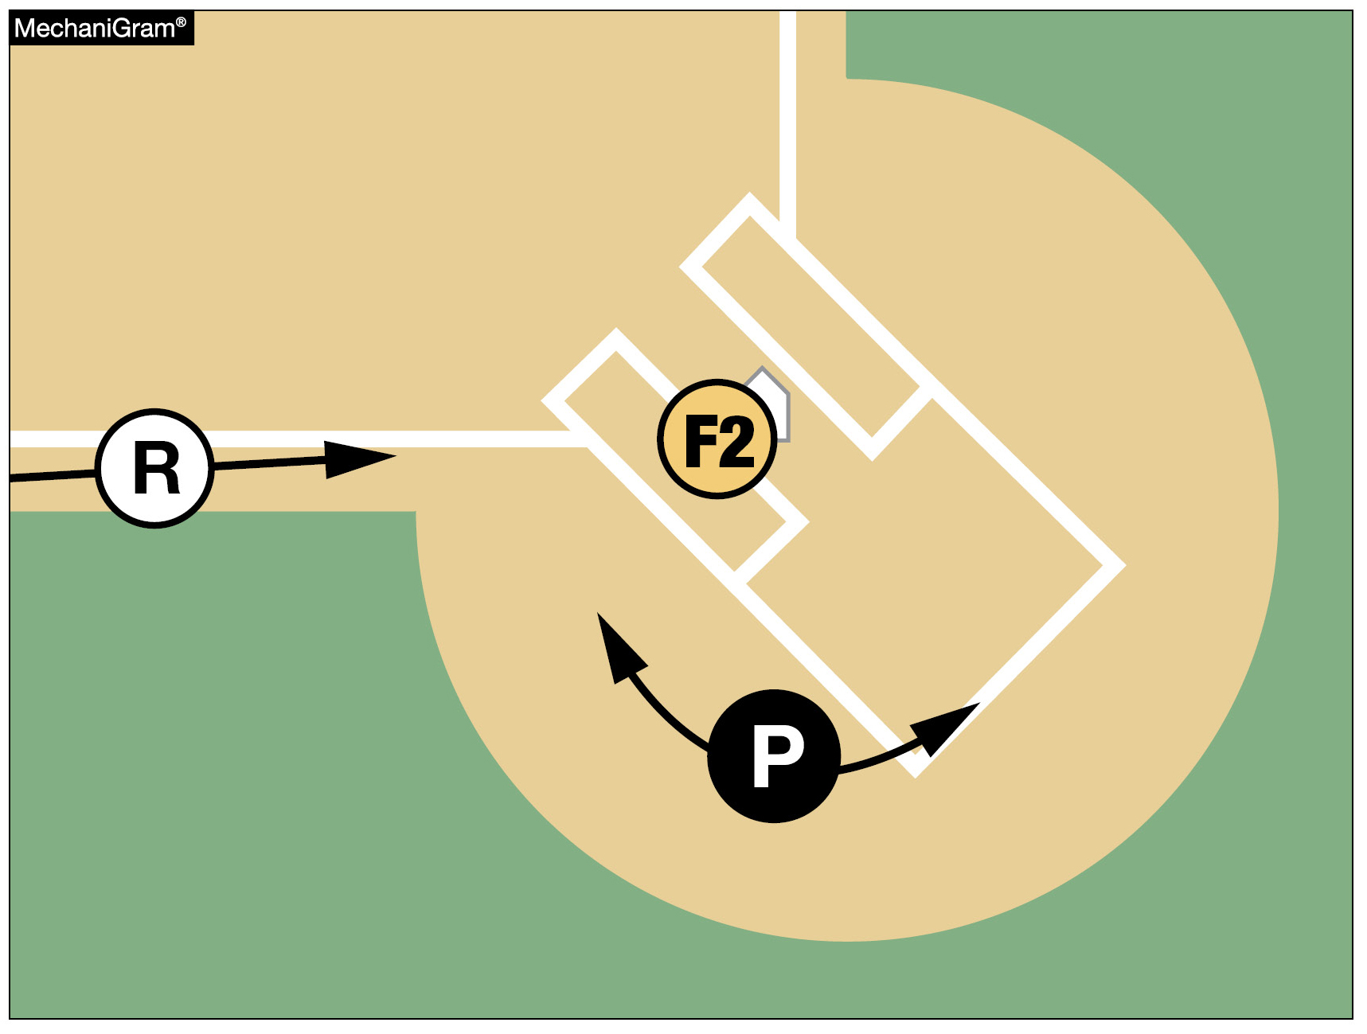
MAINTAINING AN UNOBSTRUCTED VIEW
On plays at the plate, the plate umpire should start with a primary position near the intersection of the back-left corner of the right-handed batter’s box, as shown.
Then the umpire should move left or right in order to maintain an unobstructed view of all the key interactions of the play.
Notes:
Maintaining an Unobstructed View of the Play All these items need to be evaluated in each particular play prior to moving from the primary positioning as each play develops slightly differently. Understanding how these items are going to come together on a particular play allows the umpire to determine where the key interactions will occur, allowing them to adjust, when necessary, to maintain an unobstructed view of the play.

Slide 25
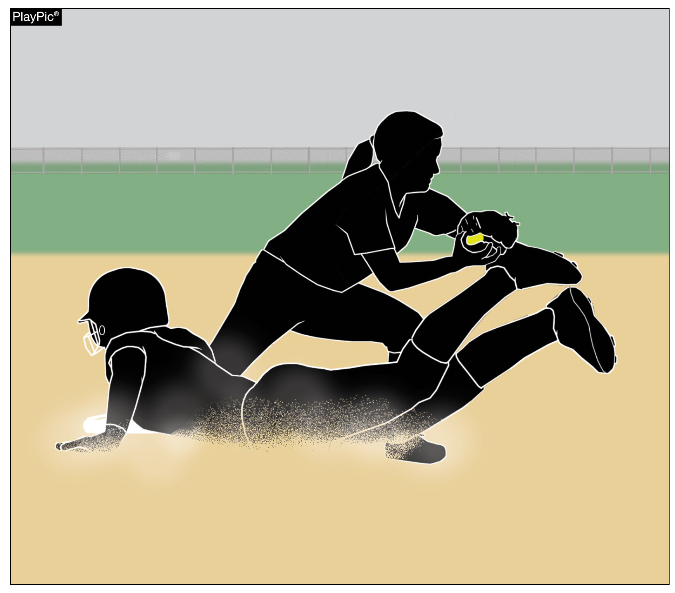
MAINTAINING AN UNOBSTRUCTED VIEW
All of these elements must be understood prior to umpires adjusting their positioning.
This is simply another example of an umpire requiring good timing in order to get calls correct.
Reading the play correctly allows umpires to adjust their position in order to maintain a view of the play, instead of becoming straightlined.
Notes:
Maintaining an Unobstructed View of the Play
All of these elements must be understood prior to umpires adjusting their positioning.
This is simply another example of an umpire requiring good timing in order to get calls correct.
Reading the play correctly allows umpires to adjust their position in order to maintain a view of the play, instead of becoming straightlined.

Slide 26
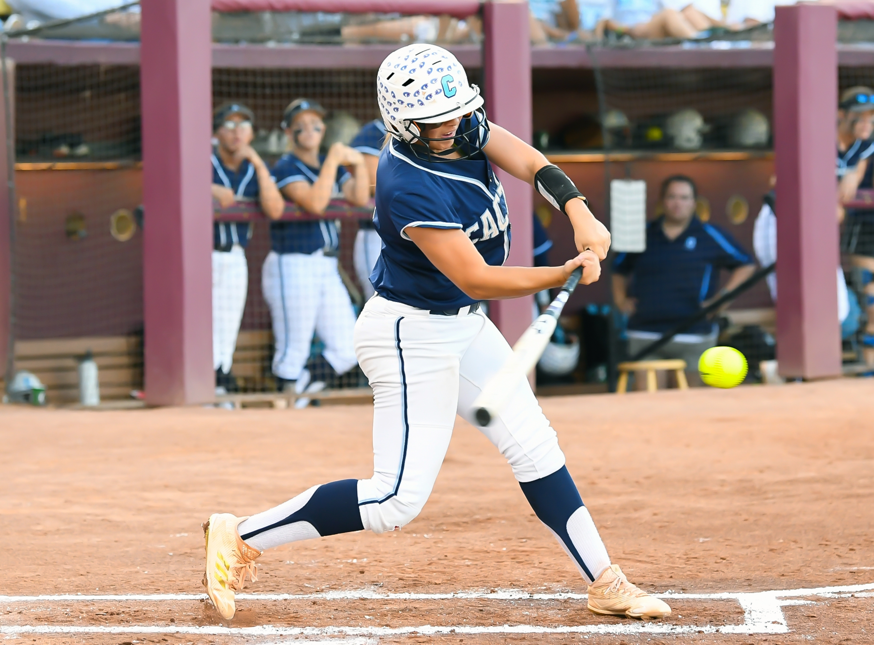
NFHS OFFICIALS EDUCATION

Slide 27

All Things Officiating in One Place!
The all-in-one, cloud-based NFHS Center for Officials Services (COS) connects everyone associated with officiating. The COS handles registration, assignments, testing, payments, and a host of other features and integrations that consolidate all officiating needs into a single, modern solution. Free to all NFHS state associations, local associations, and assigner groups.
20+
Member States
300,000+
Officials
7,000+
Schools
Notes:
The all-in-one, cloud-based NFHS Center for Officials Services (COS) connects everyone associated with officiating. The COS handles registration, assignments, testing, payments, and a host of other features and integrations that consolidate all officiating needs into a single, modern solution. Free to all NFHS state associations, local associations, and assigner groups.

Slide 28
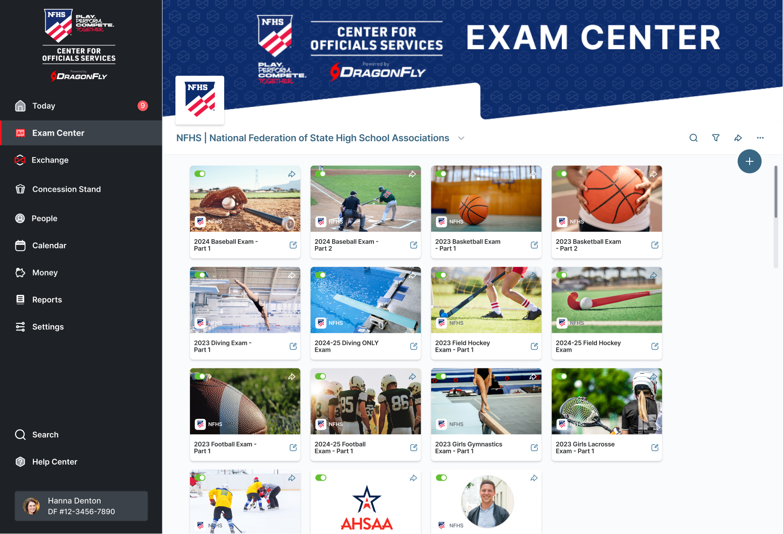
Improved Exam Center
Notes:
The NFHS Center For Officials Services is presenting an improved Exam Center for 2025.

Slide 29
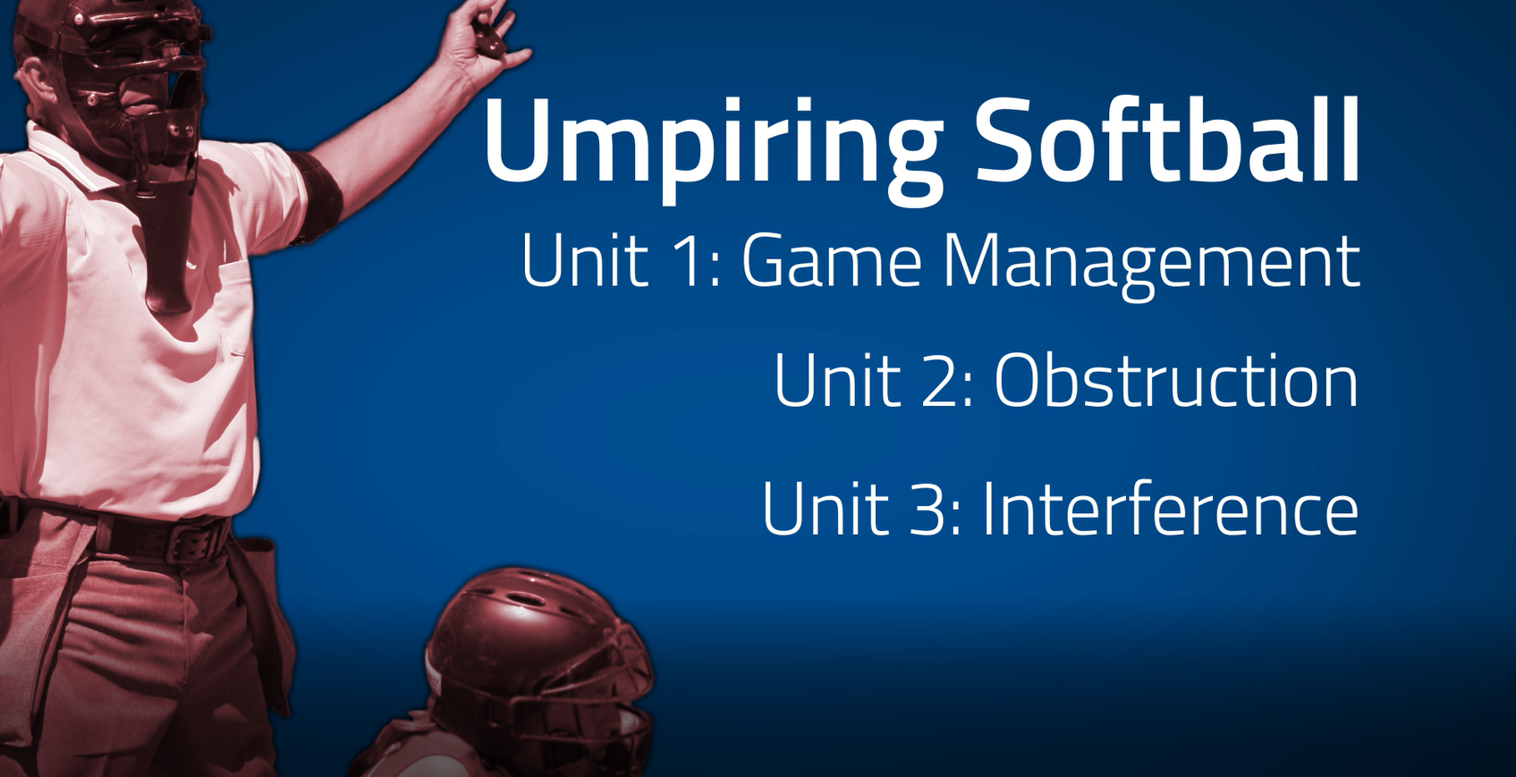
www.nfhs.org
Notes:
UMPIRING SOFTBALL In partnership with USA Softball, the NFHS has developed the first in a line of educational softball courses. This first course addresses game management as well as obstruction and interference.

Slide 30
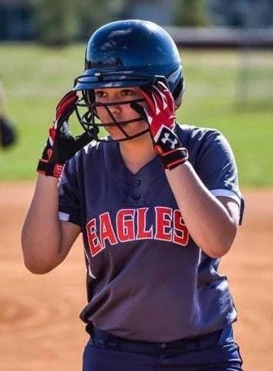
NFHS LEARNING CENTER

Slide 31

Notes:
The NFHS Learning Center is the home to more than 100 online professional development courses for everyone within the interscholastic community - coaches, students, officials, parents, administrators, and individuals within performing arts programs. More than 70 courses are available for free.
The NFHS is an Accredited Institution and has delivered more than 25 million courses on its NFHS Learning Center platform since its inception in 2007. In receiving national accreditation by Cognia, the NFHS has upheld itself to rigorous standards that focus on productive learning environments, equitable resource allocation that meet the needs of learners, and effective leadership.
The NFHS Learning Center features its flagship coaching course, “Fundamentals of Coaching,” as well as several health and safety courses that have been completed by millions of individuals, such as “Concussion in Sports,” “Heat Illness Prevention,” “Sudden Cardiac Arrest” and “Protecting Students from Abuse.” The NFHS Learning Center offers several national credentials that can be earned by individuals who complete specific NFHS courses. Through the School Honor Roll Program, schools can earn a physical banner to hang in their school.
To learn more and start your professional development journey, please visit the NFHS Learning Center at NFHSLearn.com.

Slide 32

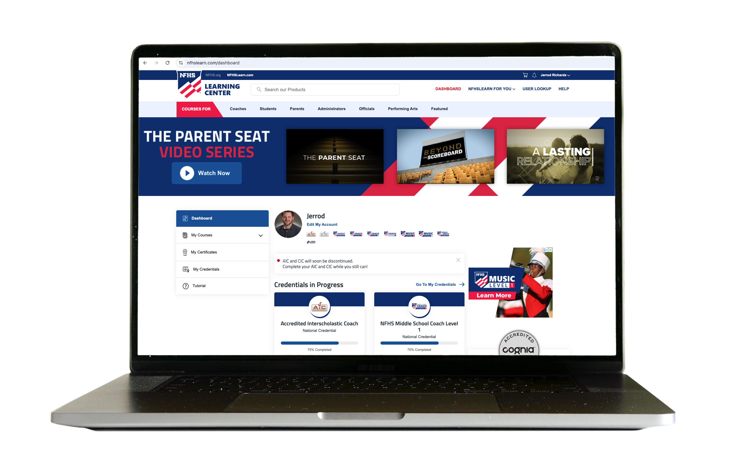
Over 21 Million Courses Delivered!
Concussion in Sports – 8.4M+
Heat Illness Prevention – 3M+
Sudden Cardiac Arrest – 3.3M+
Concussion for Students – 1.8M+
The Collapsed Student (2020) – 89,550+
CPR & AED Training (2023) – 28,500+
Sportsmanship – 1.3M+
Fundamentals of Coaching – 1,000,000+
First Aid, Health and Safety – 470,000+
Bullying, Hazing and Inappropriate Behaviors – 561,000+
Student Mental Health and Suicide Prevention – 376,000+
Protecting Students from Abuse – 400,000+
Implicit Bias (2021) – 145,000+
Notes:
Concussion in Sports – 8.4M+
Heat Illness Prevention – 3M+
Sudden Cardiac Arrest – 3.3M+
Concussion for Students – 1.8M+
The Collapsed Student (2020) – 89,550+
CPR & AED Training (2023) – 28,500+
Sportsmanship – 1.3M+
Fundamentals of Coaching – 1,000,000+
First Aid, Health and Safety – 470,000+
Bullying, Hazing and Inappropriate Behaviors – 561,000+
Student Mental Health and Suicide Prevention – 376,000+
Protecting Students from Abuse – 400,000+
Implicit Bias (2021) – 145,000+

Slide 33




Coaching Softball
$50
Identify stages of the throwing motion and recognize the proper receiving body position
Understand the mechanics of hitting, baserunning, leads and sliding
Identify key elements of the swing including phases and positions
Recognize the starting positions and footwork for all players
Identify defensive responsibilities and tactics for all positions
Available at
Notes:
The NFHS partnered with USA Softball to present the online Coaching Softball course. Go to www.nfhslearn.com to view the trailer, description and outline for this course, and encourage your coaches to sign-up today!

Slide 34
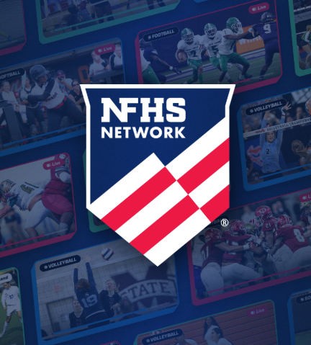

NFHS NETWORK

Slide 35
NFHS Network
27 Different Sports and Activities.
By 2028, every high school event in America will be streamed live.
The NFHS Network will be THE DESTINATION for fans.
OUR NETWORK
www.NFHSnetwork.com
Notes:
The NFHS Network is the leader in streaming Live and On Demand high school sports.
Partnered with the National Federation of State High School Associations, 45 high school state athletic/activities associations, and PlayOn! Sports, the NFHS Network is a joint venture created to provide fans with the ability to stream high school sports on any device, from wherever they are.
All NFHS Network events are available to watch online at www.NFHSnetwork.com and through the NFHS Network Live App for iOS and Android. Follow us on Facebook, Twitter, Instagram, and YouTube.
Watching high school sports and events has never been easier.
The NFHS Network’s goal to broadcast live all 2 million high school sporting events by 2025.
The NFHS Network covers 27 different regular season and postseason sports, as well as other high school activities, celebrating the accomplishments of students-athletes, student broadcasters, and high schools across the country.

Slide 36

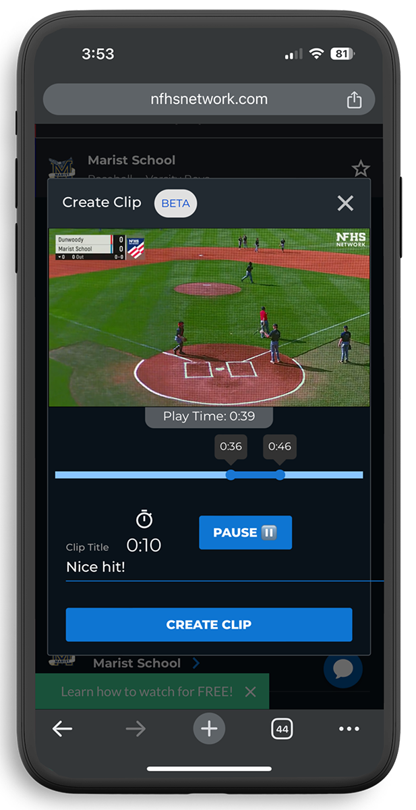
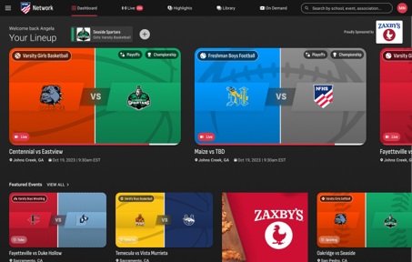
Capture Your Memories – Clip and Share
Allowing fans to capture and share their favorite moments
Notes:
The NFHS Network will broadcast over 150,000 live events this year. If your school is not a member of the NFHS Network School Broadcast Program, please contact us at Mark.Koski@NFHSnetwork.com.

Slide 37





Slide 38
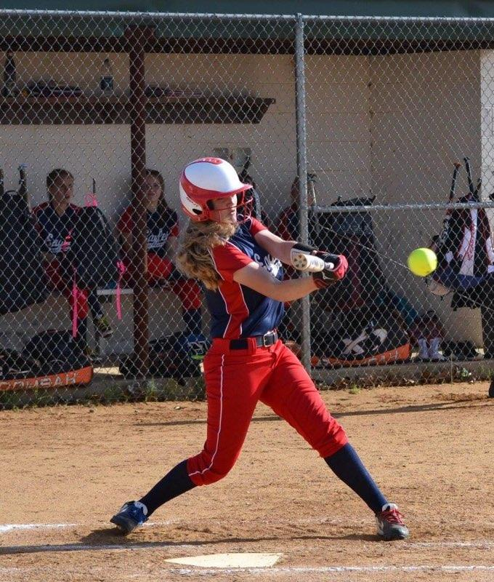
NFHS Authentication Mark Update

Slide 39



NFHS Authenticating Mark Update
Specifications
Do not use the NFHS Authenticating Mark without prior written approval from the NFHS
This mark is for use of licensees only.
Minimum size
Inflatable Balls - 2 ½“ in length (Basketball, Football, Soccer, Volleyball, and Water Polo)
Non-Inflatable Balls - 1 ¼" in length (Baseball, Field Hockey, Ice Hockey Puck, Lacrosse, and Softball)
On a ball or puck, the NFHS mark may be smaller than manufacturer’s logo, but should be placed in proximity to the manufacturer’s name for easy identification. Allow enough space around the mark so it can be easily recognized as distinct and separate.
Reproduce the mark only from the vector artwork provided on Direct Licensing Hub. Do not copy, scan art electronically or use as a template to redraw the symbol.
Note: If sizing or specifications do not work well in your particular design situation, contactK12 Licensing.
Old Logos
Current Logo

Slide 40
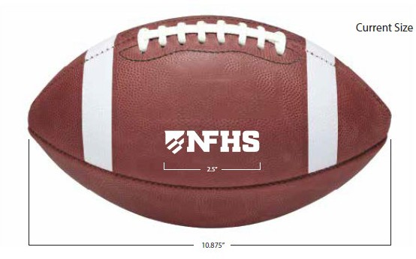
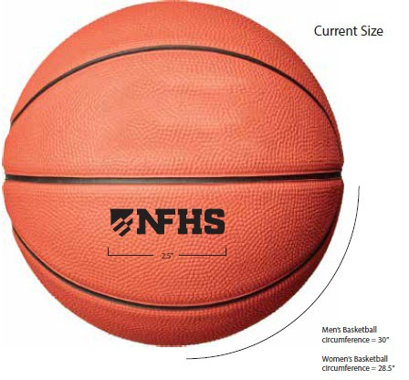
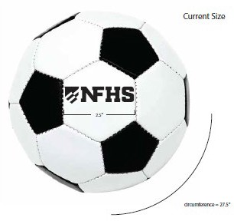
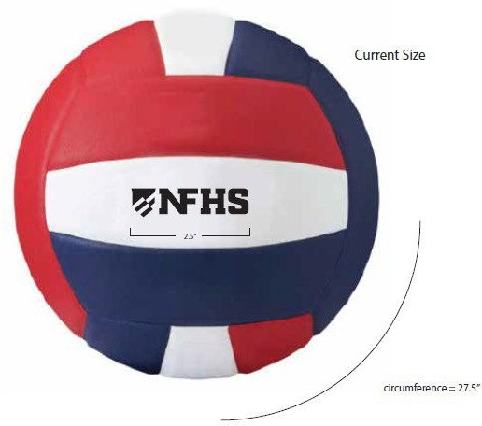
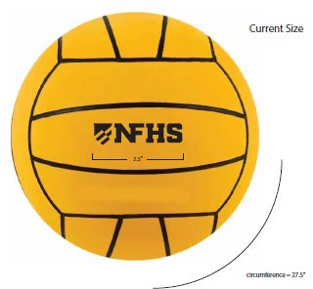
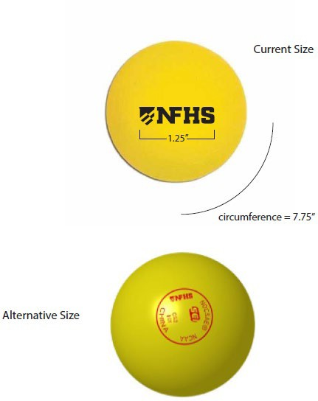
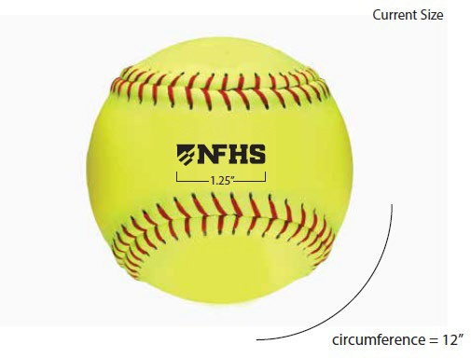
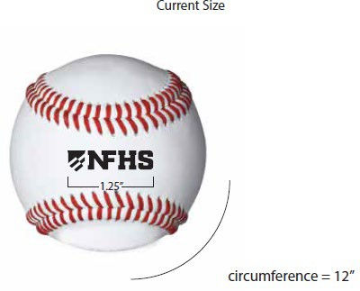
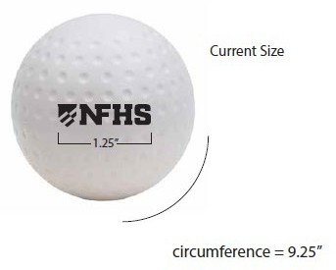
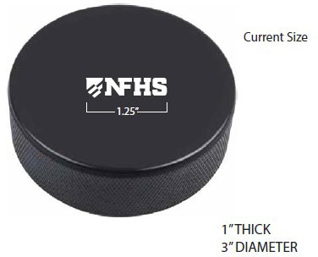
NFHS Authenticating Mark Update
A current list of NFHS authenticated products can be found at www.nfhs.org, Resources, Authenticating Mark.

Slide 41
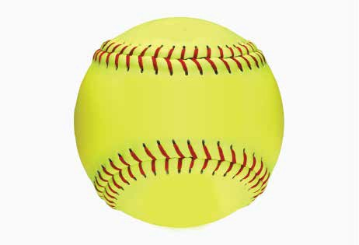


Softball
Old Size
Current Size
1.25”
circumference = 12”
circumference = 12”

Slide 42
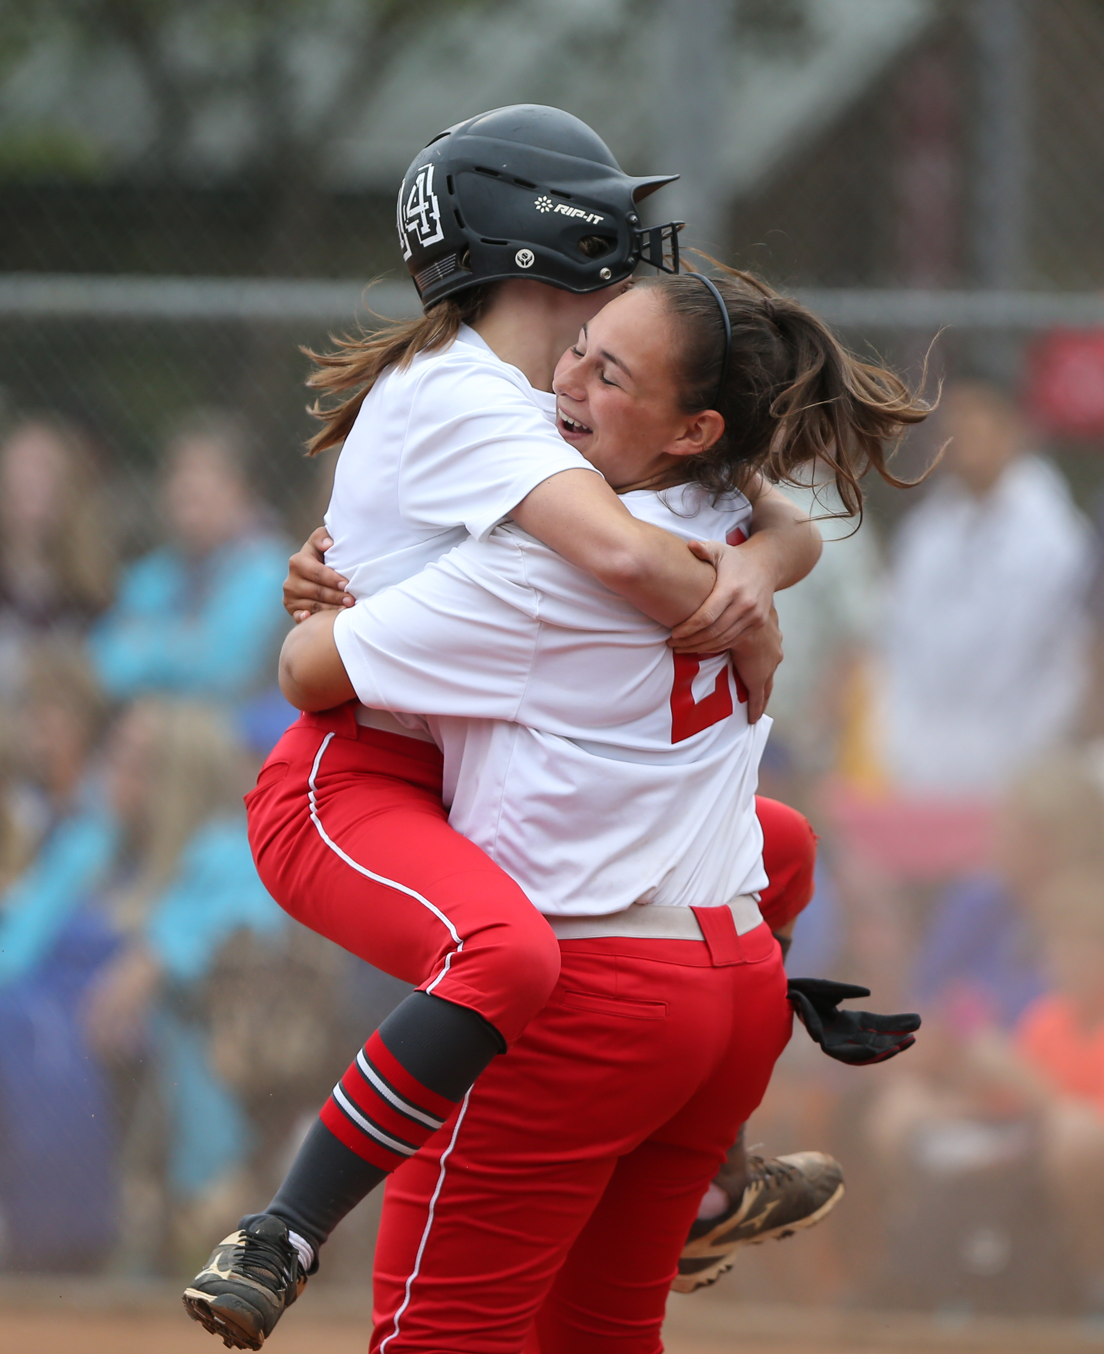
2026 NFHS SOFTBALL RESOURCES

Slide 43



NFHS SOFTBALL PUBLICATIONS
NFHS Rules Books, Case Books, and other Softball materials can be ordered online at www.nfhs.com, or by calling 1-800-776-3462.
Notes:
NFHS SOFTBALL PUBLICATIONS
The NFHS softball publications are available to order online or by using the toll-free number.

Slide 44
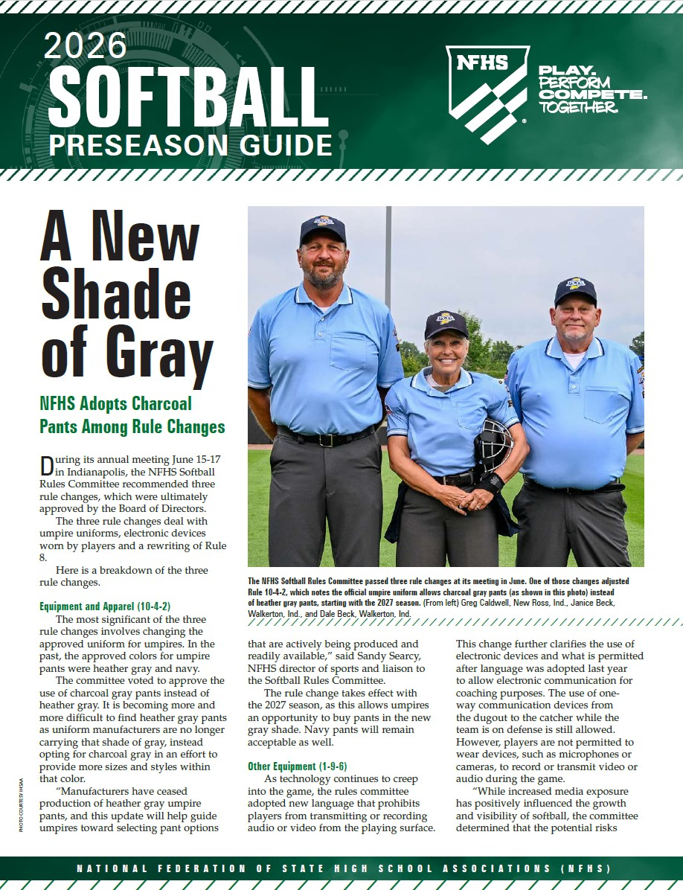
NFHS SOFTBALL PUBLICATIONS
The new NFHS Softball Pre-Season Guide will be available on or before November 1, 2025.
Notes:
The NFHS Softball Guide will be available on or before November 1st.

Slide 45
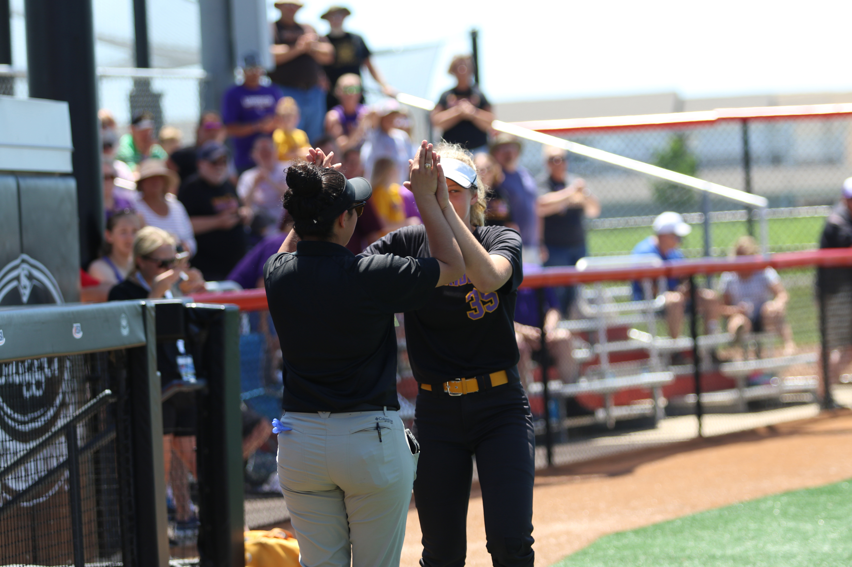
NFHS SOFTBALL RESOURCES
Video Exam Questions
Rules Videos
Softball General Survey
Mid-Season Meetings
Virtual Case Book
Notes:
Video Exam Questions
Rules Videos
Softball General Survey
Mid-Season Meetings
Virtual Case Book

Slide 46
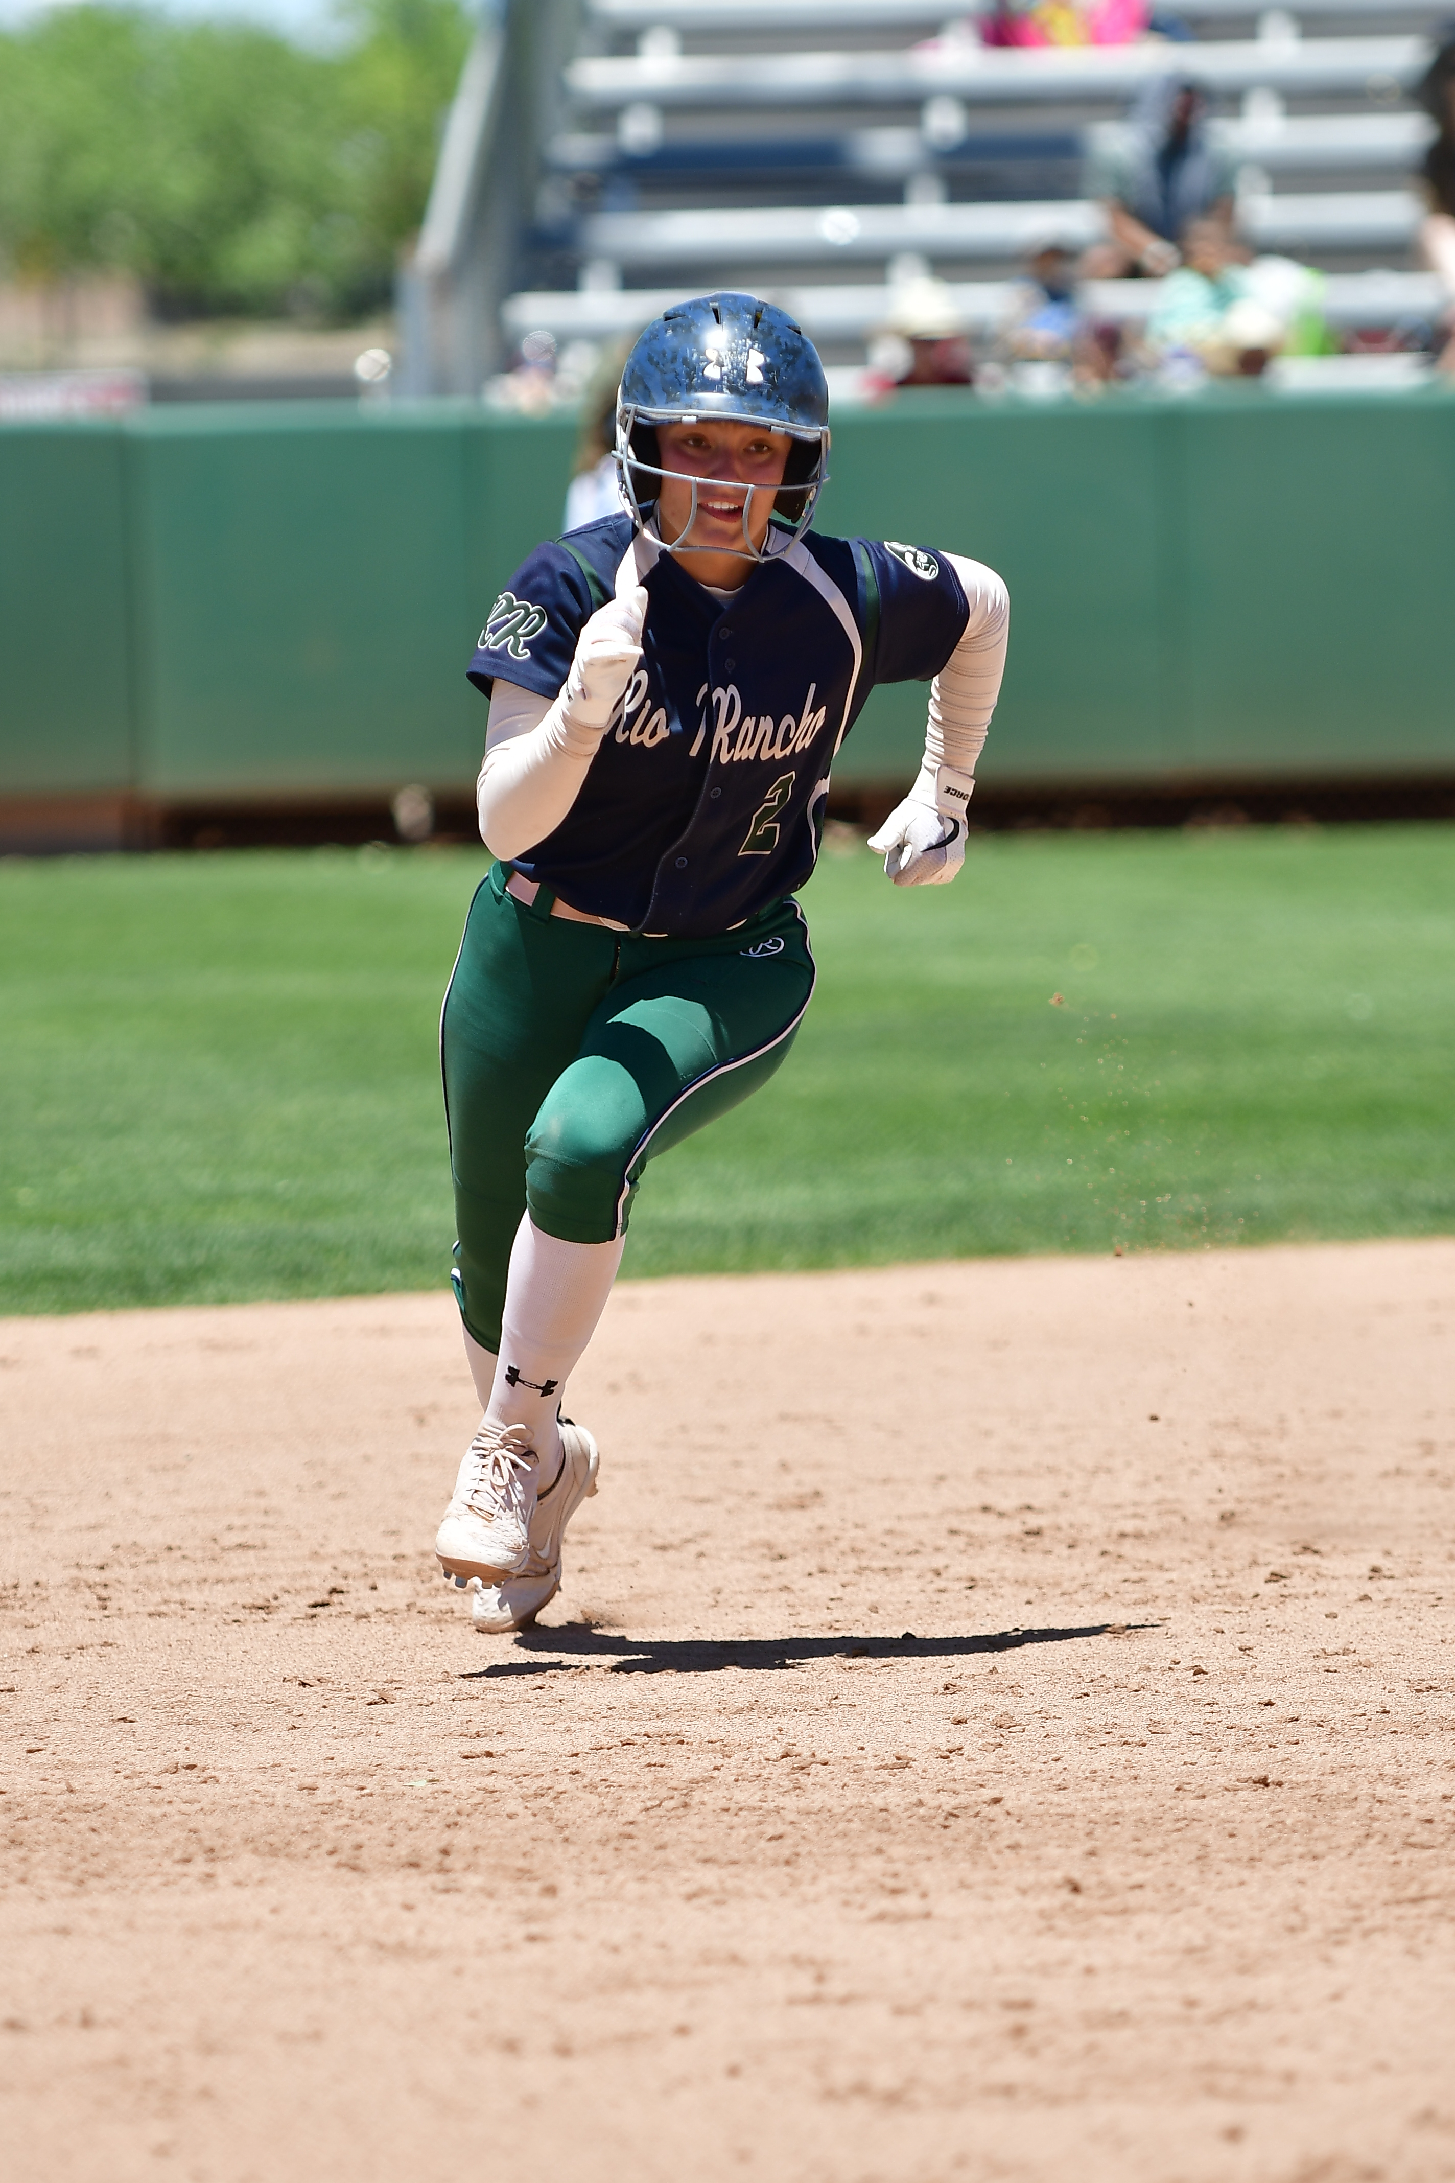
NFHS SOFTBALL RESOURCES
Weekly Rule Interpretations
Softball Pitching Videos
DP/FLEX Strategies for Coaches
PowerPoints for Umpire Training
Illegal Player Penalty Chart
Uniform Rules
Softball Field Diagram
Notes:
Weekly Rule Interpretations
Softball Pitching Videos
DP/FLEX Strategies for Coaches
PowerPoints for Umpire Training
Illegal Player Penalty Chart
Uniform Rules
Softball Field Diagram

Slide 47
Thank You
NFHS.org Phone # 317-822-5735 Email: Ssearcy@nfhs.org

