Slide 1
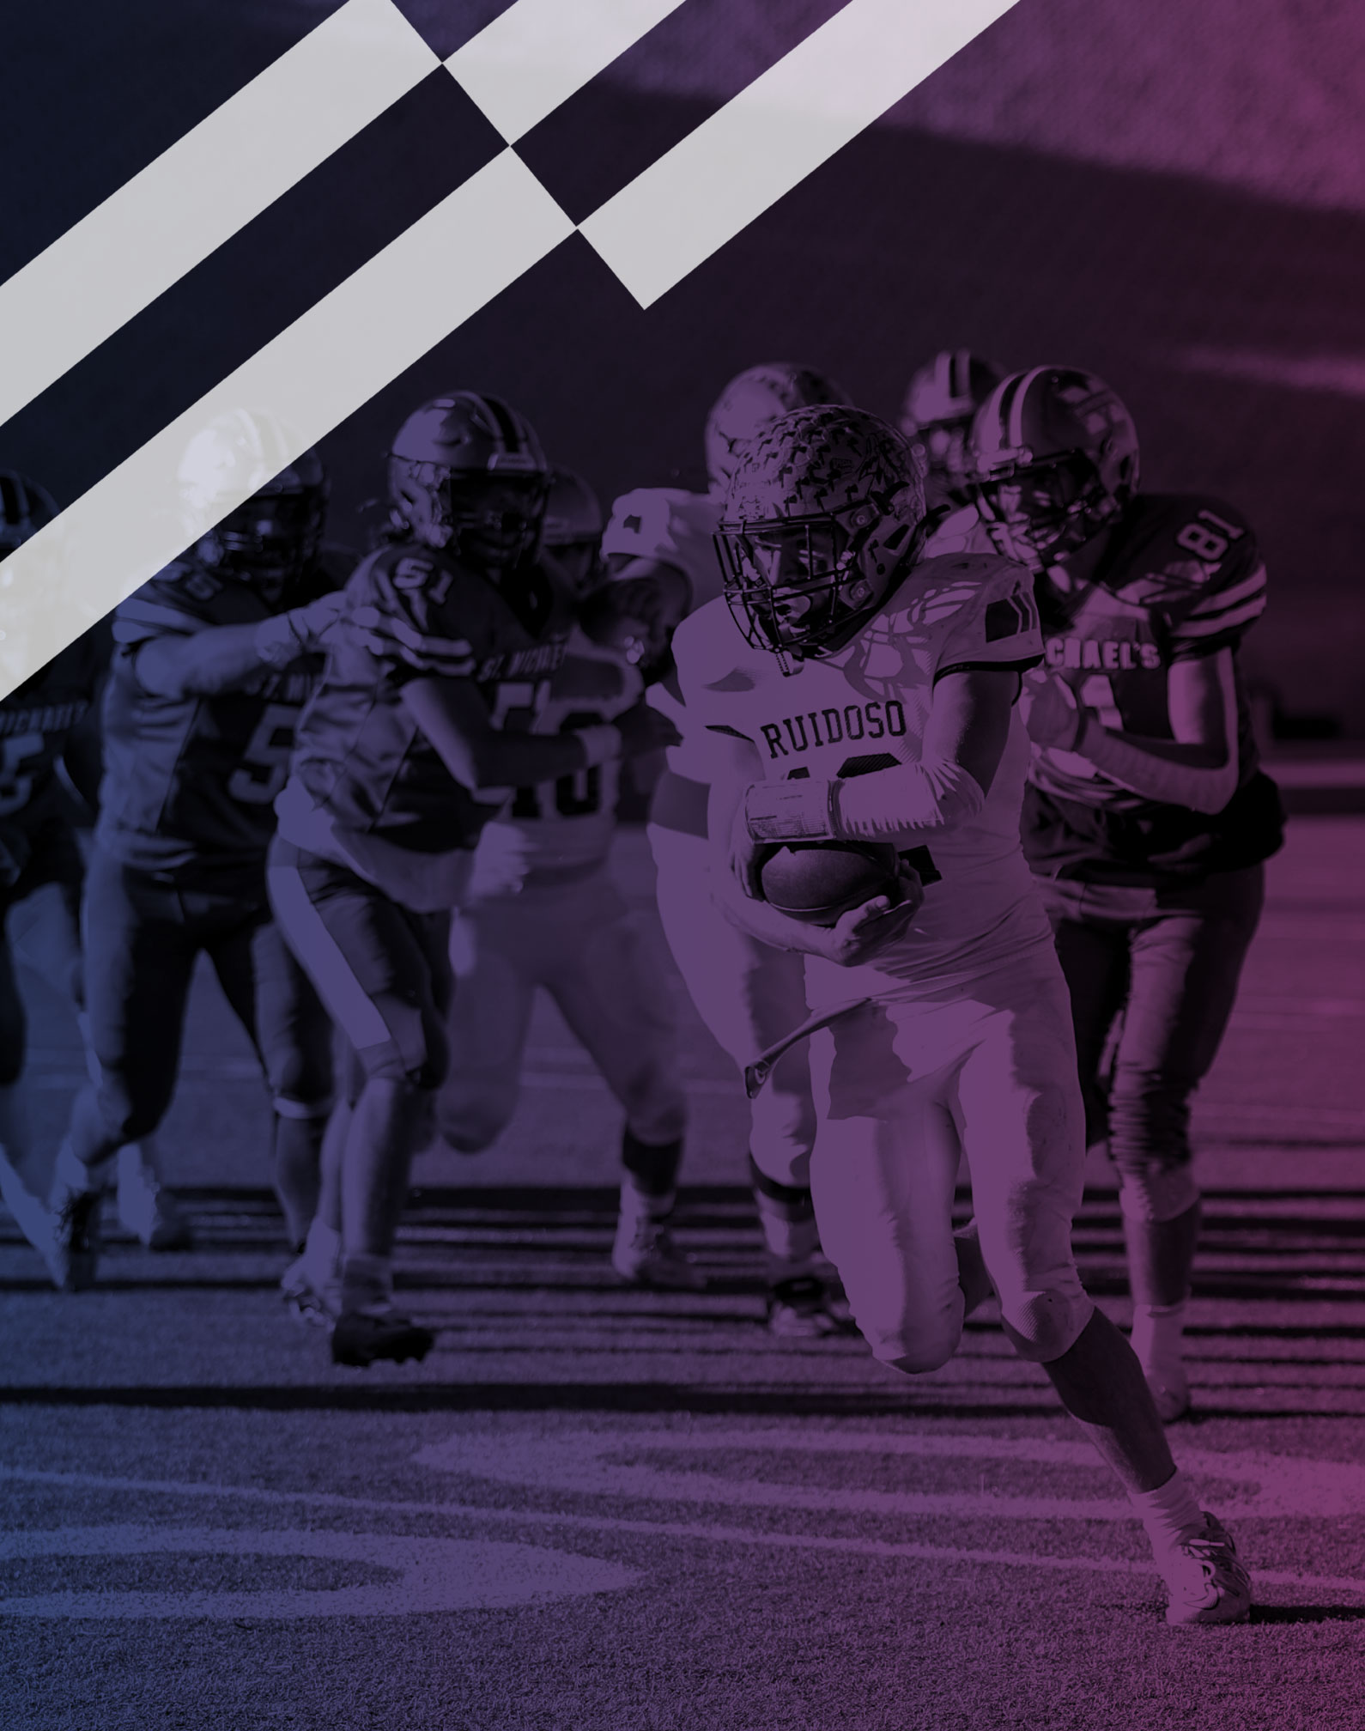
2026 NFHS FOOTBALL RULES POWERPOINT
Notes:
This PowerPoint presentation from the National Federation of State High School Associations (NFHS) covers the following:
2026 NFHS Football Rules Changes-
2026 NFHS Football Editorial Changes-
2026 NFHS Football Points of Emphasis-
2026 NFHS Football Rules Reminders-
2026 and 2027 NFHS Football Game Officials Manual Changes-
2026-27 NFHS Football Information-

Slide 2
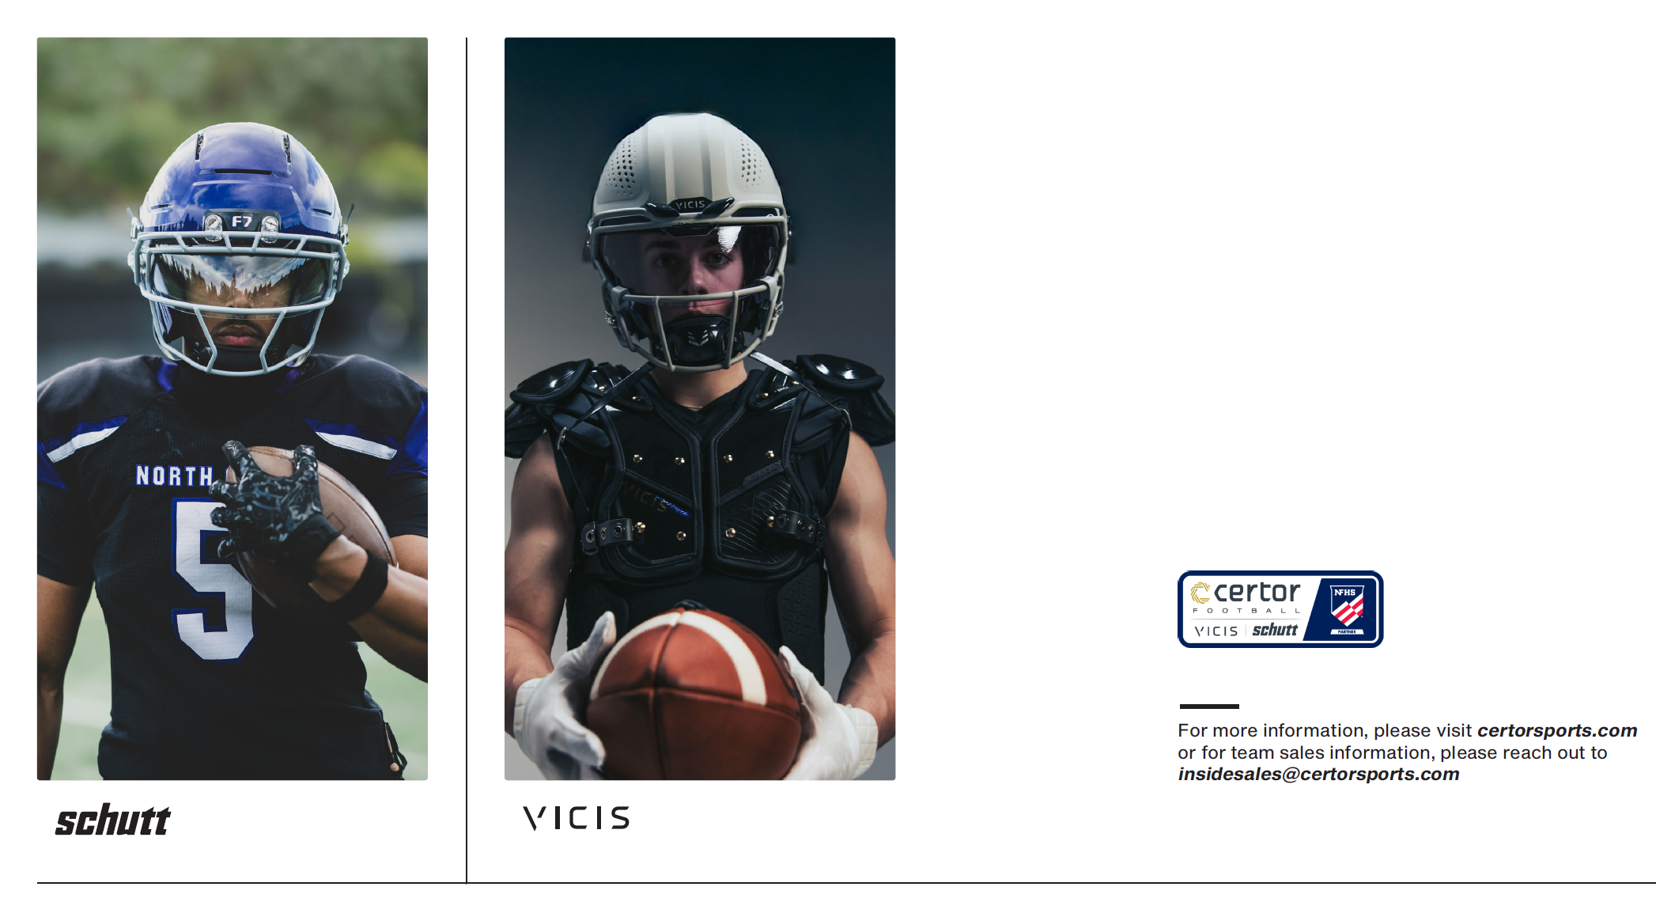
Notes:
Comment on Slide:
Certor Football (Schutt and VICIS) – Official Corporate Champion of the NFHS.

Slide 3
NFHS INFORMATION

Slide 4
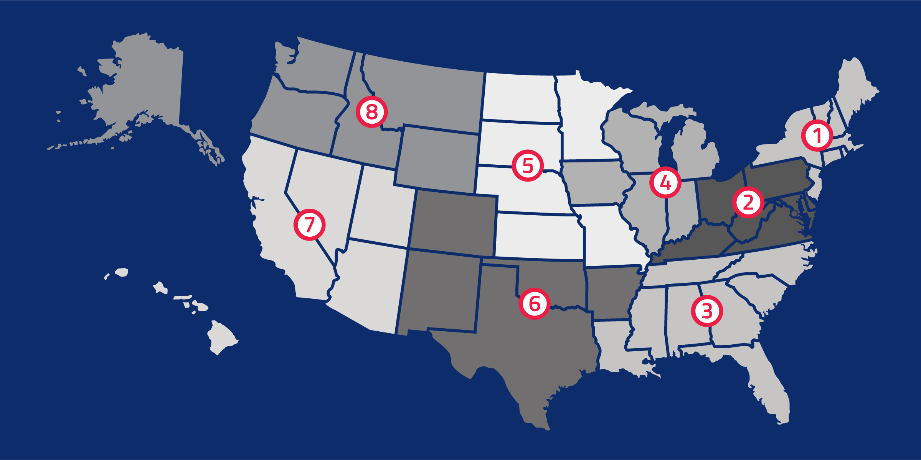
NFHS
NFHS (located in Indianapolis, IN – Est. 1920):
  National leader and advocate for high school
  athletics and performing arts programs.
  Serves 51 state associations, 19,983 high
  schools and 12 million student participants.
  Writes playing rules for 18 high school
  sports for boys and girls.
  Offers online education courses for high
  school coaches, officials, parents, students and others.
  Ensures that students have opportunity to enjoy healthy participation, achievement and good sportsmanship in education-based activities.
Notes:
Comment on Slide:
Overview of the NFHS.

Slide 5





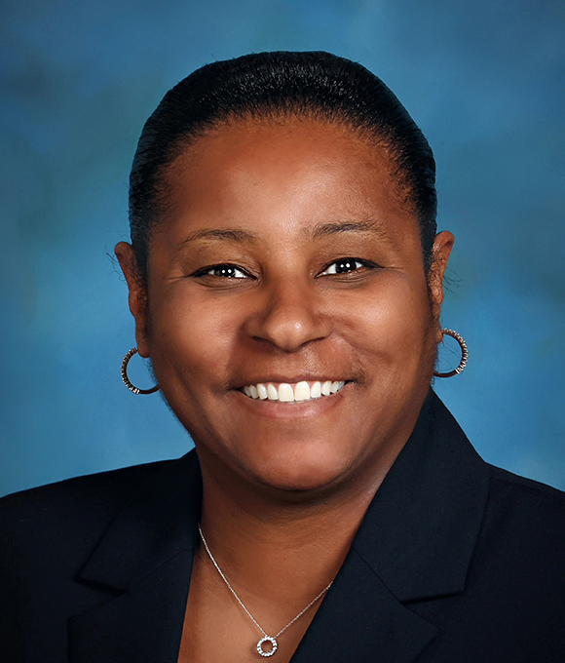

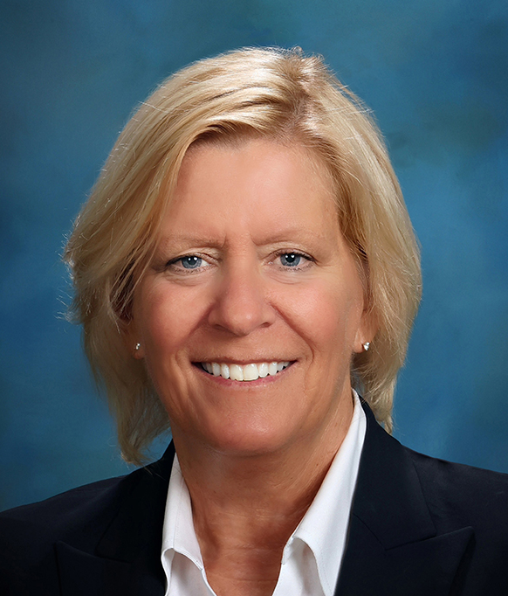

NFHS Rules Review Committee
The NFHS Rules Review Committee is chaired by the chief operating officer and composed of all rules editors. After each committee concludes its deliberations and has adopted its recommended changes for the subsequent year, such revisions will be evaluated
by the Rules Review Committee.
Davis Whitfield
Chief Operating Officer
Lindsey Atkinson
Boys & Girls Lacrosse and Volleyball
Julie Cochran
Cross Country, Soccer and Track & Field
Bob Colgate
Flag Football, Football and Sports
Medicine
Elliot Hopkins
Baseball and Wrestling
Monica Maxwell
Basketball, Field Hockey and Girls Gymnastics
Dan Schuster
Ice Hockey
Sandy Searcy
Softball, Swimming & Diving and Water Polo
Chris Paulson
Spirit
Notes:
Comment on Slide:
Overview of NFHS Rules Review Committee.

Slide 6


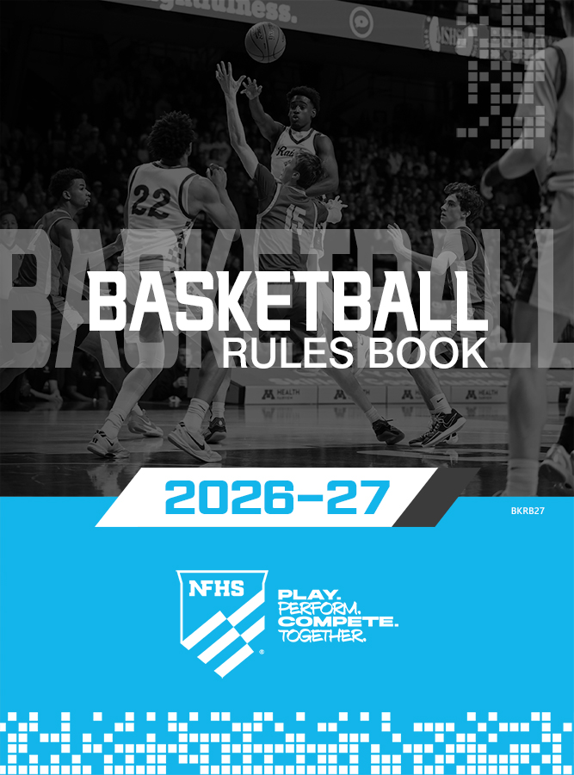




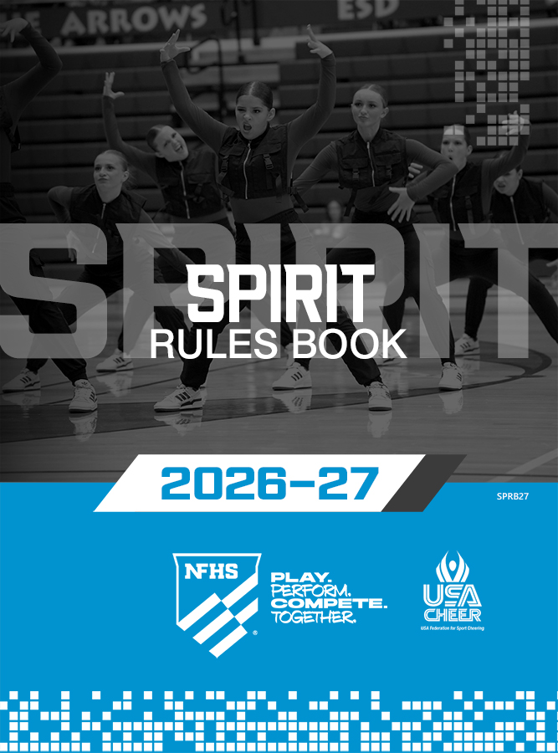





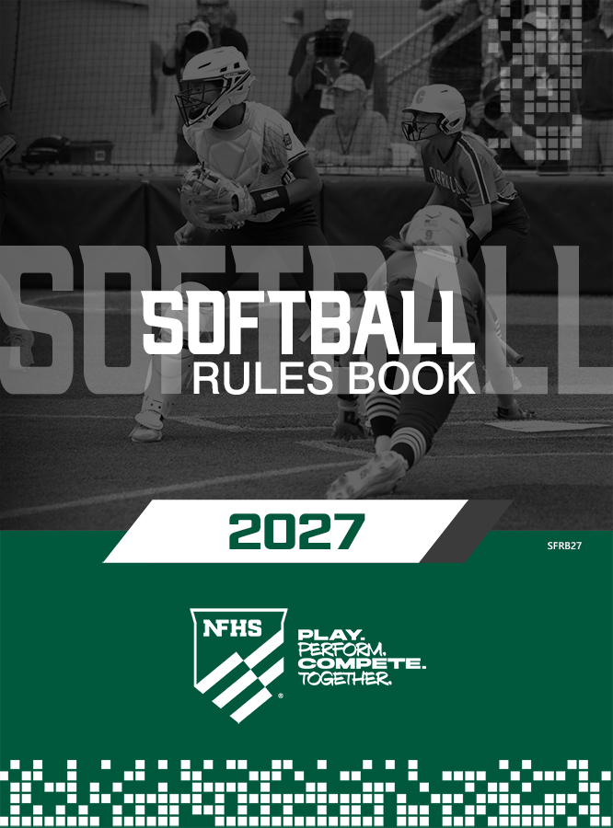
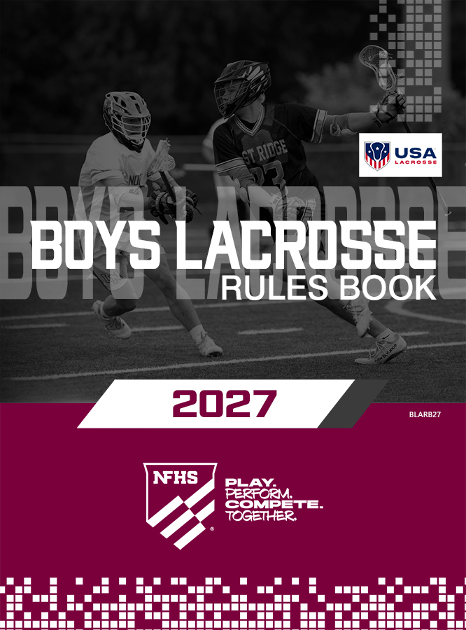



NFHS Publications
The NFHS writes playing rules for 18 sports
for boys and girls at the high school level.
  Publishes 2 million pieces of materials annually.
Notes:
Comment on Slide:
Overview of NFHS Rules Books and Publications.

Slide 7

NFHS Digital
NFHS Digital is the digital publications platform for the NFHS. The app includes:
  Rules Books
  Case Books
  Officials Manuals
  Preseason Guide
  Policy Debate Quarterly
  Other NFHS Publications
Notes:
Comment on Slide:
Overview of NFHS Digital Publications Platform.

Slide 8

NFHS Digital – Mobile App
NFHS Digital is available via mobile app (on App Store or Google Play) or as a desktop platform.
Features include:
  View publications for sale in the NFHS Digital Store
  View publications assigned to/purchased by you
  Create comments, save notes, and share!
  Highlight content to review later
  Visit https://nfhs.org/about/nfhs-digital
Notes:
Comment on Slide:
Overview of NFHS Digital – Mobile App.

Slide 9
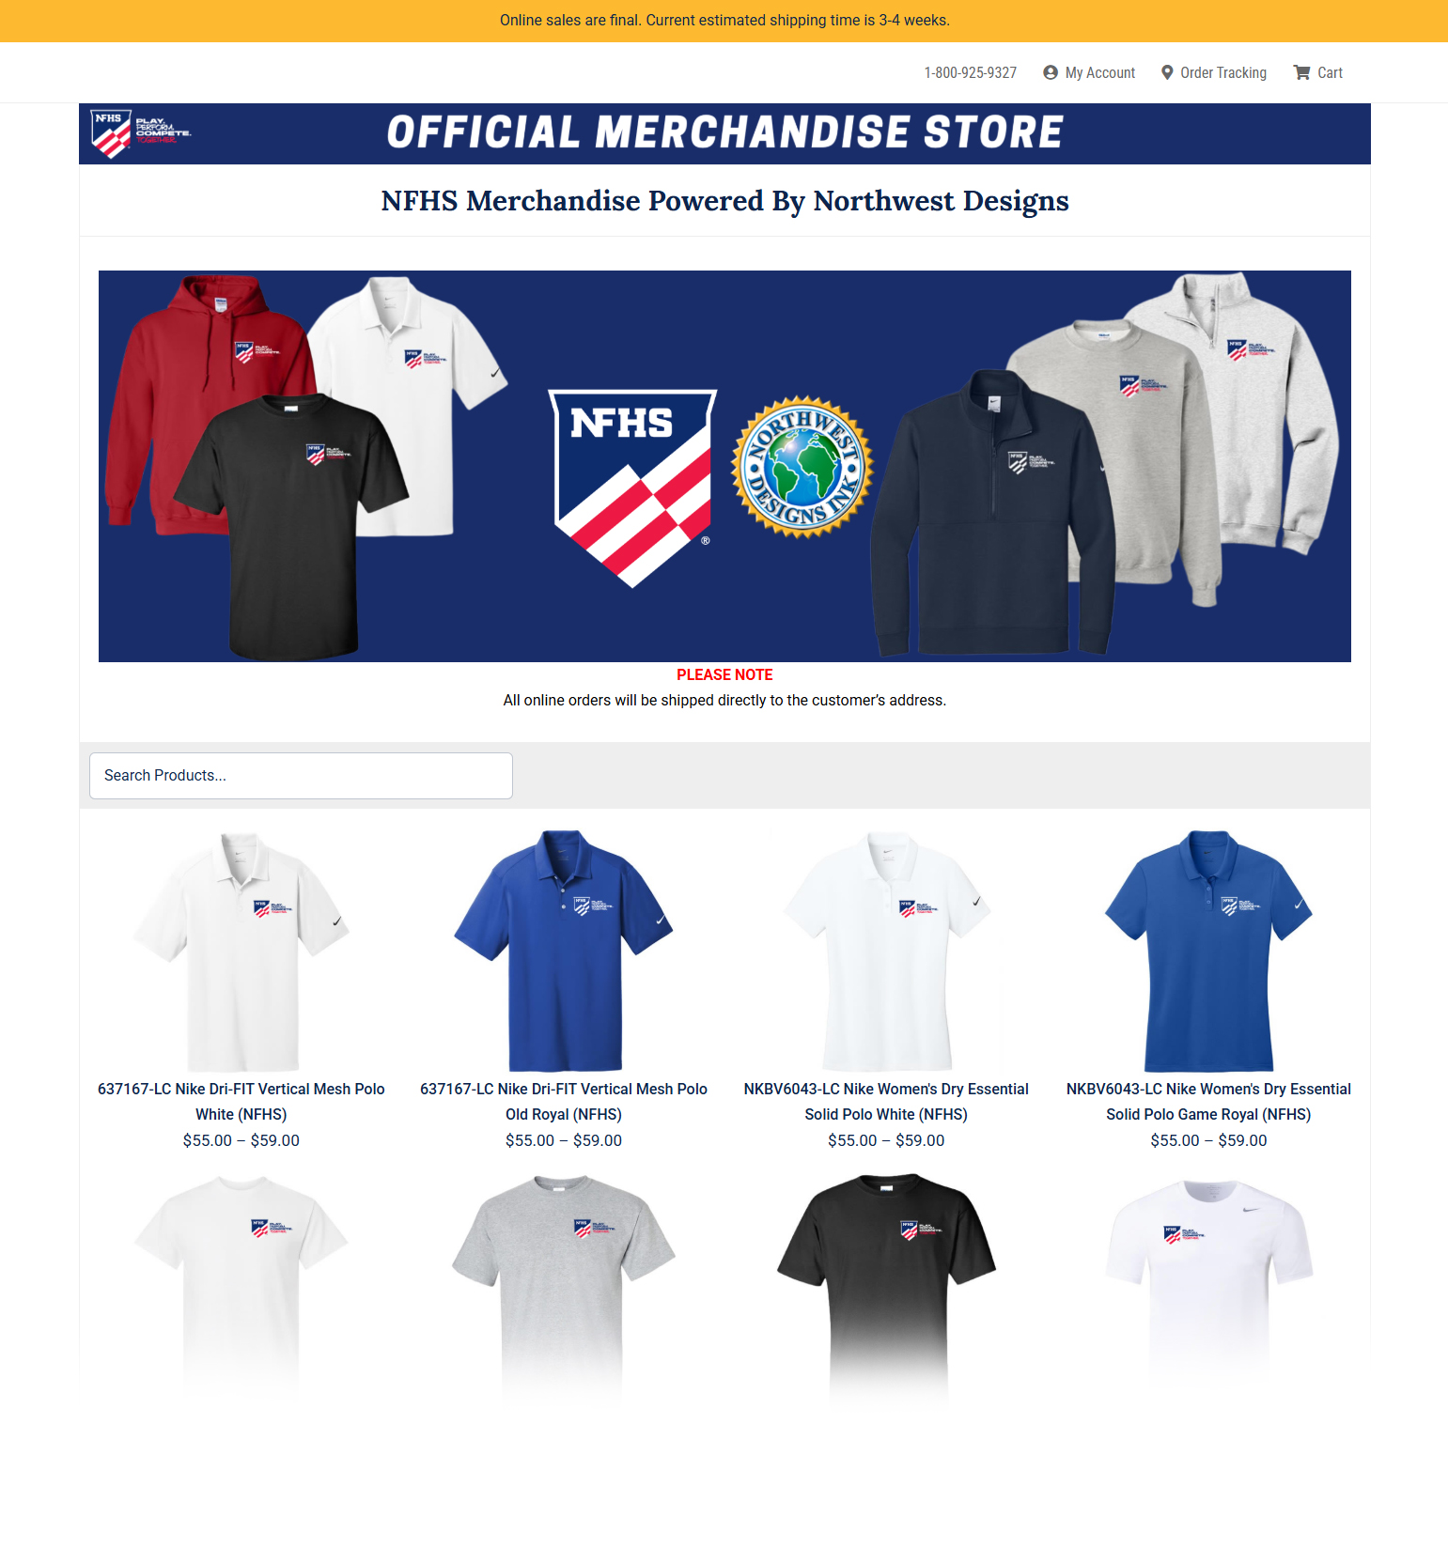
NFHS Store
We’re excited to introduce a new NFHS Store, powered by Northwest Designs, making it easier than ever to shop NFHS-branded apparel and have it delivered straight to your home or office. The collection features t-shirts, polos, sweatshirts, and quarter-zips from top brands like Nike and Gildan. We can’t wait to see our membership proudly representing the NFHS brand!
https://online-apparel.com/s/nfhs-merchandise/
Notes:
Comment on Slide:
See comments and link on NFHS Store.

Slide 10
2026 NFHS FOOTBALL RULES CHANGES

Slide 11
NFHS FOOTBALL RULES
Each state high school association adopting these NFHS football rules is the sole and exclusive source of binding rules interpretations for contests involving its member schools. Any person having questions about the interpretation of NFHS football rules should contact the football rules interpreter designated by the respective state high school association.
The NFHS is the sole and exclusive source of model interpretations of NFHS football rules. State rules interpreters may contact the NFHS for model football rules interpretations. No other model football rules interpretations should be considered.
Notes:
Comment on Slide:
This statement appears at the bottom of page three in the 2026 NFHS Football Rules Book.

Slide 12
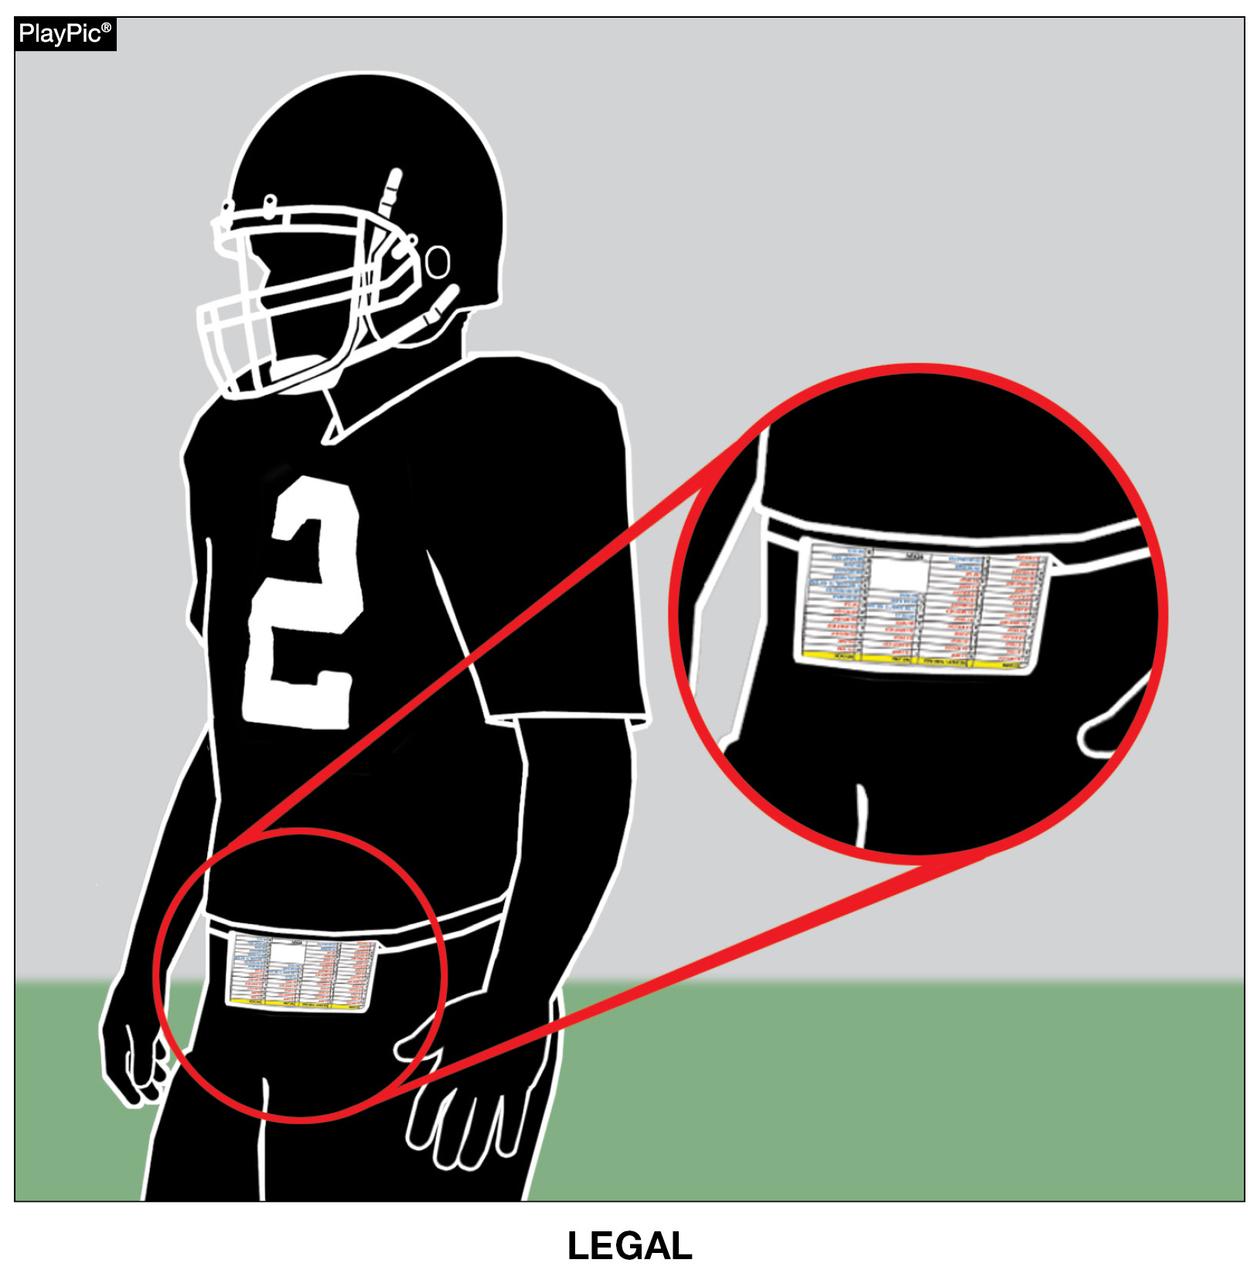

PLAY CARDS
RULE 1-5-3c(9)
“Illegal equipment shall always include but is not limited to:
9. Play cards not worn on the wrist, arm or belt.”
Notes:
RULE CHANGE:
RULE 1 – SECTION 5 PLAYER EQUIPMENT
ART. 3 . . . Illegal equipment. No player shall participate while wearing illegal equipment. This applies to any equipment, which in the opinion of the umpire is dangerous, confusing or inappropriate. Illegal equipment shall always include but is not limited to: …
c. The following Other Illegal Equipment: …
9. Play cards not worn on the wrist, arm or belt.
Comment on Change: The committee has approved the wearing of play cards on both the forearm/wrist and belt areas of the body.

Slide 13
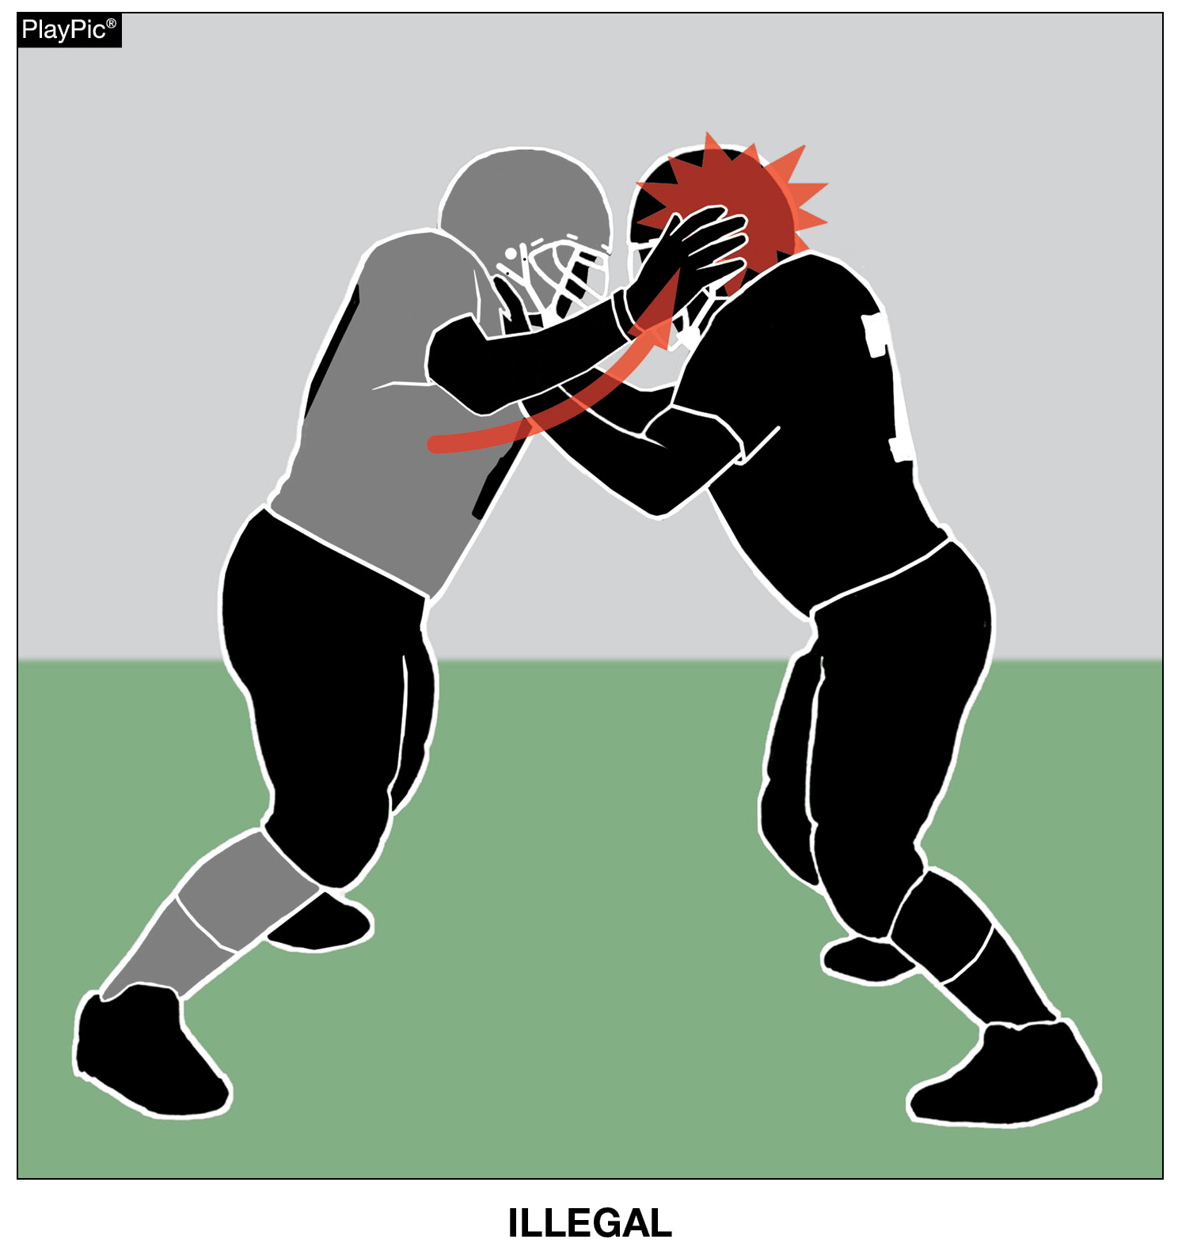
HEAD SLAP
RULE 9-4-7
“No player may use the hand(s) to slap the opponent’s head.”
Notes:
RULE CHANGE:
RULE 9 – SECTION 4 ILLEGAL PERSONAL CONTACT
ART. 7 . . . No player may use the hand(s) to slap the opponent's head.
Comment on Change: The committee approved new rules language that no player may use the hand(s) to slap the opponent’s head.
Case Book Situation: 9.4.7 SITUATION C

Slide 14
2026 NFHS FOOTBALL EDITORIAL CHANGES

Slide 15
GAME ENDING PROCEDURE
RULE 1-1-8
The game officials’ authority extends through the referee's declaration of the end of the fourth period or overtime. The jurisdiction of the game officials is terminated and the final score has been approved when all game officials leave the visual confines of the playing area. The game officials retain clerical authority over the game through the completion of any reports, including those imposing disqualifications, that are responsive to actions occurring while the game officials had jurisdiction. State Associations may intercede in the event of unusual incidents that occur before, during or after the game official’s jurisdiction has ended or in the event that a game is terminated prior to the conclusion of regulation play.
Notes:
EDITORIAL CHANGE:
RULE 1 – SECTION 1 THE GAME
ART. 8 . . . The game officials' authority extends through the referee's declaration of the end of the fourth period or overtime. The jurisdiction of the game officials is terminated and the final score has been approved when all game officials leave the visual confines of the playing area. The game officials retain clerical authority over the game through the completion of any reports, including those imposing disqualifications, that are responsive to actions occurring while the game officials had jurisdiction. State Associations may intercede in the event of unusual incidents that occur before, during or after the game officials' jurisdiction has ended or in the event that a game is terminated prior to the conclusion of regulation play.
Comment on Change: Further clarifies end of game procedures for game officials.
Case Book Situation: 1.1.8 SITUATION C

Slide 16
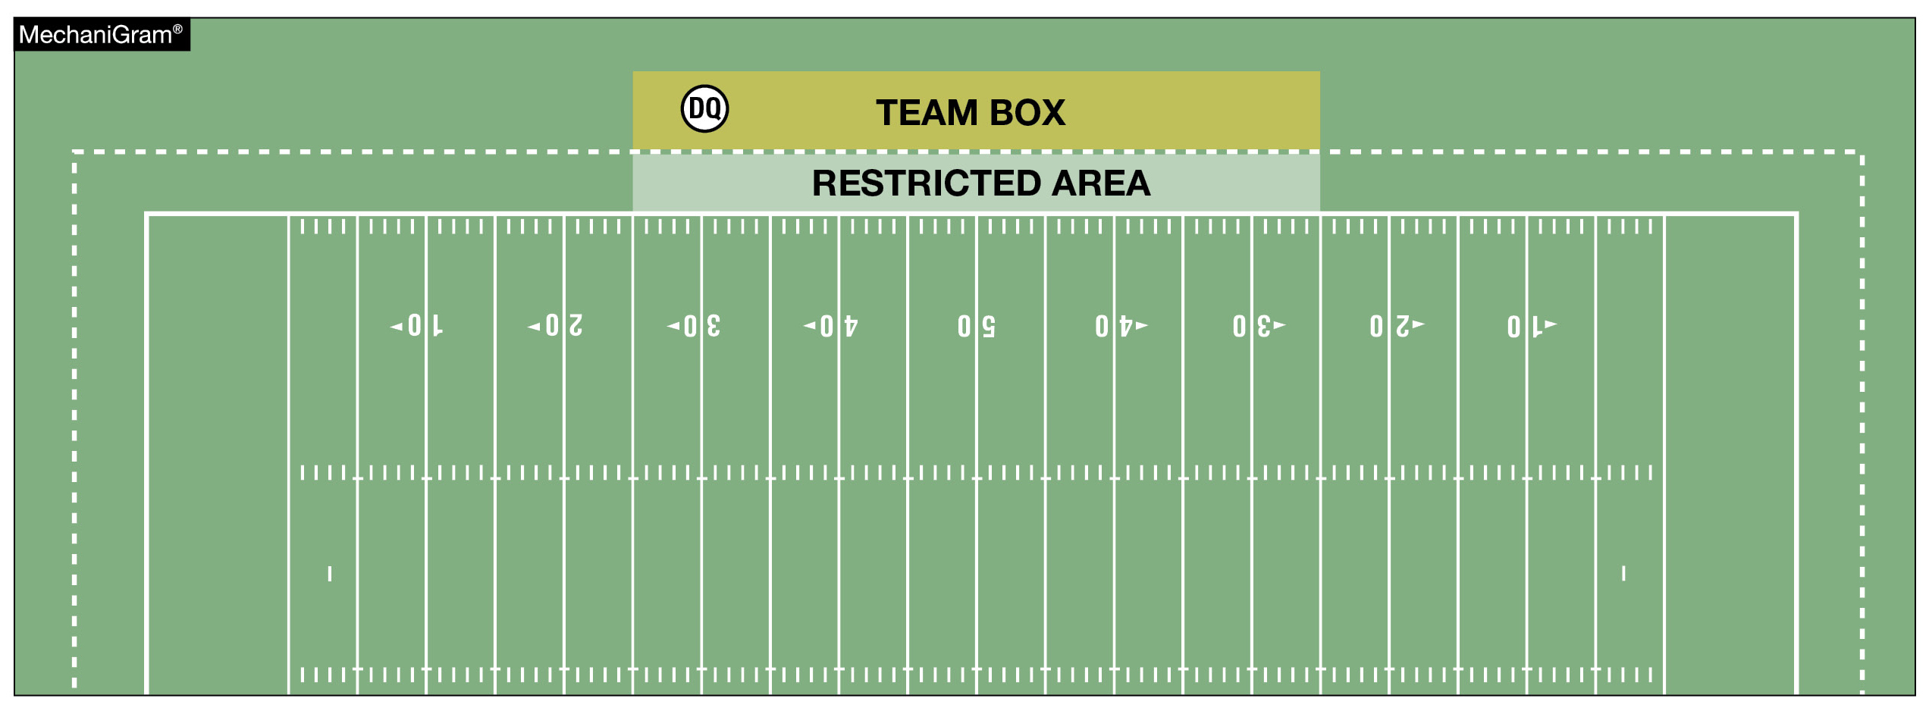
DISQUALIFIED PLAYER
RULE 2-32-6
A disqualified player is a player barred from further participation in a game. A disqualified player can be permitted to remain in the team box area.
Notes:
EDITORIAL CHANGE:
RULE 2 – SECTION 32 PLAYER DESIGNATIONS
ART. 6 . . . A disqualified player is a player barred from further participation in a game. A disqualified player can be permitted to remain in the team box area.
Comment on Change: Clarifies that a disqualified player can remain in the team box if the state association allows an ejected player to remain at the venue.

Slide 17
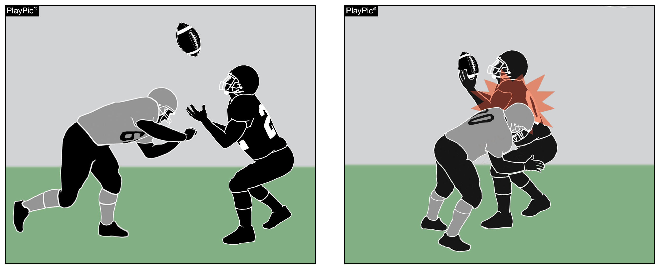
ILLEGAL PERSONAL CONTACT/DEFENSELESS PLAYER
RULE 9-4-3p
No player or nonplayer shall:
  p. Initiate forceful contact against a defenseless receiver as in 2-32-16b, 2-32-16c and 2-32-16e that is not:
    1. Incidental contact as a result of making a play on the ball;
    2. Initiated with open hands; or
    3. An attempt to tackle by wrapping arm(s) around the receiver.
Notes:
EDITORIAL CHANGE:
RULE 9 – SECTION 4 ILLEGAL PERSONAL CONTACT
ART. 3 . . . No player or nonplayer shall: …
p. Initiate forceful contact against a defenseless receiver as in 2-32-16b, 2-32-16c and 2-32-16e that is not:
1. Incidental contact as a result of making a play on the ball;
2. Initiated with open hands; or
3. An attempt to tackle by wrapping arm(s) around the receiver.
Comment on Change: Clarifies type of contact against a kick receiver that is illegal.

Slide 18
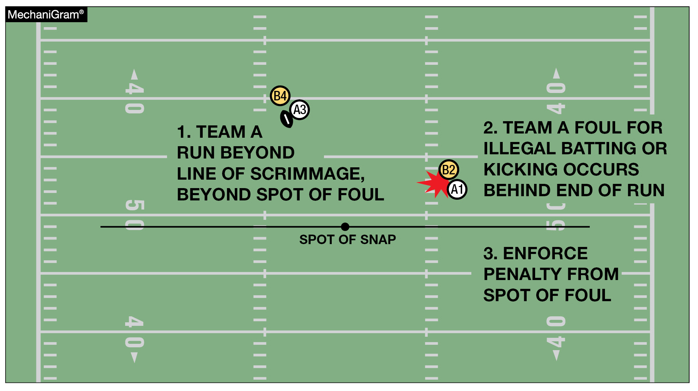
BASIC SPOT
RULE 10-4-4a
The basic spot is the spot of the foul for:
a. Illegal batting or illegal kicking by A that occurs behind the basic spot.
Notes:
EDITORIAL CHANGE:
RULE 10 – SECTION 4 BASIC SPOTS
ART. 4 . . . The basic spot is the spot of the foul for:
a. Illegal batting or illegal kicking by A that occurs behind the basic spot; …
Comment on Change: Further clarifies the basic spot for illegal batting or kicking by A.

Slide 19
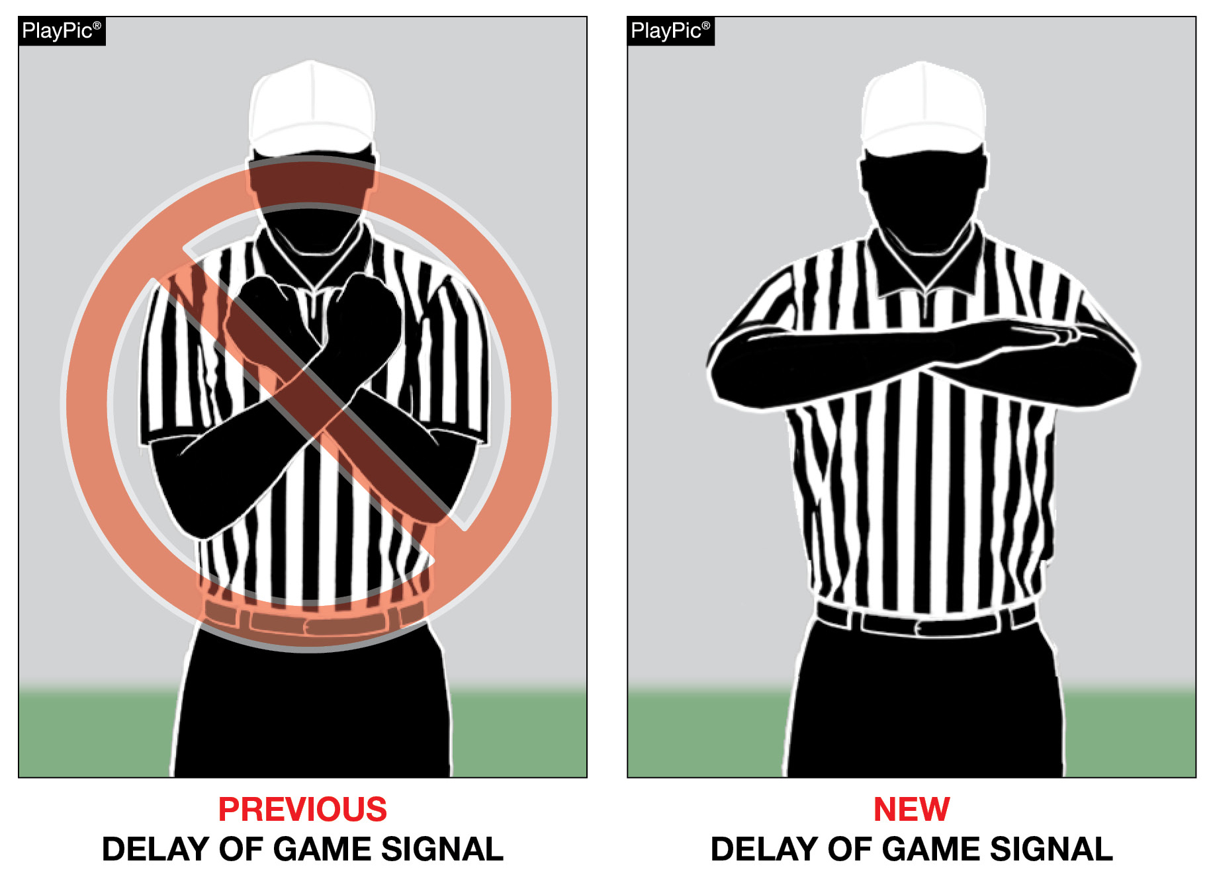
NEW DELAY OF GAME SIGNAL
Notes:
EDITORIAL CHANGE:
NFHS OFFICIAL FOOTBALL SIGNALS – Signal #21 – Delay of Game
Comment on Change: The NFHS Football Game Officials Manual Committee recommended changing Signal #21 – Delay of Game – to folded crossed arms in front of the body for 2026. The NFHS Football Rules Editorial Committee approved this change.

Slide 20
2026 NFHS FOOTBALL EDITORIAL CHANGES
1-3-5b | Changed “Head Linesman” to “Head Line Judge.
1-5-3a(2) | Deleted the reference to “opponent.”
2-15-1 | Further clarified to make definition more consistent with forward fumble rule that was approved in 2025.
3-5-7g | Replaced “heat and humidity” with “circumstances and conditions” better covers a variety of situations that may create a health risk to players.
4-1-3 | Deleted “if elected” from the rule as it was not needed.
5-3-1 | Added “ball being” before ready-for-play for clarification.
5-3-2 | Changed “Head Linesman” to “Head Line Judge.
8-2-2, 8-2-3, 8-2-4, 8-2-5 | Changed “subsequent kickoff” to “succeeding spot” for clarification.
Notes:
EDITORIAL CHANGES:
Comment on Slide:
This slide lists the rules references and a brief description of the additional football editorial changes that were made to the 2026 NFHS Football Rules Book.

Slide 21
2026 NFHS FOOTBALL EDITORIAL CHANGES
9-8 PENALTY | Added ‘basic spot” to the PENALTY section to give better clarity that unsportsmanlike and nonplayer unsportsmanlike fouls are enforced from the basic spot.
10-4-2 | Revised the rules references in the rule.
10-4-2b | Deleted “behind the line of scrimmage” from the rule to eliminate redundancy.
10-5-3 | Deleted “and enforcement is from behind its goal line” to eliminate conflicts with recent rules changes to Rule 10-4.
FOOTBALL FUNDAMENTAL – Penalty Measurement (4) | Removed all of the rules references and relaced with “otherwise specified by rule.”
RESOLVING TIED GAMES – (3-1) | Changed “Head Linesman” to “Head Line Judge.
6-Player Rules Differences – Rule 7 | Further clarified when a passer becomes eligible if the pass was touched by B.
Notes:
EDITORIAL CHANGES:
Comment on Slide:
This slide lists the rules references and a brief description of the additional football editorial changes that were made to the 2026 NFHS Football Rules Book.

Slide 22
2026 NFHS FOOTBALL RULES REMINDERS

Slide 23
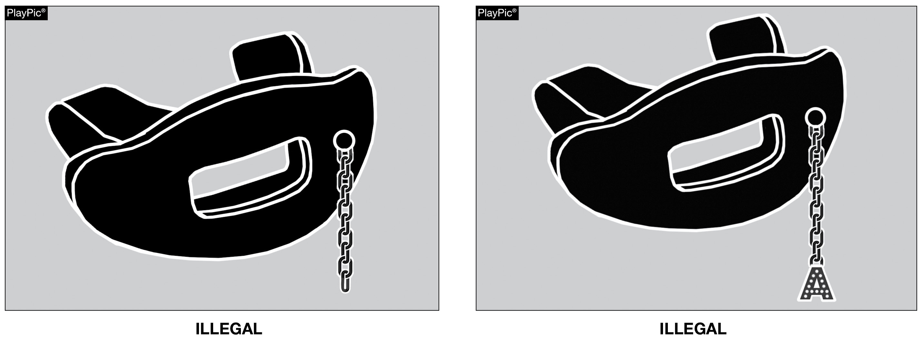
TOOTH & MOUTH PROTECTOR
RULE 1-5-1d(5)a – 4
Effective 2026: Tooth and mouth protectors may not include any attachment(s) that do not serve a purpose and function in protecting the teeth or mouth.
Notes:
RuleS Reminder:
See PlayPics and comments on slide.

Slide 24
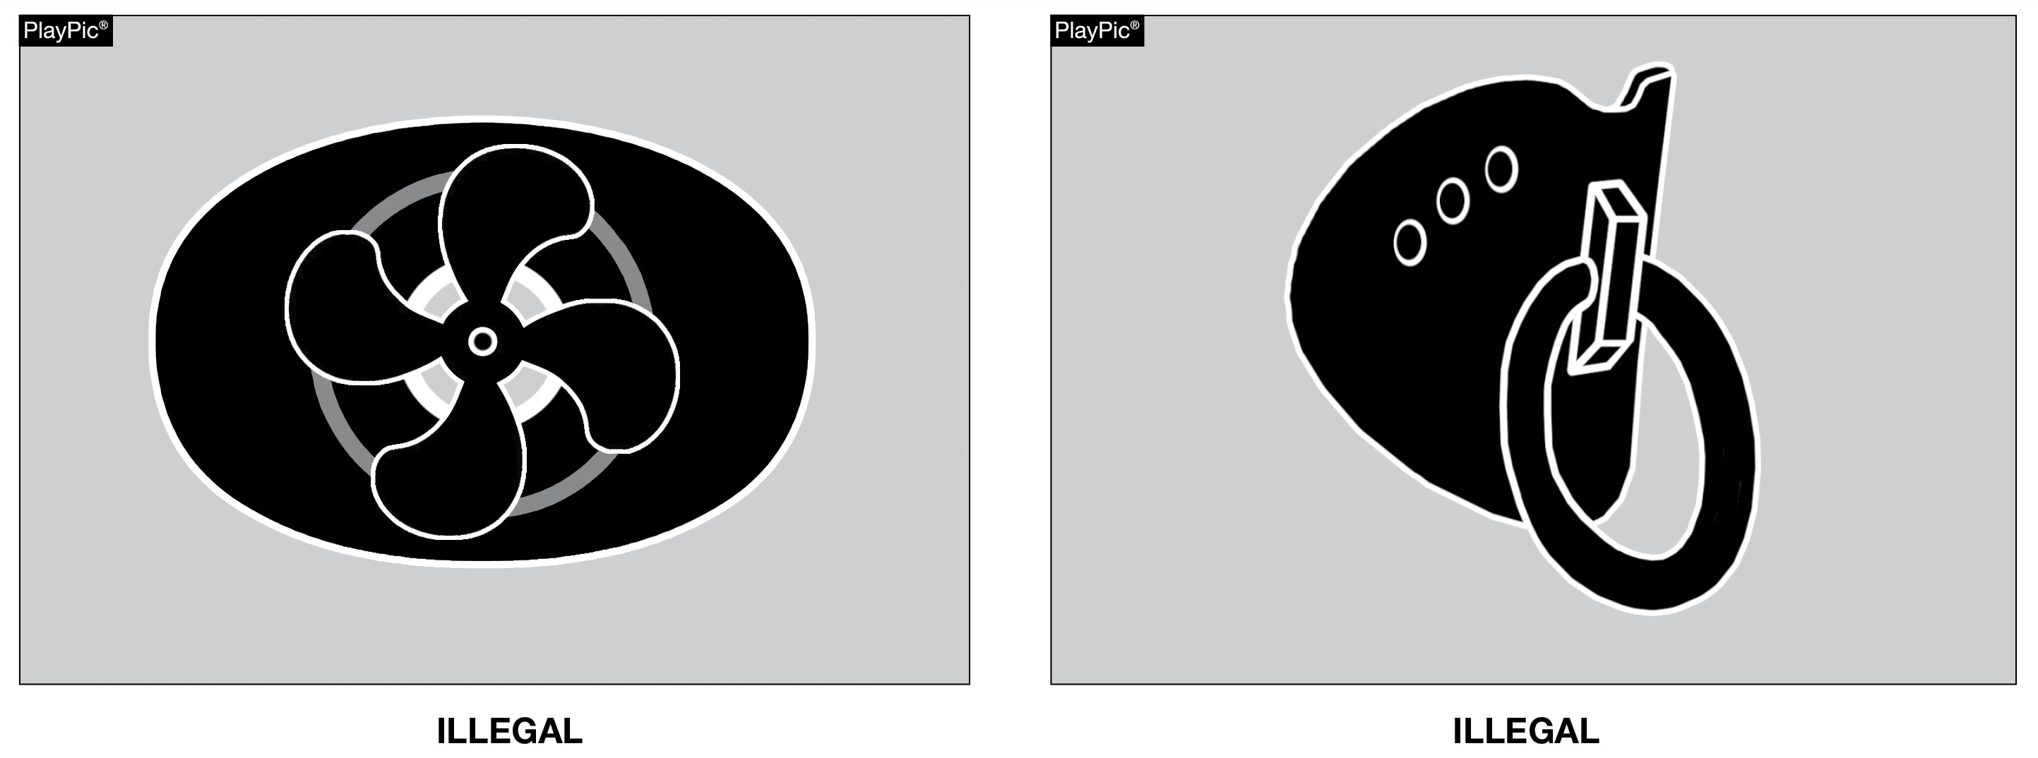
TOOTH & MOUTH PROTECTOR
RULE 1-5-1d(5)a – 5
Effective 2026: Tooth and mouth protectors may not include anything on them that is a health or risk issue and can pose a danger to themselves or other players.
Notes:
RuleS Reminder:
See PlayPics and comments on slide.

Slide 25
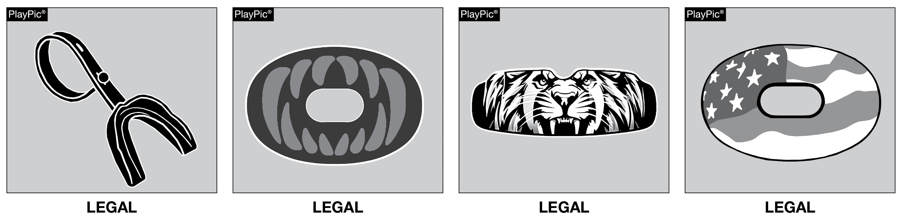
TOOTH & MOUTH PROTECTOR
RULES 1-5-1d(5)a – 4, 5
These tooth and mouth protectors neither include any attachment(s) that does not serve a purpose and function in protecting the teeth or mouth, nor anything that is a health or risk issue posing a danger and are not impacted by this rule change.
Notes:
RuleS Reminder:
See PlayPics and comments on slide.

Slide 26
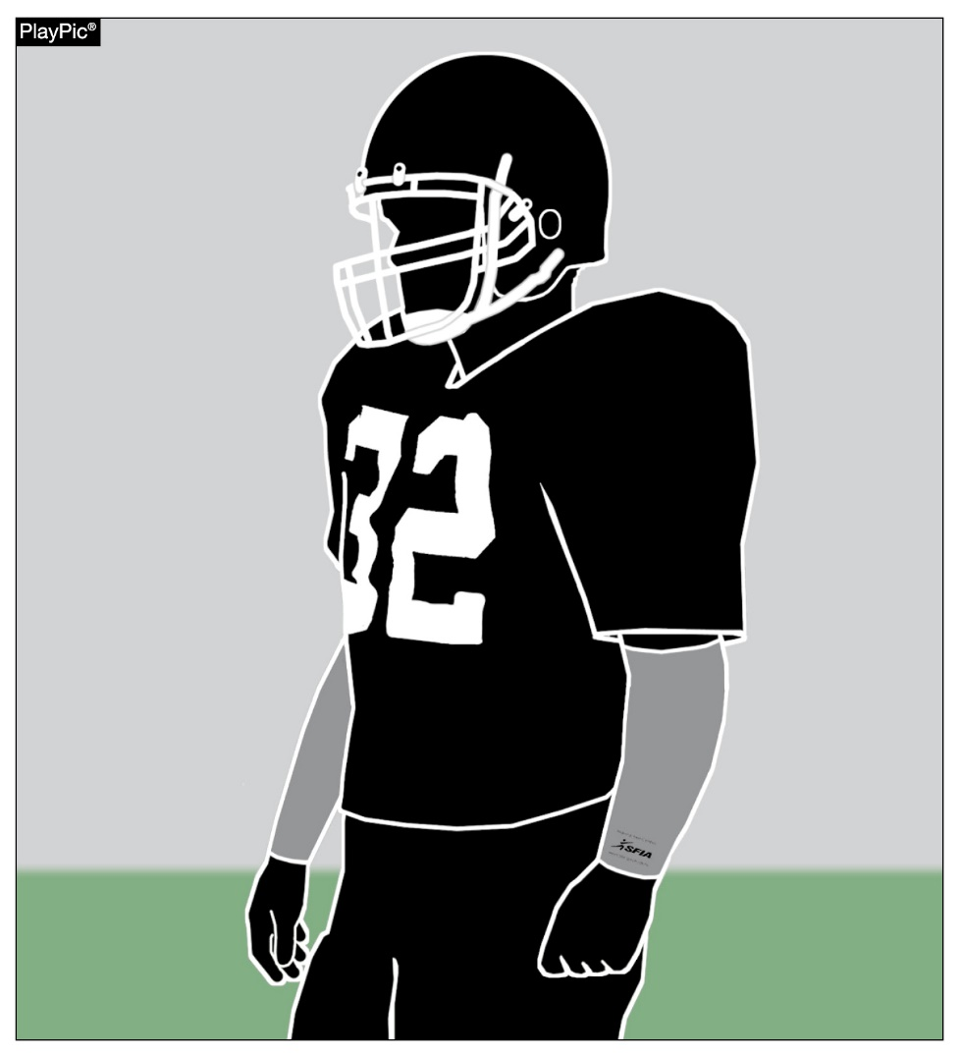
ARM SLEEVES
RULES 1-5-2d, 1-5-3c(6)
Effective 2027: Arm sleeves, whether attached to a shirt or unattached, manufactured to enhance contact with the football or opponent must meet the SFIA Specification at the time of manufacture.
Notes:
RuleS Reminder:
See PlayPic and comments on slide.

Slide 27
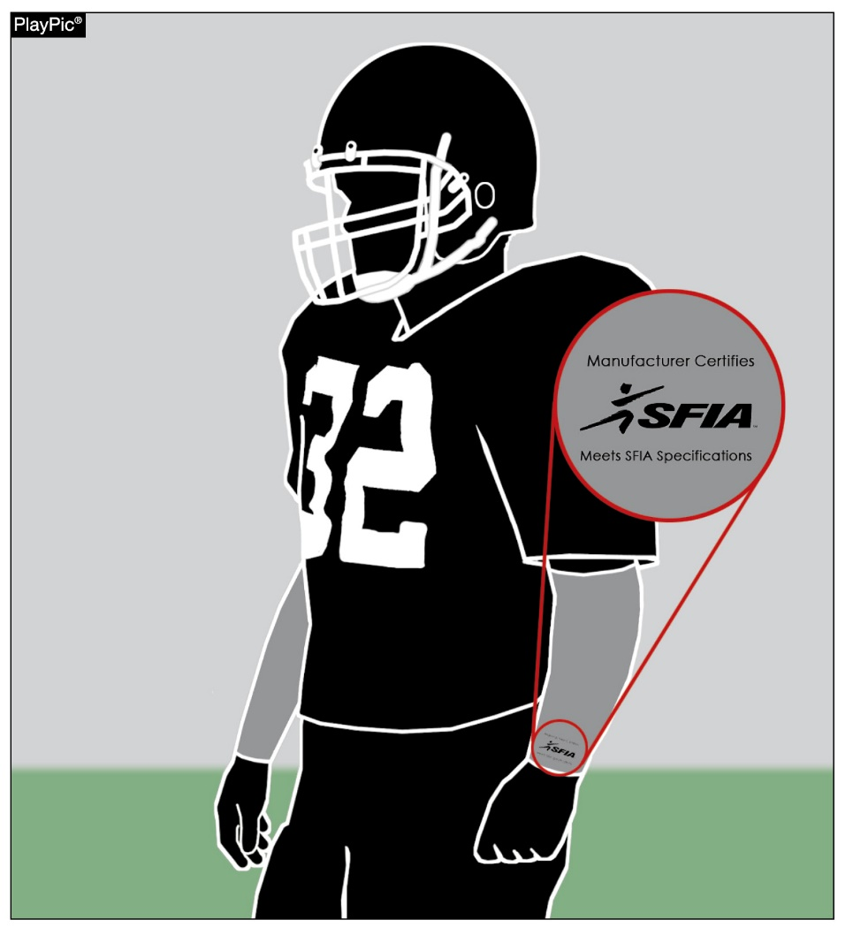
ARM SLEEVES
RULES 1-5-2d, 1-5-3c(6)
Effective 2027: Arm sleeves must have a permanent, exact replica of the SFIA arm sleeve seal (meets SFIA Specification), that must be visible and appear legibly on the exterior of the arm sleeve.
Notes:
RuleS Reminder:
See PlayPic and comments on slide.

Slide 28
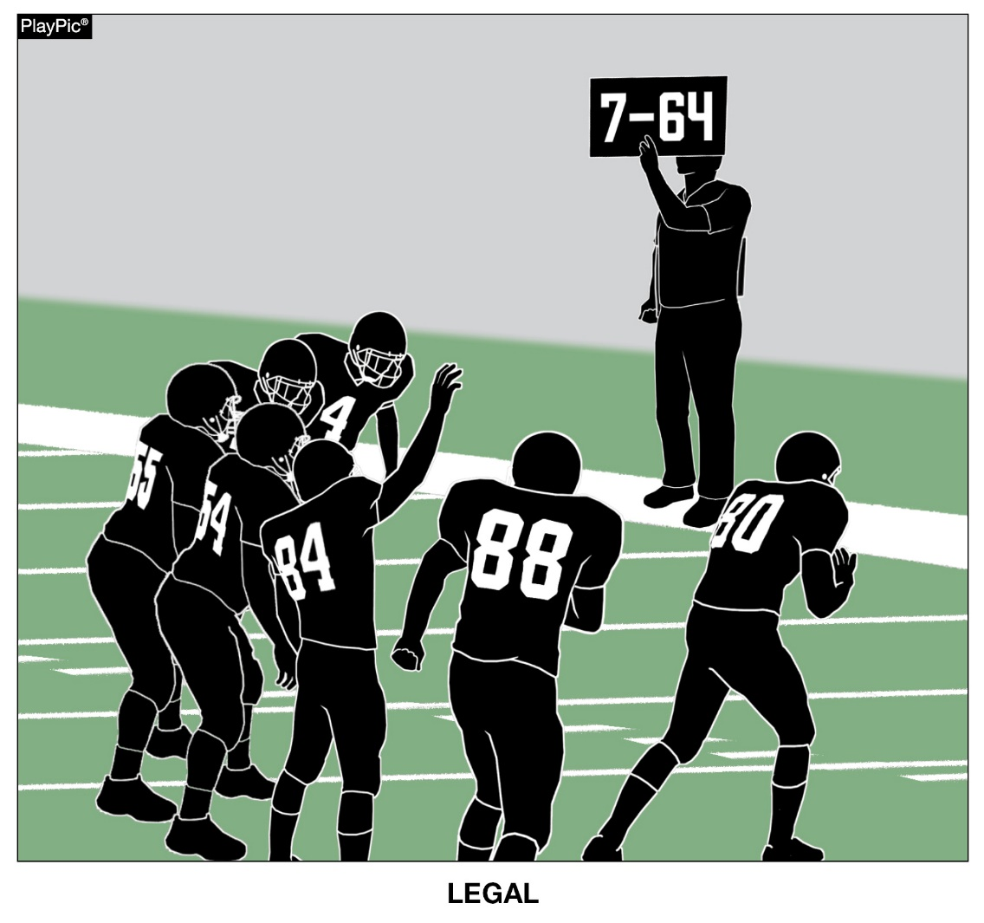
ELECTRONIC SIGNS
RULE 1-5-3c(2)
Fixed electronic signs (non-audio) with play signals are allowed to communicate from the sideline.
Notes:
RuleS Reminder:
See PlayPic and comments on slide.

Slide 29
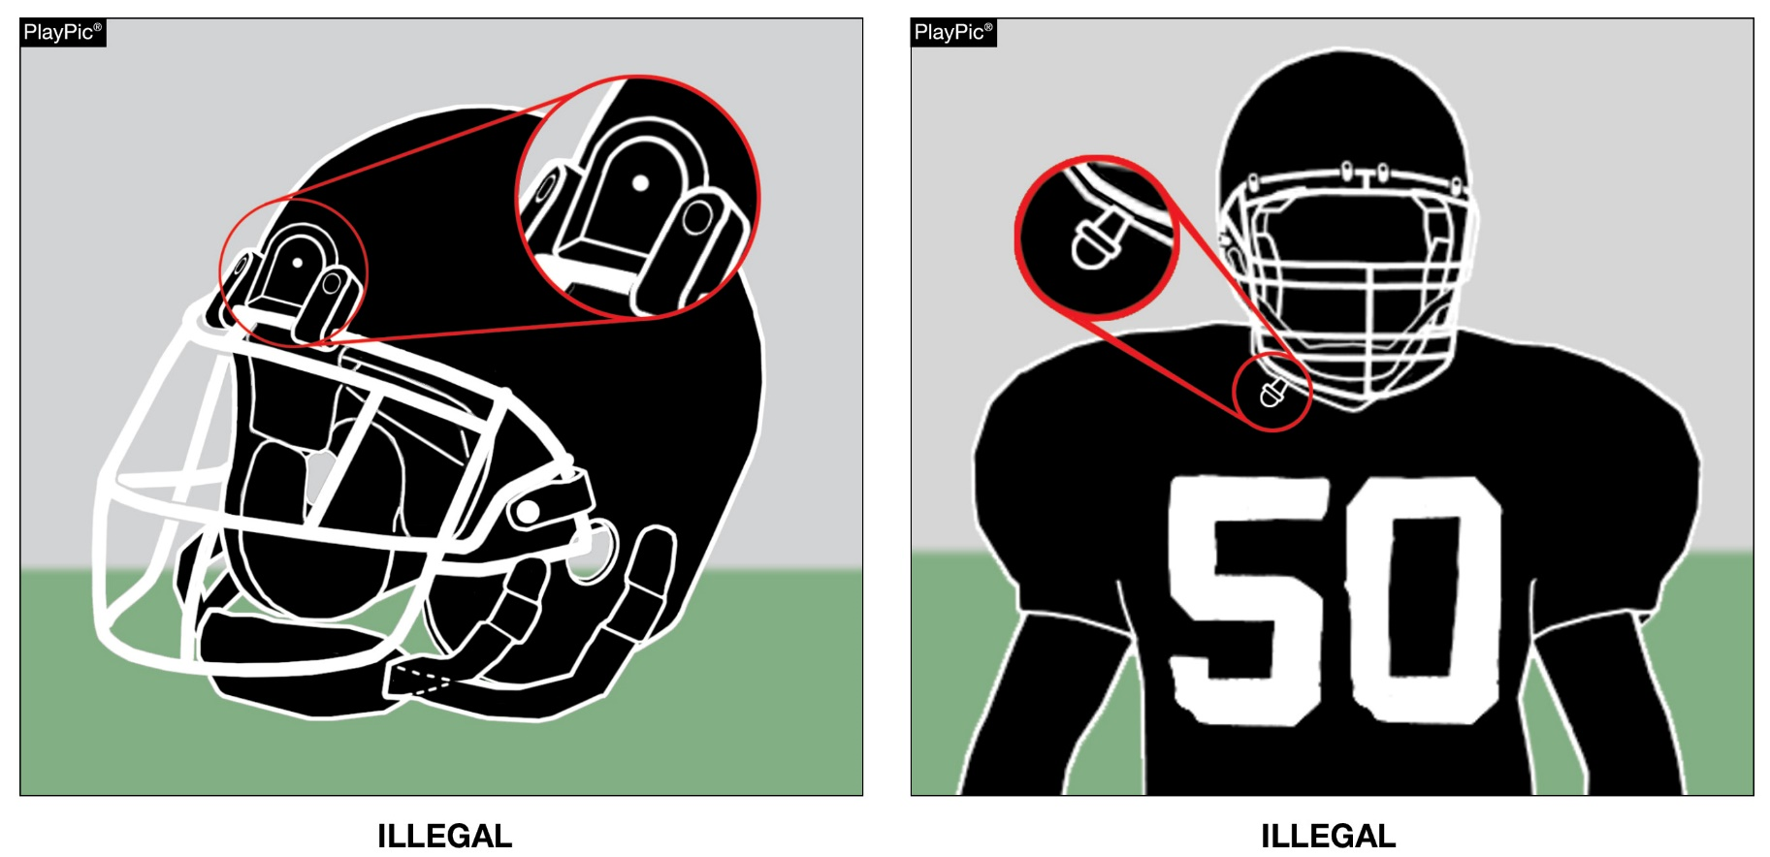
ILLEGAL EQUIPMENT
RULE 1-5-3c(3) (NEW)
Any video (camera) device or audio (microphone) worn by a player during the game is illegal.
Notes:
RuleS Reminder:
See PlayPics and comments on slide.

Slide 30
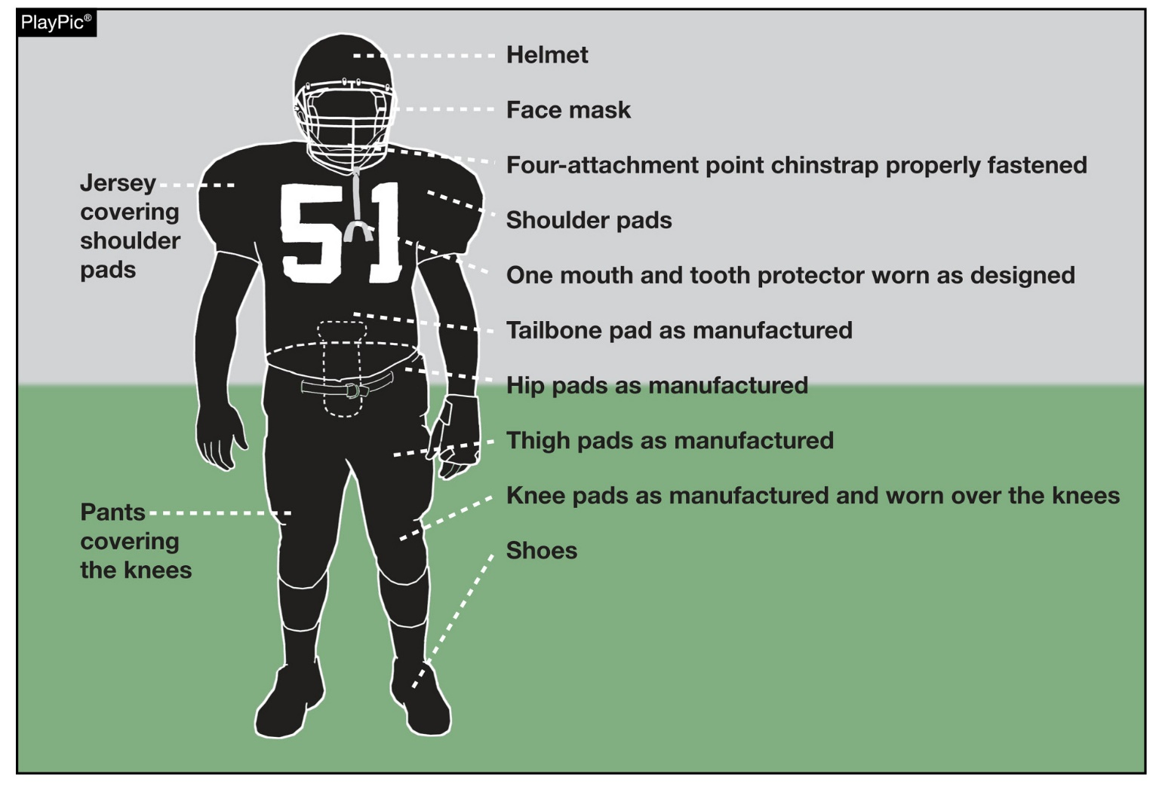
ILLEGAL AND IMPROPERLY WORN PLAYER EQUIPMENT
To support the safety of all participants, players must wear equipment and uniforms that are properly fitted and worn as intended by the manufacturer. Before starting each game, the head coach must verify that all players are properly and legally equipped. Allowing players to use illegal equipment or to wear required equipment improperly could subject the coach to a penalty.
Notes:
RuleS Reminder:
See PlayPic and comments on slide.

Slide 31
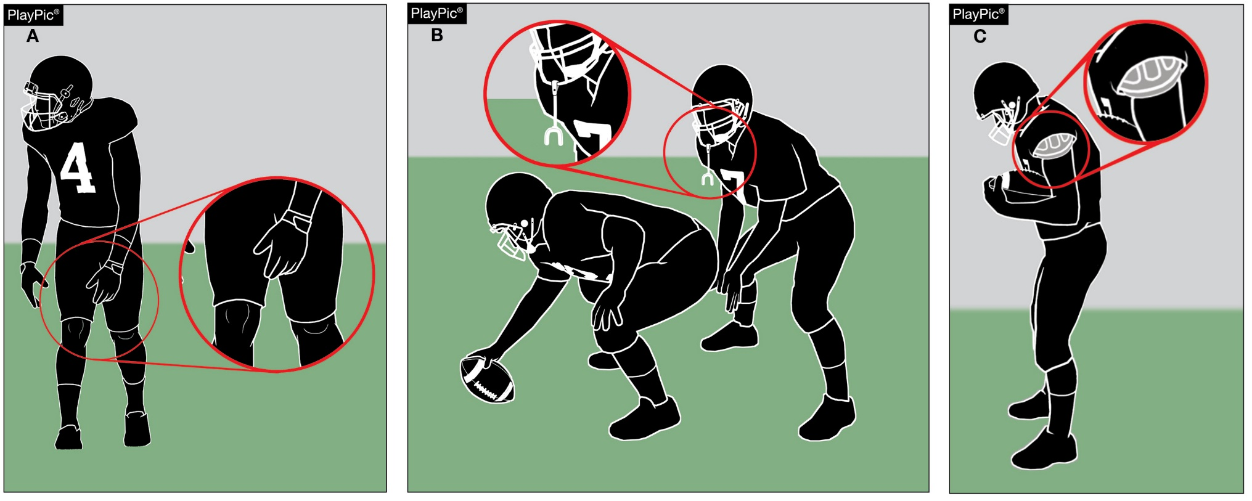
ILLEGAL AND IMPROPERLY WORN PLAYER EQUIPMENT
Improperly worn equipment pertains to all equipment that is otherwise legal but not worn as intended. Examples include pants not covering the knees, tooth and mouth protectors not being worn as play starts and shoulder pads not properly covered by the jersey.
Notes:
RuleS Reminder:
See PlayPics and comments on slide.

Slide 32
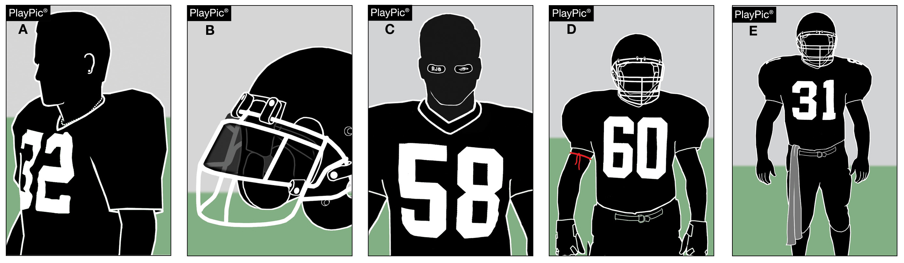
ILLEGAL AND IMPROPERLY WORN PLAYER EQUIPMENT
Illegal (prohibited) equipment includes jewelry (A), tinted visors (B), non-compliant eye shade (C), bands worn around the upper arm, neck or legs (D), and uniform adornments like towels that do not conform to rules (E).
Notes:
RuleS Reminder:
See PlayPics and comments on slide.

Slide 33
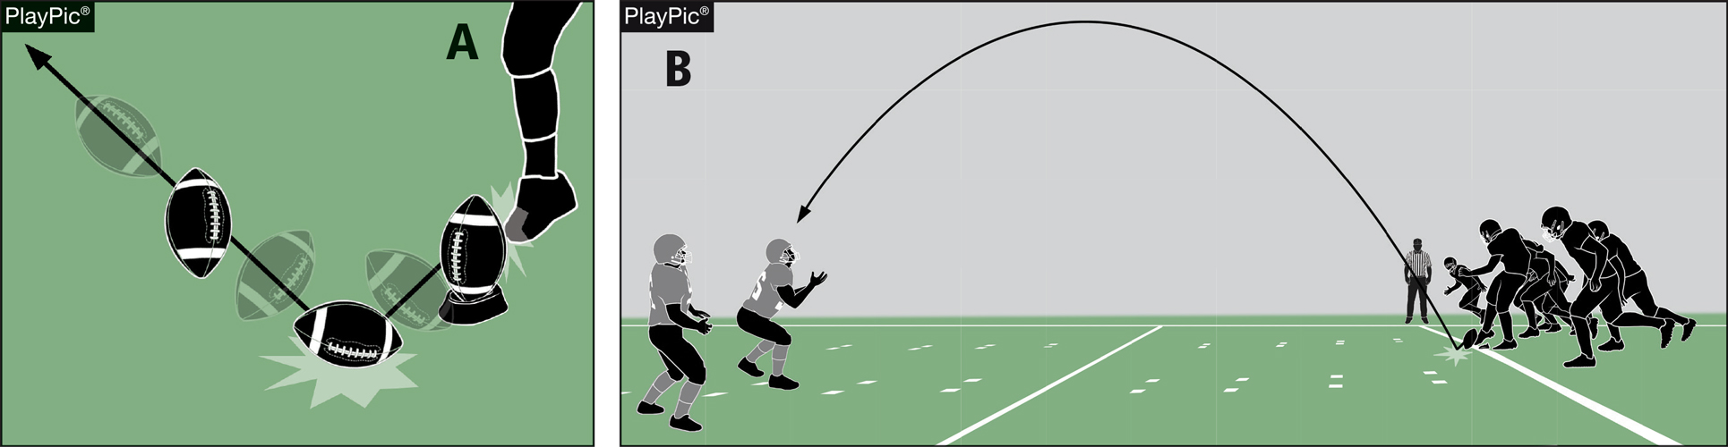
POP-UP KICK
RULES 2-24-10; 6-1-11; 6-1 PENALTY
A pop-up kick is a free kick in which the kicker drives the ball immediately to the ground, the ball strikes the ground once and goes into the air in the manner of a ball kicked directly off the tee. Such kicks are penalized as a dead-ball foul.
Notes:
RuleS Reminder:
See PlayPics and comments on slide.

Slide 34
2026 NFHS FOOTBALL POINTS OF EMPHASIS

Slide 35
2026 NFHS FOOTBALL POINTS OF EMPHASIS
1. Flagrant and Unsportsmanlike Fouls
2. Helping the Runner
3. Sideline Management and Control
4. Identification of the NFHS Authenticating Mark on Game Balls
Notes:
POINTS OF EMPHASIS:
Comment on Slide:
The following football points of emphasis were selected by the NFHS Football Rules Committee for the 2026 high school football season. These four football points of emphasis need to be stressed to all coaches, game officials, players, parents, school administrators, appropriate health-care professionals and all others who have an interest in high school football.

Slide 36
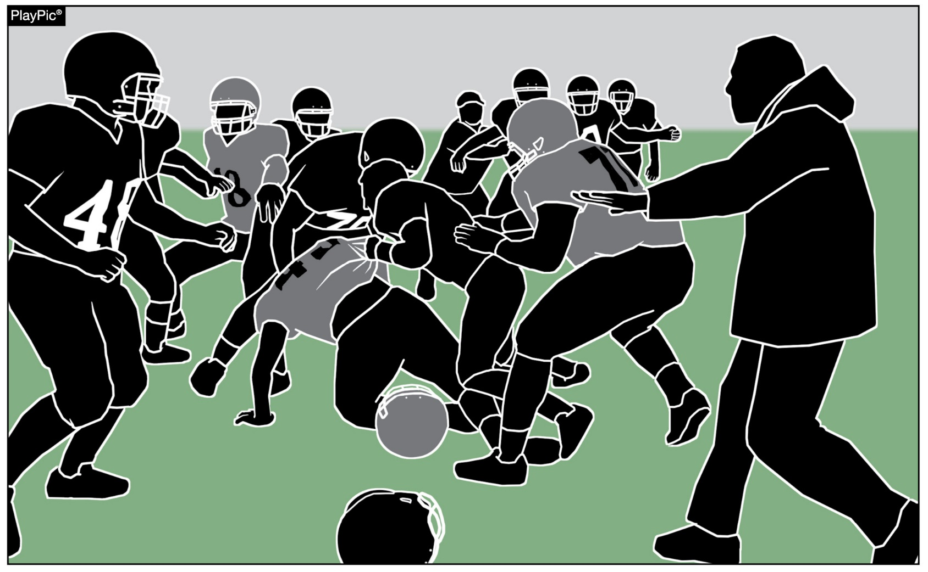
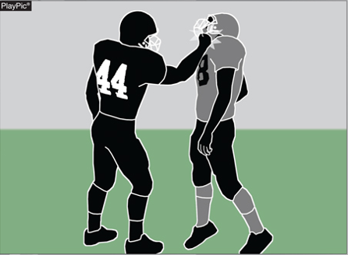
FLAGRANT AND UNSPORTSMANLIKE FOULS
In high school football, flagrant fouls and unsportsmanlike fouls are serious rule violations that threaten player safety and the integrity of the game.
Game officials must consistently penalize both flagrant and unsportsmanlike fouls to maintain control of the game.
Notes:
Flagrant and Unsportsmanlike Fouls (Point of Emphasis):
In high school football, flagrant fouls and unsportsmanlike fouls are serious rule violations that threaten player safety and the integrity of the game. The National Federation of State High School Associations (NFHS) places a strong emphasis on sportsmanship and risk minimization because players are still developing physically and emotionally. Game officials play a critical role in identifying and penalizing these fouls to ensure the game is played fairly, safely, and with respect for all participants.
Flagrant fouls are the most severe type of personal foul in high school football. These actions involve intentional, reckless or excessively violent behavior that shows a clear disregard for the safety of others. Flagrant fouls are fouls so severe or extreme that they place an opponent in danger of serious injury. They may also involve violations that are extremely or persistently vulgar or abusive. Examples include fighting, maliciously targeting the head or neck area, striking an opponent, or delivering a violent illegal blindside block or late hit. When a flagrant foul occurs, the penalty is 15 yards and automatic disqualification of the offending player. Removing players who commit flagrant fouls helps prevent serious injuries and stops situations from escalating into further violence.

Slide 37
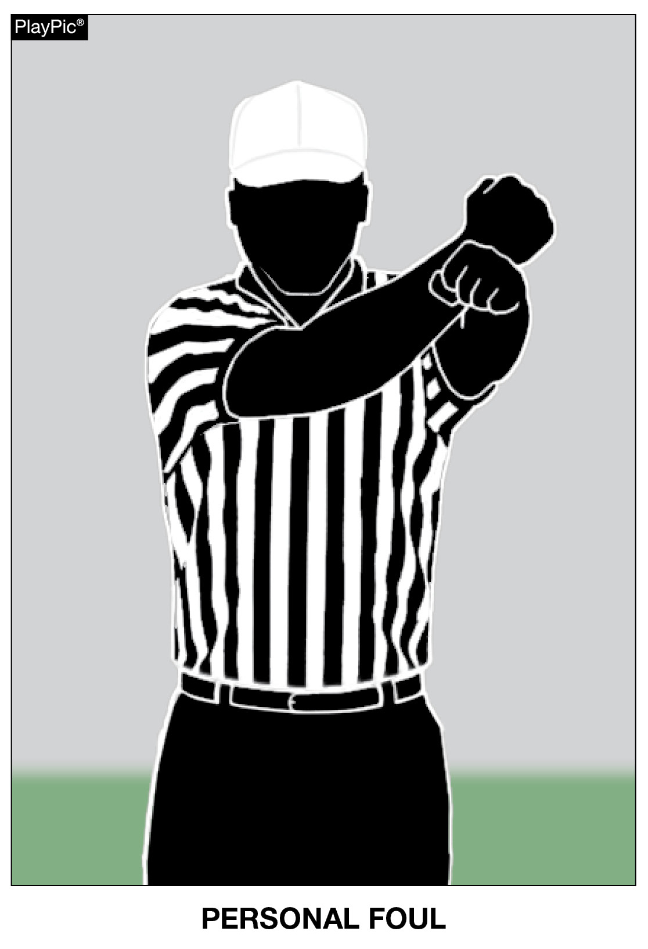
FLAGRANT AND UNSPORTSMANLIKE FOULS
Flagrant fouls are the most severe type of personal foul in high school football.
A foul so severe or extreme that it places an opponent in danger of serious injury, and/or involves violations that are extremely or persistently vulgar or abusive conduct.
These actions involve intentional, reckless or excessively violent behavior that shows a clear disregard for the safety of others. Examples include fighting, maliciously targeting the head or neck area, striking an opponent, or delivering a violent illegal blindside block or late hit.
Disqualification if any foul is judged by the game official to be flagrant.
Notes:
Flagrant and Unsportsmanlike Fouls (Point of Emphasis) - continued:
In high school football (NFHS rules), unsportsmanlike fouls are non-contact fouls that violate standards of fair play, respect and sportsmanship, while personal fouls are fouls that involve illegal personal contact. Unsportsmanlike fouls are penalized even if they don’t directly affect the play, and while they may not be physically violent, they harm the tone of the game. Common examples include:
• taunting,
• threatening gestures or posturing,
• racist comments,
• trash talking,
• excessive or choreographed celebrations,
• aggressively spiking, spinning or throwing the ball high into the air,
• using profanity,
• spitting,
• arguing with game officials, or
• throwing equipment.
Unsportsmanlike fouls can be committed by players, coaches or other team personnel. Each unsportsmanlike foul results in a 15-yard penalty, and a player who commits two such fouls in one game is disqualified.

Slide 38
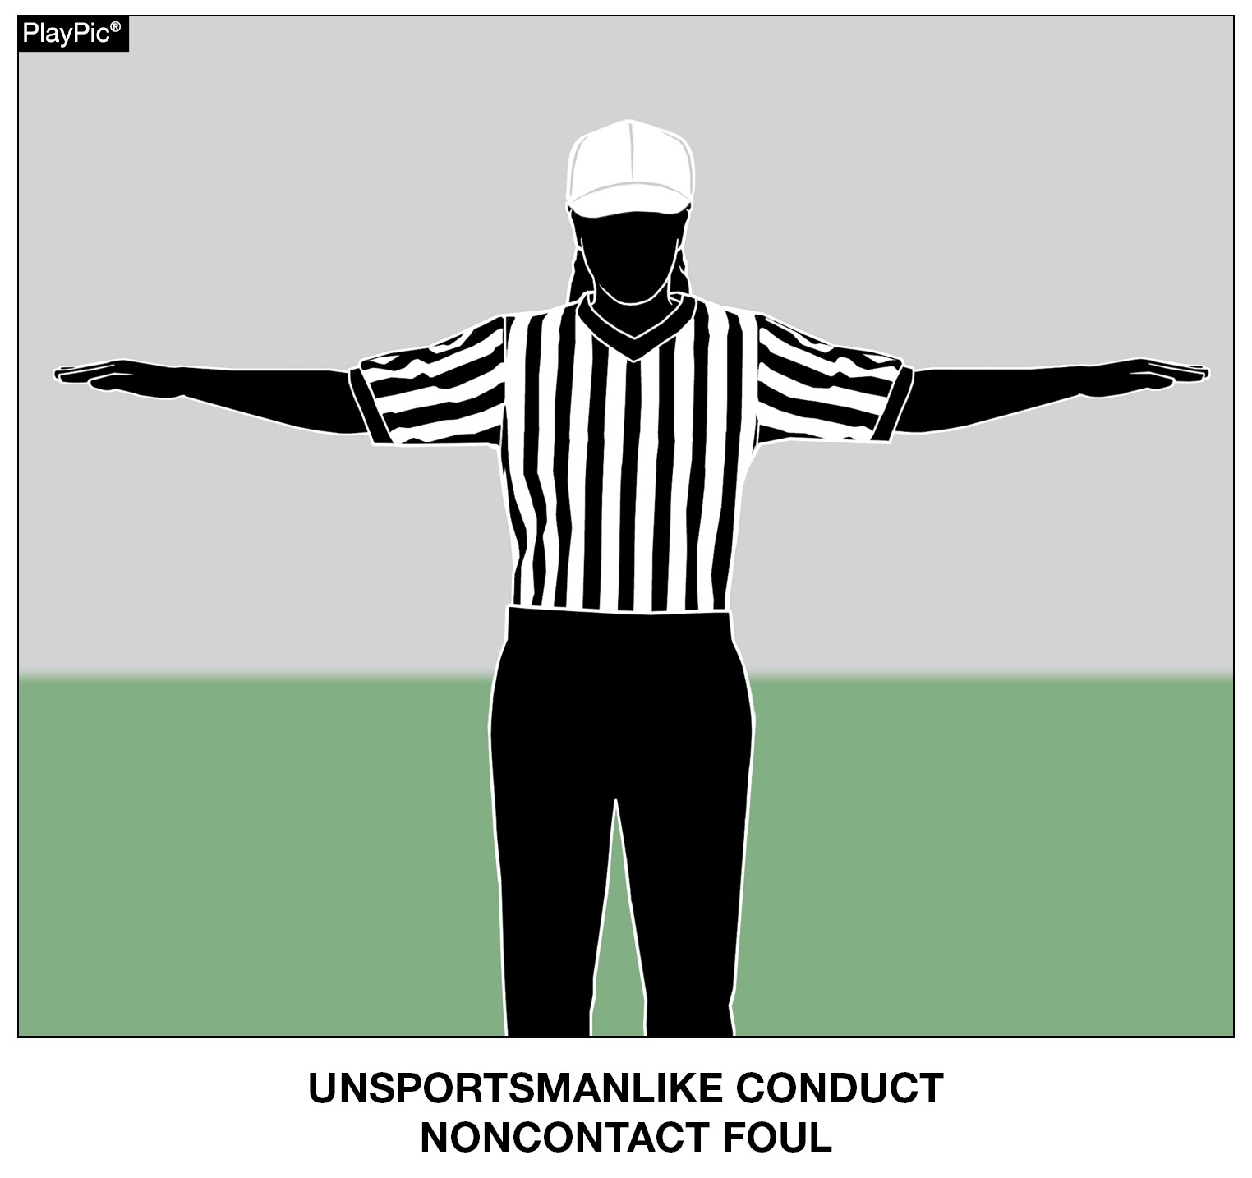
FLAGRANT AND UNSPORTSMANLIKE FOULS
Unsportsmanlike fouls are non-contact fouls that violate standards of fair play, respect and sportsmanship.
Common examples include taunting, threatening gestures or posturing, racist comments, trash talking, excessive or choreographed celebrations, aggressively spiking, spinning or throwing the ball high into the air, using profanity, spitting, arguing with game officials, or throwing equipment.
Notes:
Flagrant and Unsportsmanlike Fouls (Point of Emphasis) - continued:
Game officials must consistently penalize both flagrant and unsportsmanlike fouls to maintain control of the game. When these actions go unpunished, players may feel emboldened to act more aggressively or disrespectfully, increasing the risk of fights and injuries. Proper enforcement sends a clear message that dangerous or unsportsmanlike behavior will not be tolerated, helping to keep emotions in check and the game orderly.
Penalizing flagrant and unsportsmanlike fouls is important because high school football is about more than winning; it is about teaching values such as respect, discipline, and responsibility. By enforcing these rules, game officials protect players, promote good sportsmanship, and set a positive example for young athletes. Consistent enforcement helps ensure that high school football remains a safe, competitive and educational experience for everyone involved.

Slide 39
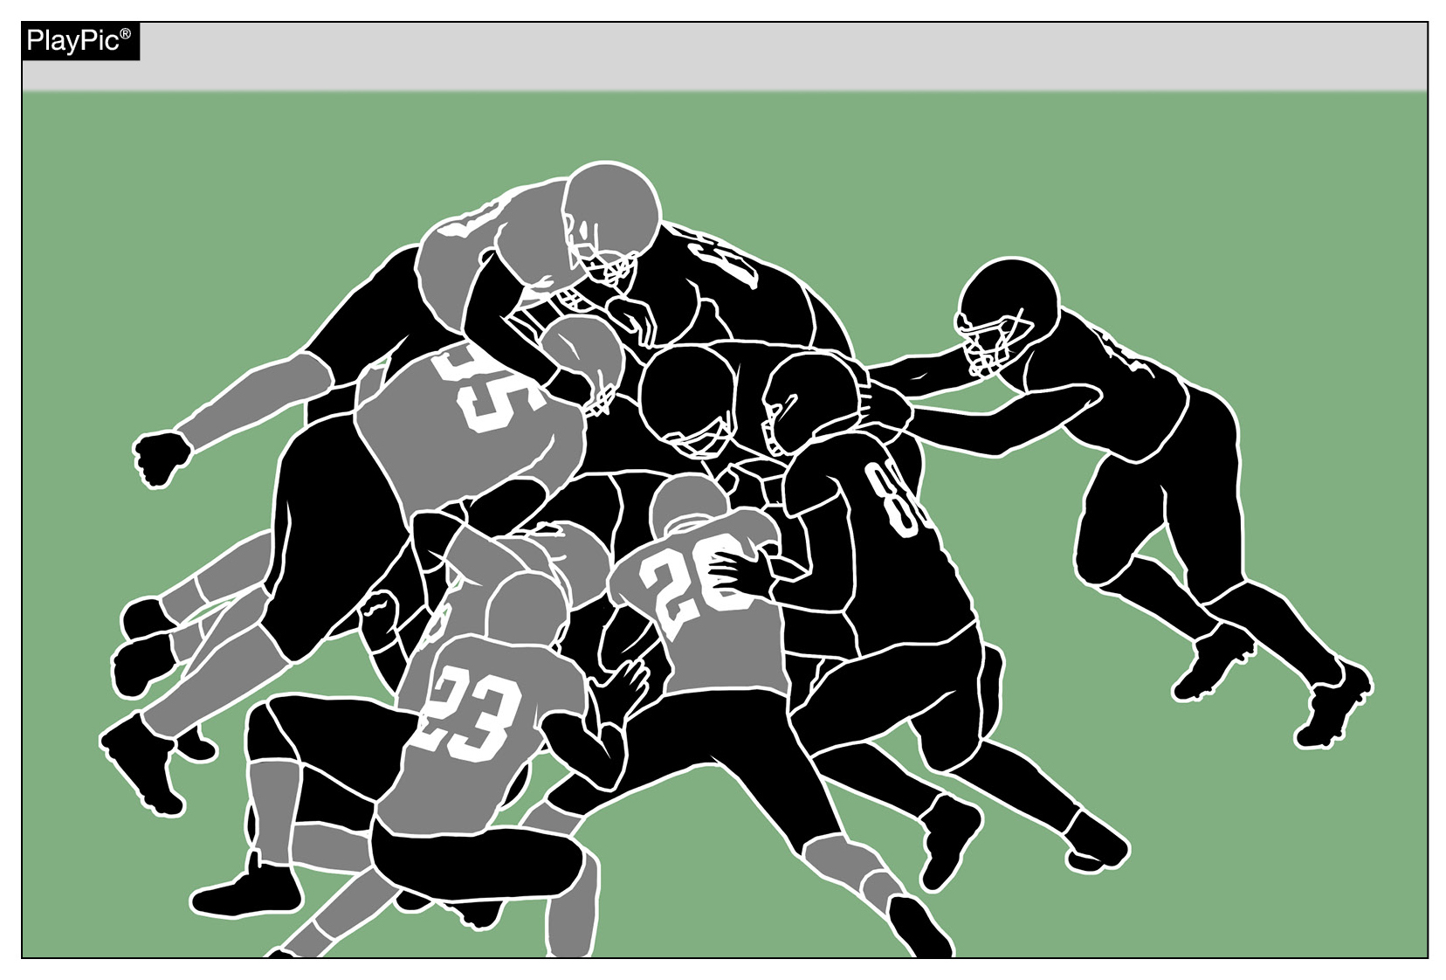
HELPING THE RUNNER
Illegally helping the runner to assist forward progress presents a risk of injury to the runner and others. The additional momentum to a particular offensive player, as opposed to the pile, swings the competitive balance toward the offense in a manner not intended by the rules.
Notes:
Helping the Runner (Point of Emphasis):
Collegiate and professional football rules allow offensive players to pile in behind and directly push the runner. The “tush push” is an example of such a play often used at those levels. Although illegal under NFHS rules, these plays are becoming more common in the high school game. As guardians of the game, it is imperative that all stakeholders work together to remove “illegally helping the runner” from our high school game.
Administrators, coaches and football game officials all have a responsibility to know, respect and teach/enforce the NFHS rules of high school football. Football is a vigorous, physical contact game and, for this reason, much attention is given to minimizing risk of injury to all players. Each respective rules code (NFL, NCAA and NFHS) has rules that coincide with the physical development of competing athletes and their goals for the game.
The NFHS Football Rules Committee focuses on minimizing risk and supporting a balance between offensive and defensive rules. Illegally helping the runner to assist forward progress presents a risk of injury to the runner and others. The additional momentum to a particular offensive player, as opposed to the pile, swings the balance toward the offense in a manner not intended by the rules.

Slide 40
HELPING THE RUNNER
Although direct contact with the runner is illegal under NFHS rules, these types of plays are becoming more common in the high school game. As guardians of the game, it is imperative that all stakeholders work together to remove “illegally helping the runner” from our high school game.
Notes:
Helping the Runner (Point of Emphasis) - continued:
Football game officials should be aware of ruling plays dead when a runner’s forward progress is clearly stopped, and they should penalize actions by offensive teammates who directly contact the runner and push, pull or lift the runner forward in a clear and obvious attempt to keep the runner’s progress moving forward.
Of course, not all contact with the runner is illegal. Game officials should observe and judge an offensive teammate’s actions and the runner’s progress to determine whether a foul for illegally helping the runner is warranted. Although a foul can occur on any play, game officials should especially be alert for this type of action on short-yardage plays near the goal line and line to gain. Remember, pushing the pile is legal; direct contact while pushing, pulling, lifting of the runner to assist forward progress is not.

Slide 41
HELPING THE RUNNER
Although a foul can occur on any play, game officials should especially be alert for this type of action on short-yardage plays near the goal line and line to gain. Remember, pushing the pile is legal; direct contact while pushing, pulling, lifting of the runner to assist forward progress is not.
Notes:
Helping the Runner (Point of Emphasis) - continued:
The NFHS Coaches Code of Ethics states: “Coaches shall master the contest rules and shall teach the rules to their team members. Coaches shall not seek an advantage by circumvention of the spirit or letter of the rules. Coaches have a tremendous influence, for good or ill, on the education of the student, and thus shall never place the value of winning above the value of instilling the highest ideals of character.”
If school administrators/athletic directors truly believe that activities are an extension of the classroom, they must be actively involved with programs they supervise and redirect coaches when they observe them teaching prohibited tactics.
Removing “illegally helping the runner” from high school football will, at times, be met with resistance, especially considering the visibility of this type of play at other levels of the game. School administrative support of football game officials, re-focus of coaches and education of players will lead to a smooth transition. All stakeholders must remain committed to trying to minimize risk to all players and maintain the balance between offensive and defensive play.

Slide 42
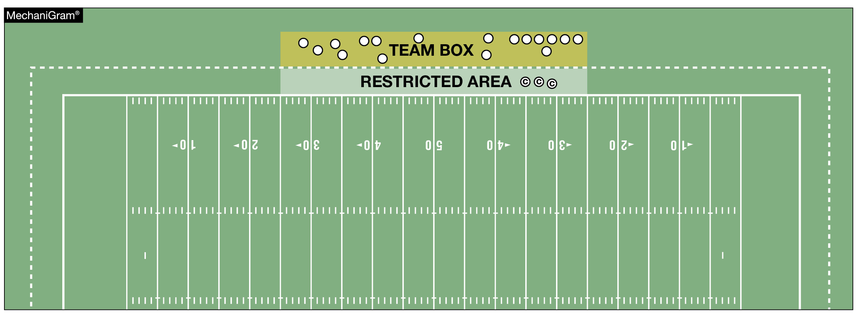
SIDELINE MANAGEMENT AND CONTROL
Sideline management has become a recurring “point of emphasis” because it improves game safety. To minimize the risk of all involved, non-players must remain in their team box and out of any restricted areas, especially while the ball is live. The coaches’ area is a minimum of a 2-yard belt between the front of the team box and the sideline, and becomes the restricted area when the ball is live. A maximum of three coaches – and only coaches – may be in this area when the ball is dead between plays.
Notes:
Sideline Management and Control (Point of Emphasis):
Sideline management has become a recurring “point of emphasis” because it improves game safety by keeping game officials, players, coaching staff and other team personnel clear of the active game play areas. It promotes good sportsmanship and professionalism across all levels of play and also prevents unnecessary
delays and confrontations that can impact game flow and fairness.
The sideline includes the team area and any restricted zones around the field where players and coaches stand during the game. Game officials expect this area to be organized and kept clear of unnecessary personnel. Coaches must remain in the designated team area when interacting with game officials, especially for rule discussions. Leaving that area to step onto the field or challenge calls results in an automatic unsportsmanlike conduct foul. Coaches are generally only allowed to step toward the sideline (into the working area, often a marked 2-yard border) to call offensive or defensive signals after play has stopped.
Game officials are instructed to strictly enforce NFHS Football Rules when the following behaviors are observed:
• Coaches or team personnel entering the field of play to dispute rulings or address game officials outside the coaching area.
• Prolonged or excessive celebrations or demonstrations that carry onto the field.
• Failing to maintain professional behavior. Coaches and team personnel are expected to set a standard for sportsmanship.
• Game officials shall call fouls for violations of sideline control when they are observed.

Slide 43
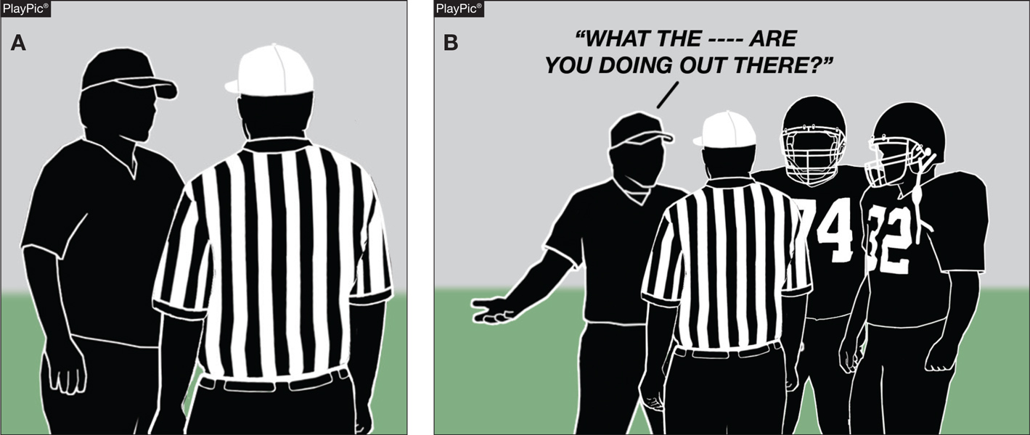
SIDELINE MANAGEMENT AND CONTROL
Game officials are instructed to strictly enforce NFHS Football Rules when coaches or team personnel enter the field of play to dispute rulings or address game officials outside the coaching area.
Notes:
Sideline Management and Control (Point of Emphasis) - continued:
• Infractions such as approaching game officials with devices (e.g., to view or review video).
The following is a summary checklist for coaches/teams to follow during a game:
• Remain inside your team area for game official discussions.
• Only move toward the sideline after play is dead, and for signal/play calling.
• Keep non-essential personnel and spectators off the field level.
• Avoid approaching game officials during play or with electronic/video devices.
• Set a professional, sportsmanlike example for the entirety of the contest.
To minimize the risk of all involved, non-players (including substitutes, athletic trainers and coaches) must remain in their team box and out of any restricted areas, especially while the ball is live. Non-players may never be on the field while the ball is live and may only be on the field when the ball is dead in very limited situations. In the excitement of the game, it is not uncommon for substitutes and other non-players to move closer to the sideline beyond their team box area. This inevitably causes coaches to move up into restricted areas and closer to the field - often impeding game officials in their essential duties. Crowding at the sideline puts players, non-players, coaches and game officials in danger of severe injury. Game officials and coaches must be aware of this problem and take the necessary steps to prevent and correct these occurrences. Coaches, substitutes, athletic trainers and others affiliated with the team may be in their team’s area, which is out-of-bounds and between the 25-yard lines (unless otherwise approved to be adjusted by state association adopted policy). Their movements and positions are limited by this designated area.

Slide 44
SIDELINE MANAGEMENT AND CONTROL
Sideline management and control promotes good sportsmanship and professionalism across all levels of play, and also prevents unnecessary delays and confrontations that can impact game flow and fairness.
Notes:
Sideline Management and Control (Point of Emphasis) - continued:
The coaches’ area extends at least a 2-yard depth out-of-bounds from the sideline. A maximum of three coaches – and only coaches – may be in this area when the ball is dead between plays. However, all coaches must leave this area when the ball is about to become live, such as when the snapper is approaching the ball, and no one may be in this area while the ball is live. The team box area is outside the field, beyond the restricted area and between the 25-yard lines. All coaches and non-players associated with the team may be in this area. A nonplayer may not be outside of this area unless to become a player or return as a replaced player.
When nonplayers are outside of the team box area, or anyone is in the restricted area while the ball is live, game officials will give a sideline warning to the team involved. A second offense results in a 5-yard penalty. All subsequent offenses result in 15-yard penalties for unsportsmanlike conduct fouls, which are charged to the head coach. If a game official unintentionally contacts a coach or other nonplayer in the restricted area while the ball is live, the team is assessed a 15-yard penalty for a nonplayer, illegal personal contact foul. As a nonplayer foul, the penalty is enforced from the succeeding spot. A second such offense would result in the head coach’s disqualification. Unlike a foul for sideline interference (non-contact, Rule 9-8-1k or 9-8-3), no warning or 5-yard penalty is required in this situation.

Slide 45
IDENTIFICATION OF NFHS AUTHENTICATING MARK ON GAME BALLS
The NFHS Authenticating Mark ensures easy identification of inflated and non-inflated balls used in interscholastic competition for which the NFHS writes playing rules. All such balls are required to display the NFHS Authenticating Mark.
Notes:
Identification of NFHS Authenticating Mark on Game Balls (Point of Emphasis):
The NFHS Authenticating Mark ensures easy identification of inflated and non-inflated balls used in interscholastic competition for which the NFHS writes playing rules. All such balls are required to display the NFHS Authenticating Mark.
The use of conforming equipment is essential to the integrity of contests played under the NFHS rules. This mark helps to promote a level playing field by ensuring consistency in the equipment being used. The mark allows for the development of more sophisticated standards in balls and clearly communicates to administrators, coaches, and game officials that these standards are being met.
Non-compliance with these requirements will be reported to the state association for potential penalties, following the contest. Administrators and coaches play a pivotal role in making sure all inflated and non-inflated balls meet these specifications. They must instill the importance of proper equipment use through consistent reinforcement during the pre-competition certification meeting and throughout the season. Game officials must also remain vigilant and report any non-compliant balls to the state association office.

Slide 46



NFHS Authenticating Mark Update
Specifications
Do not use the NFHS Authenticating Mark without prior written approval from the NFHS
This mark is for use of licensees only.
Minimum size
  Inflatable Balls - 2 ½“ in length (Basketball, Football, Soccer, Volleyball, and Water Polo)
  Non-Inflatable Balls - 1 ¼" in length (Baseball, Field Hockey, Ice Hockey Puck, Lacrosse, and Softball)
  On a ball or puck, the NFHS mark may be smaller than manufacturer’s logo, but should be placed in proximity to the manufacturer’s name for easy identification. Allow enough space around the mark so it can be easily recognized as distinct and separate.
  Reproduce the mark only from the vector artwork provided on Direct Licensing Hub. Do not copy, scan art electronically or use as a template to redraw the symbol.
Note: If sizing or specifications do not work well in your particular design situation, contactK12 Licensing.
Old Logos
Current Logo
Notes:
Identification of NFHS Authenticating Mark on Game Balls (Point of Emphasis) - continued:
See comments on slide.

Slide 47
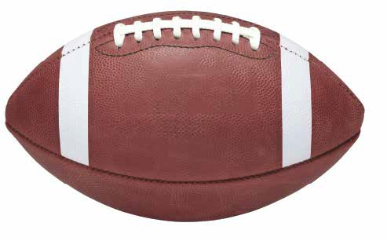


Football
Old Size
Current Size
1.25”
2.5”
10.875”
10.875”
Notes:
Identification of NFHS Authenticating Mark on Game Balls (Point of Emphasis) - continued:
See comments on slide dealing with the size of the NFHS Authenticating Mark Logo on the ball.

Slide 48
2026 AND 2027
NFHS FOOTBALL GAME OFFICIALS MANUAL

Slide 49
2026 AND 2027
NFHS FOOTBALL GAME OFFICIALS MANUAL
POINTS OF EMPHASIS
1. Penalty Communication
2. Forward Progress
3. Free-Kick Coverage
Notes:
Comment on Slide:
The following points of emphasis were selected by the NFHS Football Game Officials Manual Committee for the 2026 and 2027 high school football seasons. These three football points of emphasis from the NFHS Football Game Officials Manual Committee, need to be stressed to all coaches, game officials, players, parents, school administrators, appropriate health-care professionals and all others who have an interest in high school football.

Slide 50
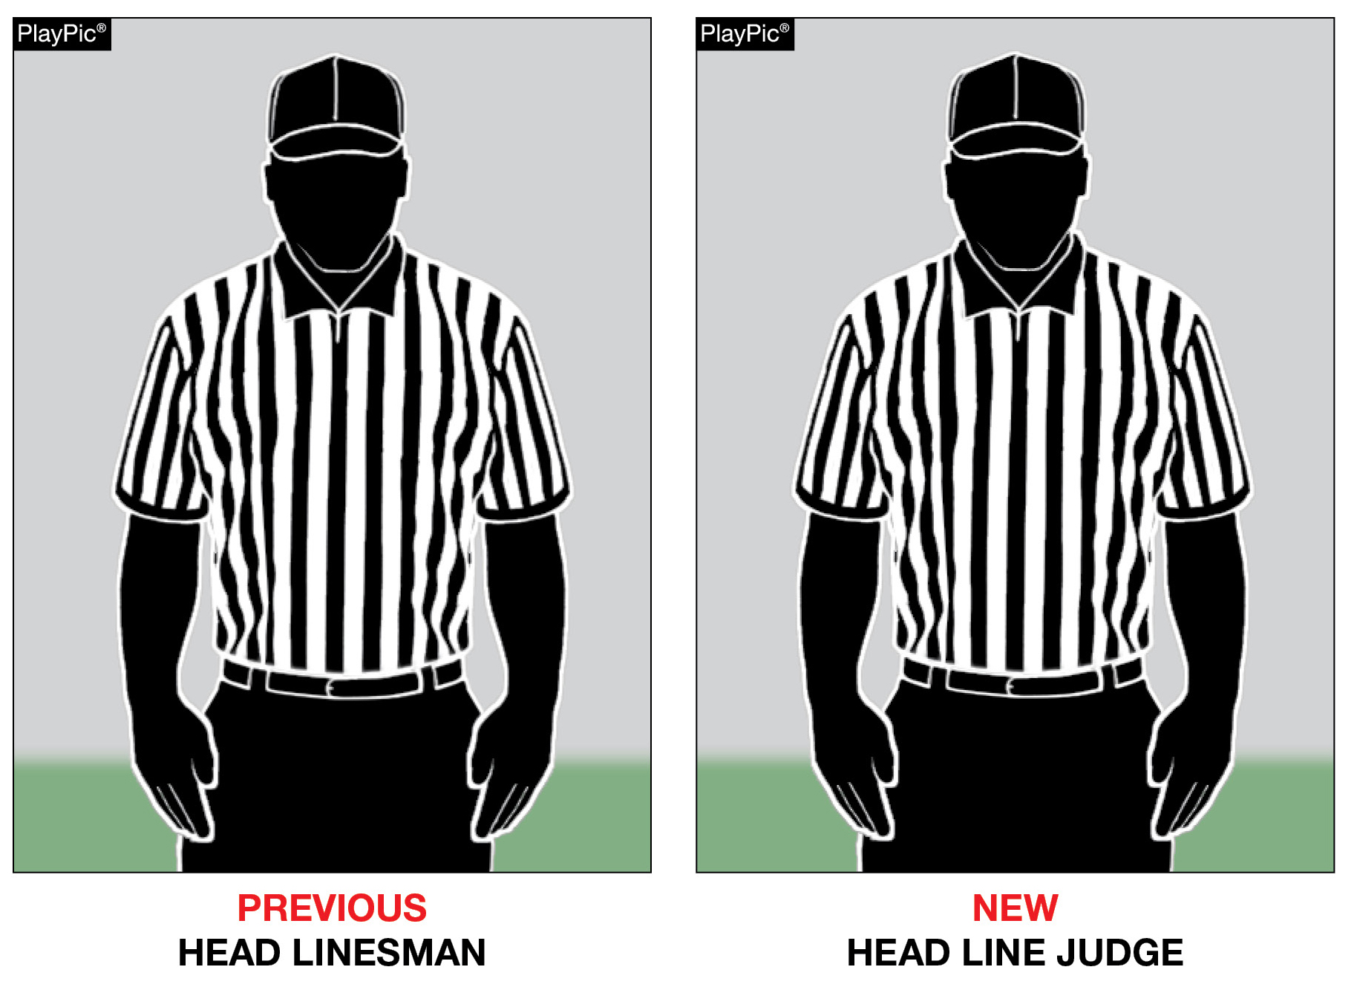
NEW POSITION NAME
The Head Linesman position is now referred to as Head Line Judge.
Notes:
MANUAL CHANGES:
See PlayPics and comments on slide.

Slide 51
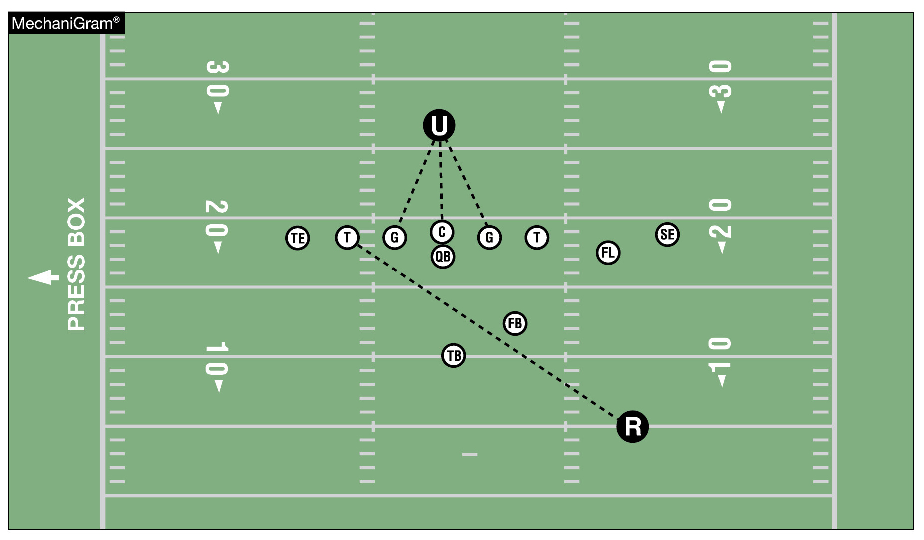
REFEREE & UMPIRE KEYS
In all but the rarest cases, the Referee will key on the opposite side tackle. In all cases the Umpire will key on the center and both guards.
Notes:
MANUAL CHANGES:
See MechaniGram and comments on slide.

Slide 52
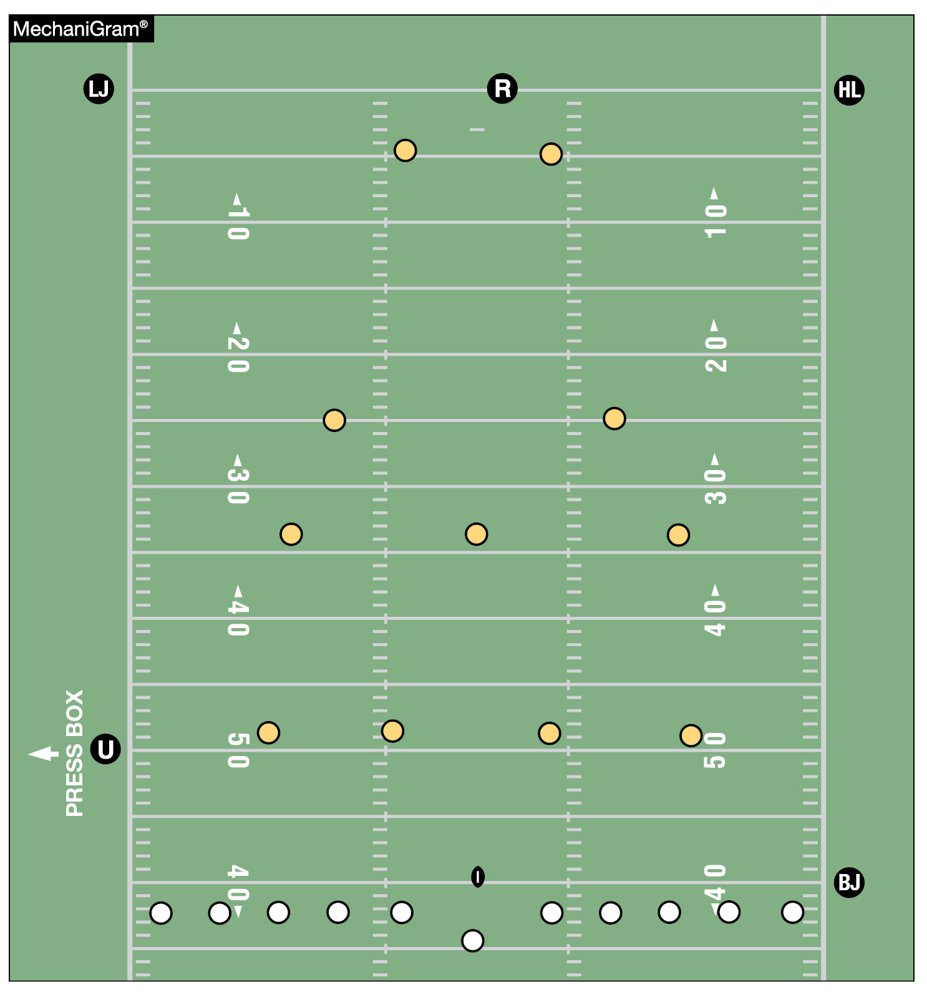
CREW OF FIVE FREE KICK POSITIONS
REFEREE: Starting position is on the goal line between the hash marks and in the center of the field.
UMPIRE: Starting position is outside the sideline on the side opposite the chains, on Team R’s free-kick line.
WING OFFICIALS: Starting position is on Team R’s goal line extended but can be adjusted based on the deepest receiver. If starting position is adjusted, both line of scrimmage officials must be on the same yard line and deeper than the deepest receiver.
BACK JUDGE: Starting position is outside the sideline on the side with the chains, on Team K’s free-kick line.
Notes:
MANUAL CHANGES:
See MechaniGram and comments on slide.

Slide 53
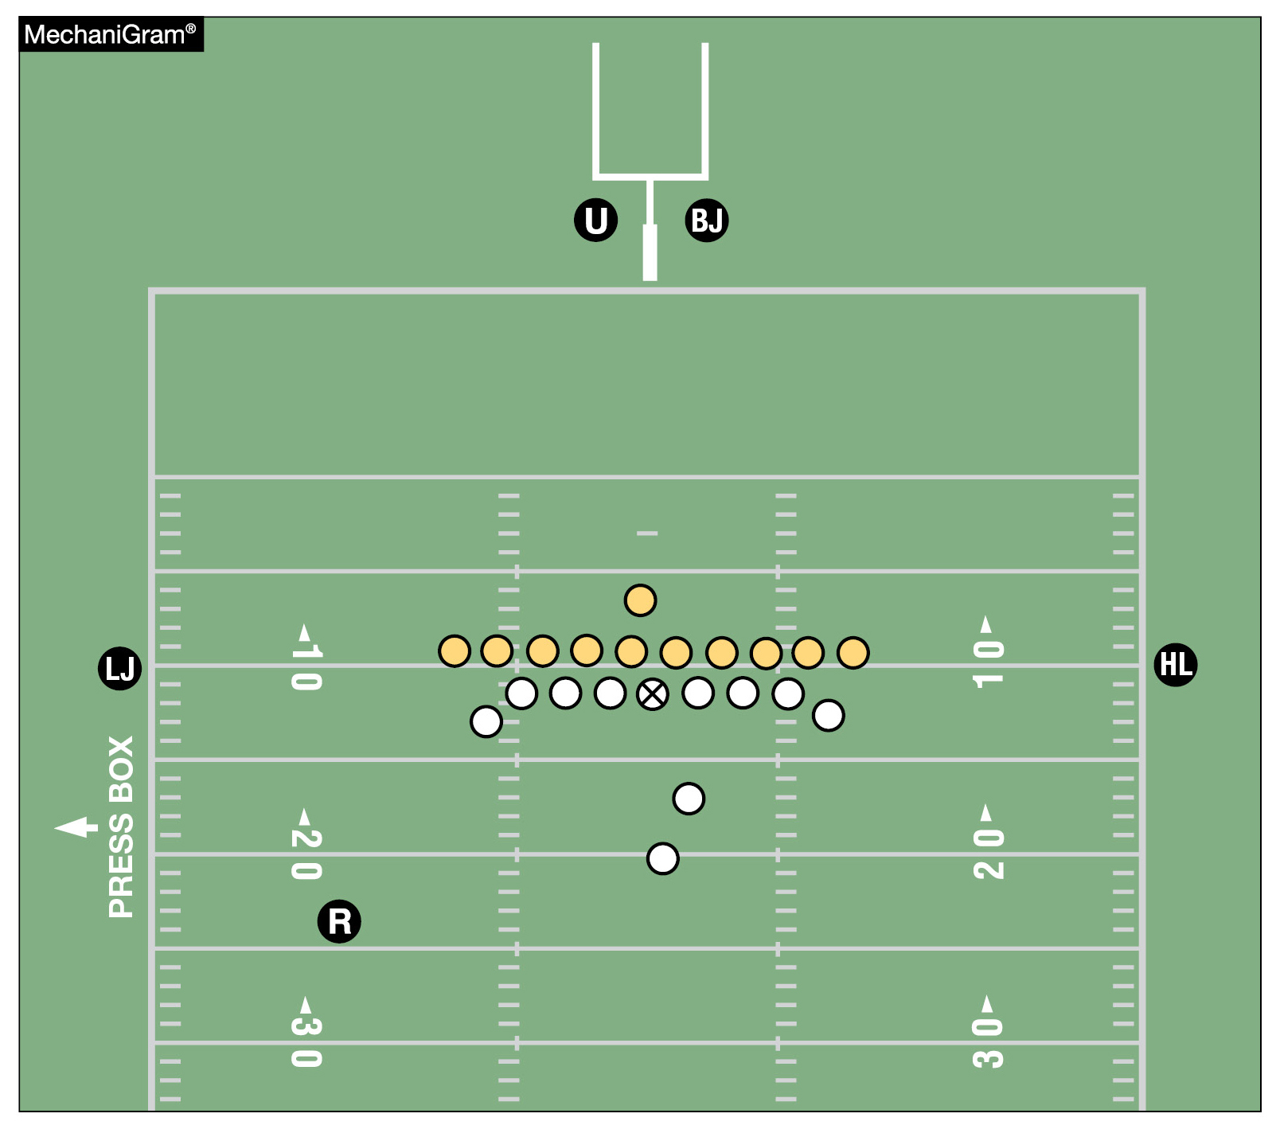
CREW OF FIVE SCORING KICK POSITIONS
REFEREE: Starting position is 2 to 3 yards to rear and 3 to 5 yards to side of potential kicker, facing holder.
UMPIRE: Starting position is beyond the end line and behind the upright.
WING OFFICIALS: Starting position is straddling the line of scrimmage.
BACK JUDGE: Starting position is beyond the end line and behind the upright.
NOTE: On a field-goal attempt by free kick (in accordance with Rules 6-1-1a and 8-4-1a), the chains are set to establish the 10-yard neutral zone. Referee is behind the upright. Umpire is behind the upright and rules on the crossbar. Both game officials determine whether kick is successful. All other game officials’ mechanics are the same as for a kickoff.
Notes:
MANUAL CHANGES:
See MechaniGram and comments on slide.

Slide 54
2026-27 NFHS FOOTBALL INFORMATION

Slide 55
2027 nfhs football rule change proposal online form
Due:
November 1, 2026
Must be submitted to your state association office for approval.
Notes:
Comment on Slide:
ALL 2027 NFHS Football Rule Change Proposal Online Forms must first go through the state association office before it can be sent to the NFHS.
Only member state associations, football coaches and football game officials approved by the member state association, members of the NFHS Football Rules Committee and the NFHS can submit football rule change online proposal forms.
ALL 2027 NFHS Football Rule Change Online Proposal Forms must be submitted electronically online to the NFHS by November 1, 2026.

Slide 56
2026-27 nfhs football information
2026 In-Person NFHS Football Rules State Interpreters Meeting
  June 27, 2026 (NFHS Summer Meeting – Salt Lake City, Utah)
  3:45 p.m. (Mountain Time)
2026 Online Mid-Season NFHS Football Rules Webinar
  September 21, 2026
  2:00 p.m. (Eastern Time)
2027 NFHS Football Rule Change Proposal Form Due
  November 1, 2026
2027 NFHS Football Rules Committee Meeting
  January 10-12, 2027
  Indianapolis, Indiana
Notes:
Comment on Slide:
2026-27 NFHS information with regards to football.

Slide 57
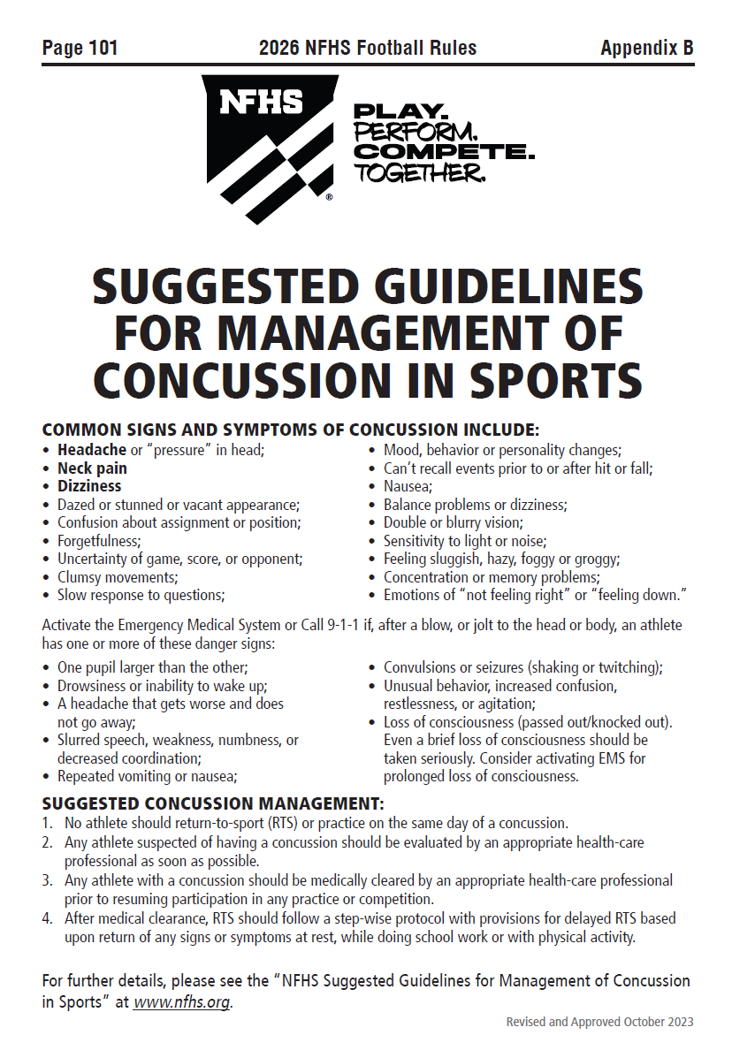
Nfhs suggested guidelines For management of concussion in sports
In the Appendix
in all of the
2026-27 NFHS
Rules Book
Notes:
Comment on Slide:
The “NFHS Suggested Guidelines for Management of Concussion” is in the Appendix in all of the 2026-27 NFHS Rules Books and was developed by the NFHS Sports Medicine Advisory Committee (SMAC).

Slide 58
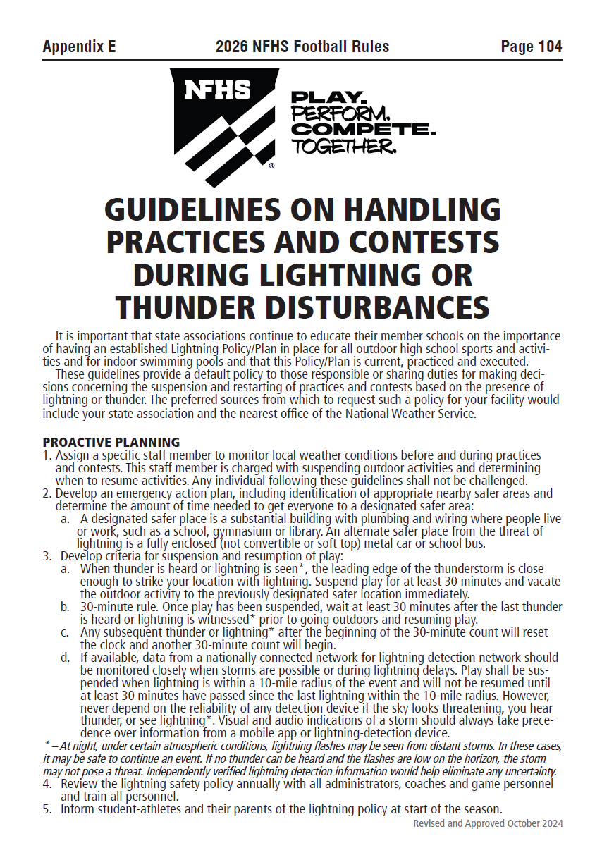
Nfhs guidelines on handling practices and contests during lightning or thunder disturbances
In Appendix E
in the
2026 NFHS
Football Rules Book
Notes:
Comment on Slide:
The “NFHS Guidelines on Handling Practices and Contests During Lightning or Thunder Disturbances” is in Appendix E in the 2026 NFHS Football Rules Book and was developed by the NFHS Sports Medicine Advisory Committee (SMAC) with guidance from national lightning and weather experts.

Slide 59
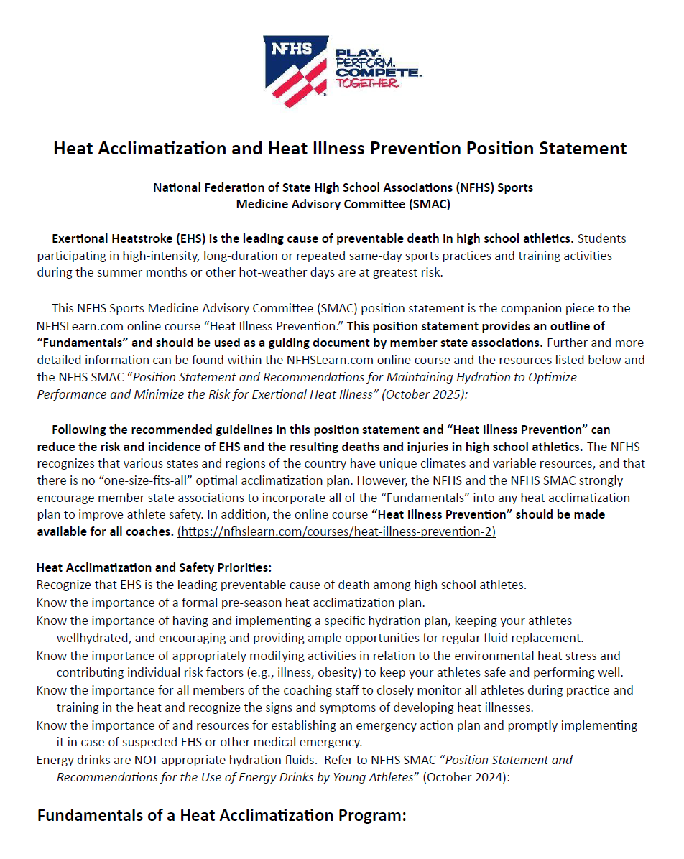
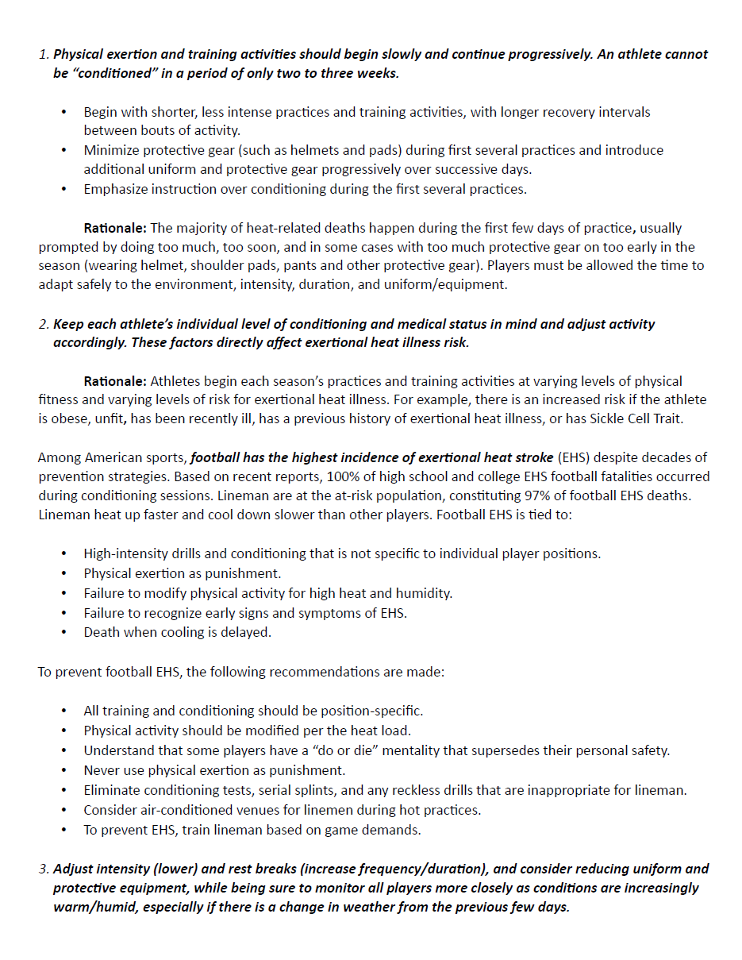
NFHS Heat Acclimatization and Heat Illness Prevention Position Statement
Notes:
Comment on Slide:
The “NFHS Heat Acclimatization and Heat Illness Prevention Position Statement” was developed by the NFHS Sports Medicine Advisory Committee (SMAC). This Position Statement can be found on the Sports Medicine page on the NFHS Website.

Slide 60
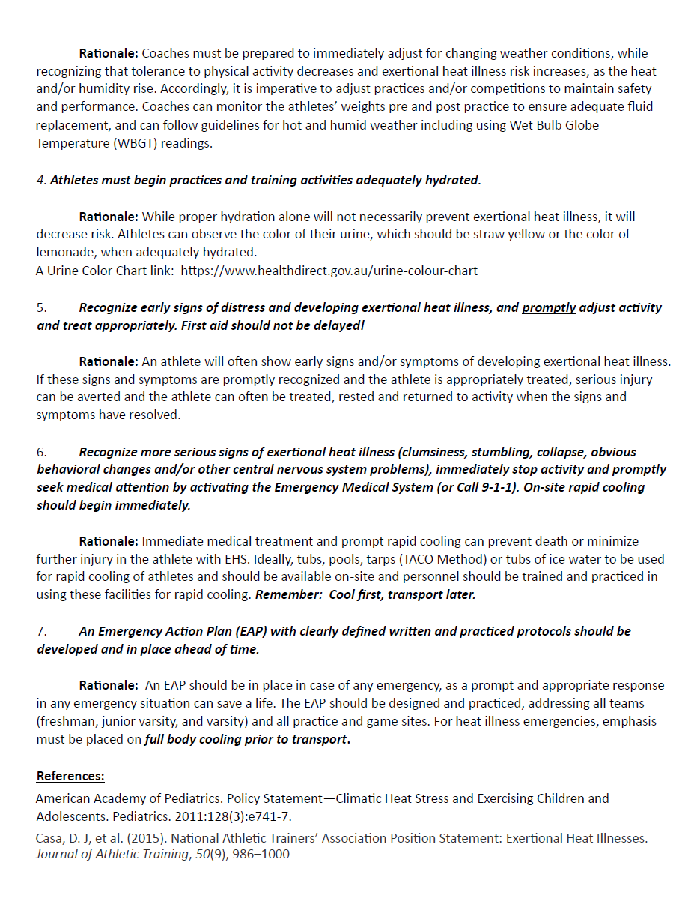
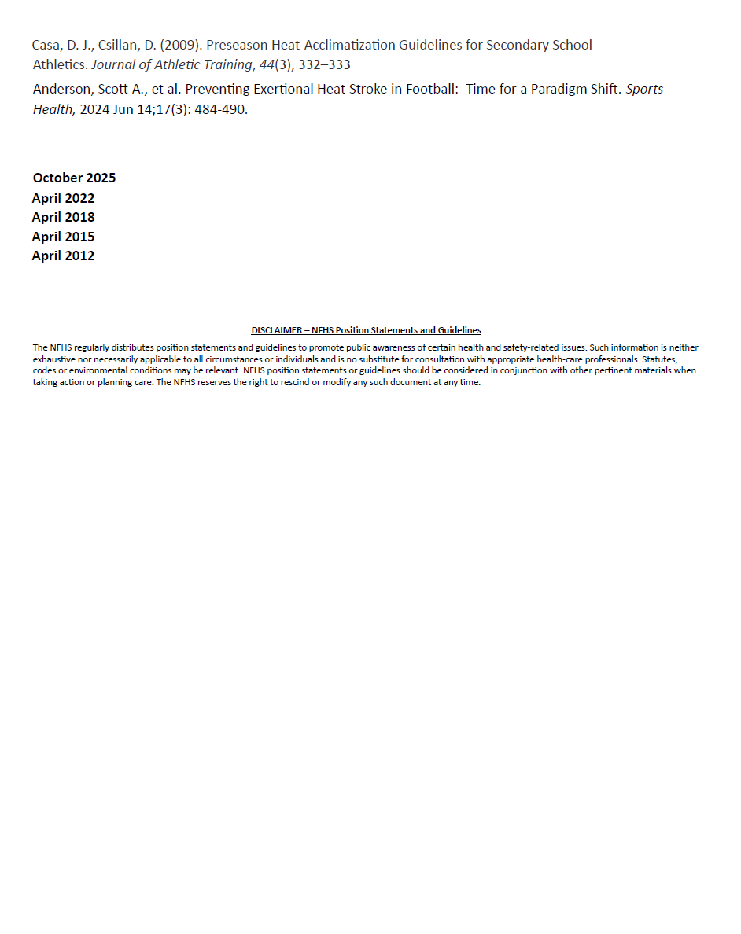
NFHS Heat Acclimatization and Heat Illness Prevention Position Statement
Notes:
Comment on Slide - continued:
The “NFHS Heat Acclimatization and Heat Illness Prevention Position Statement” was developed by the NFHS Sports Medicine Advisory Committee (SMAC). This Position Statement can be found on the Sports Medicine page on the NFHS Website.

Slide 61
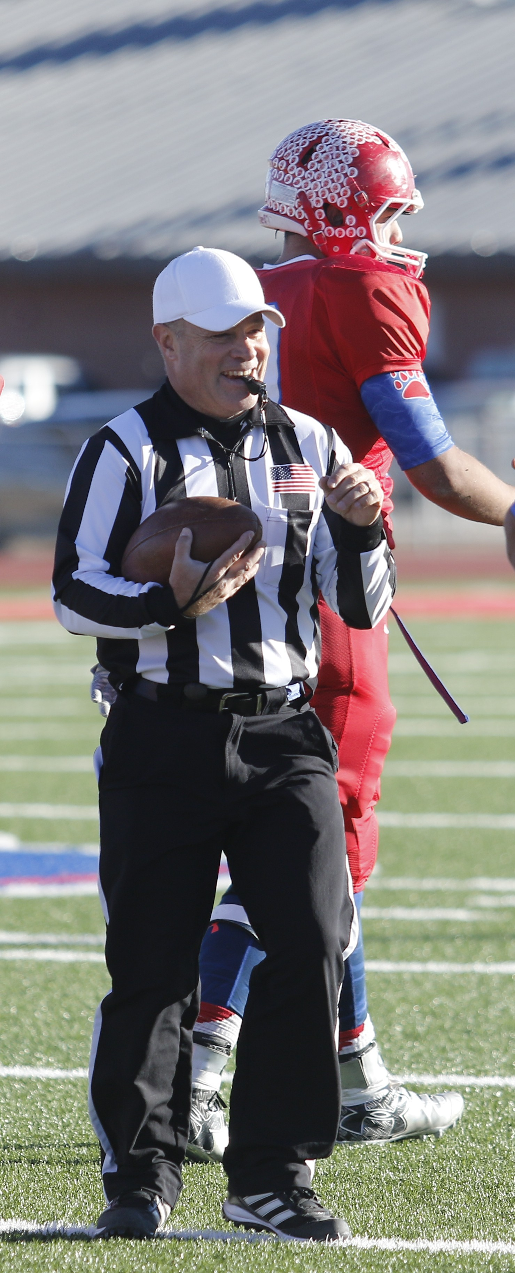
NFHS OFFICIALS EDUCATION

Slide 62

All Things Officiating in One Place!
The all-in-one, cloud-based NFHS Center for Officials Services (COS) connects everyone associated with officiating. The COS handles registration, assignments, testing, payments, and a host of other features and integrations that consolidate all officiating needs into a single, modern solution. Free to all NFHS state associations, local associations, and assigner groups.
20+
Member States
300,000+
Officials
7,000+
Schools
Notes:
NFHS Center for Officials Services:
See comments on slide.

Slide 63
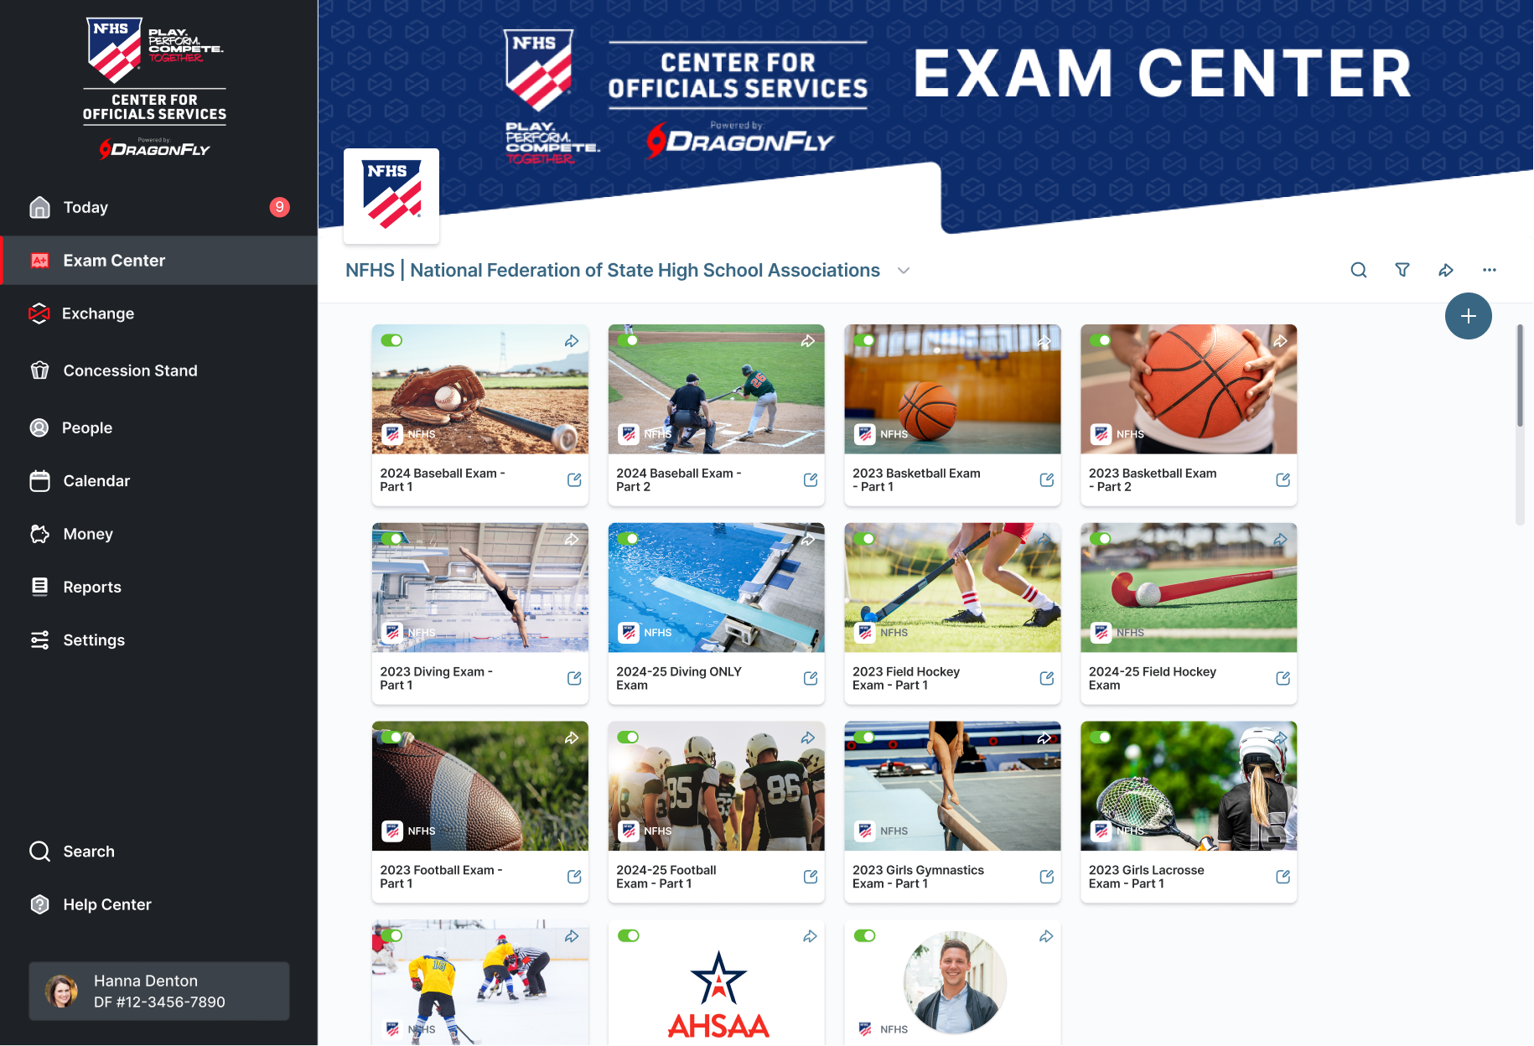
Improved Exam Center
Notes:
NFHS Center for Officials Services:
See comments on slide.

Slide 64
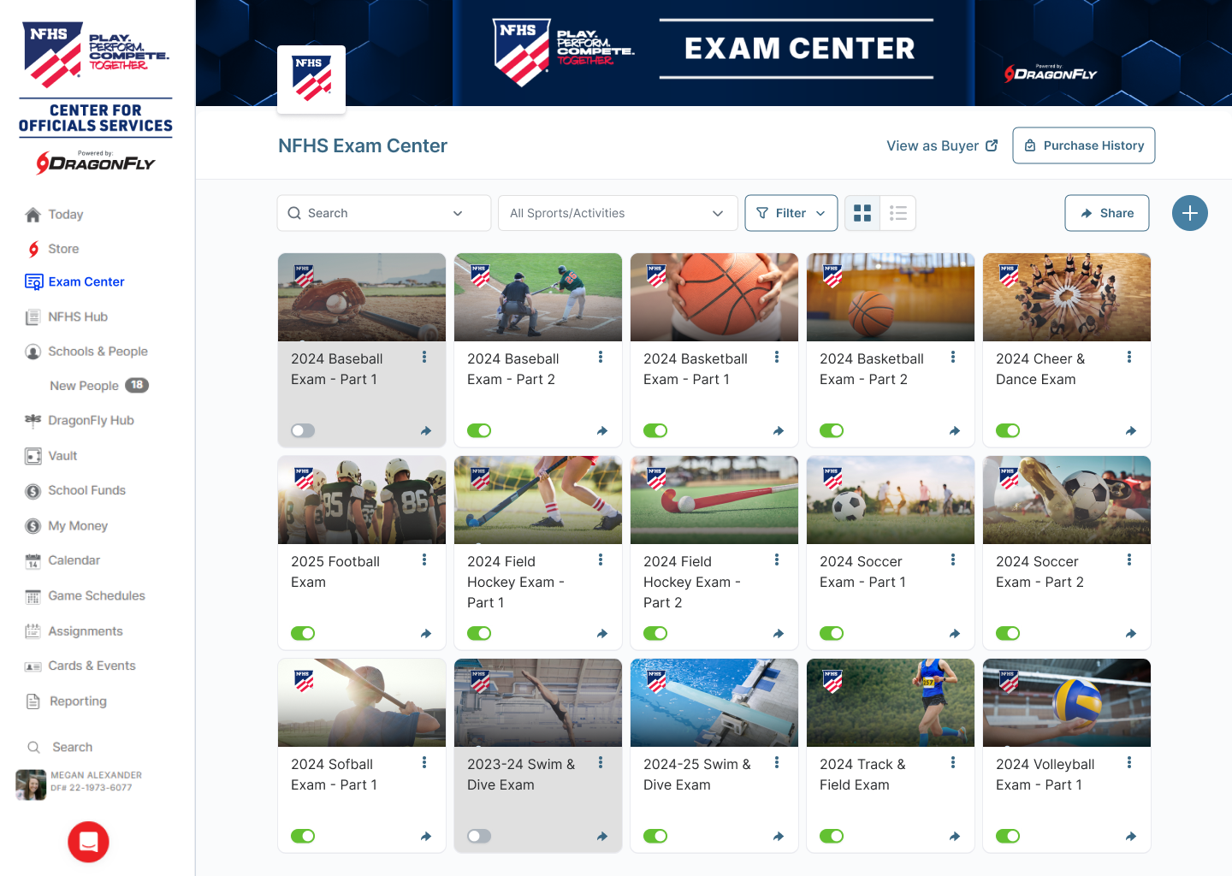
Notes:
NFHS Center for Officials Services:
See comments on slide.

Slide 65
NFHS LEARNING CENTER

Slide 66

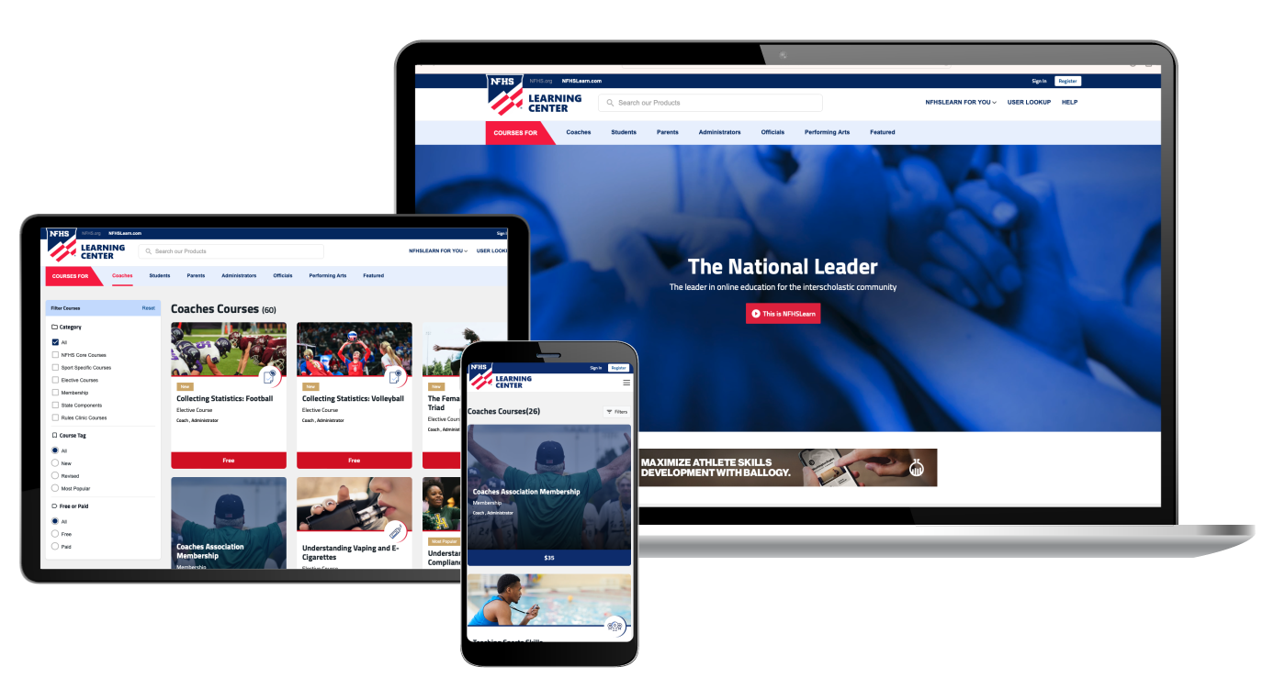
The National Leader
100+ Online Courses
75+ Available at No Cost!
Active in All 50 States
Valuable Professional Development
Earn Completion Certificates
Earn National Credentials
Earn Badges
www.nfhslearn.com
Notes:
NFHS Learning Center:
See comments on slide.

Slide 67
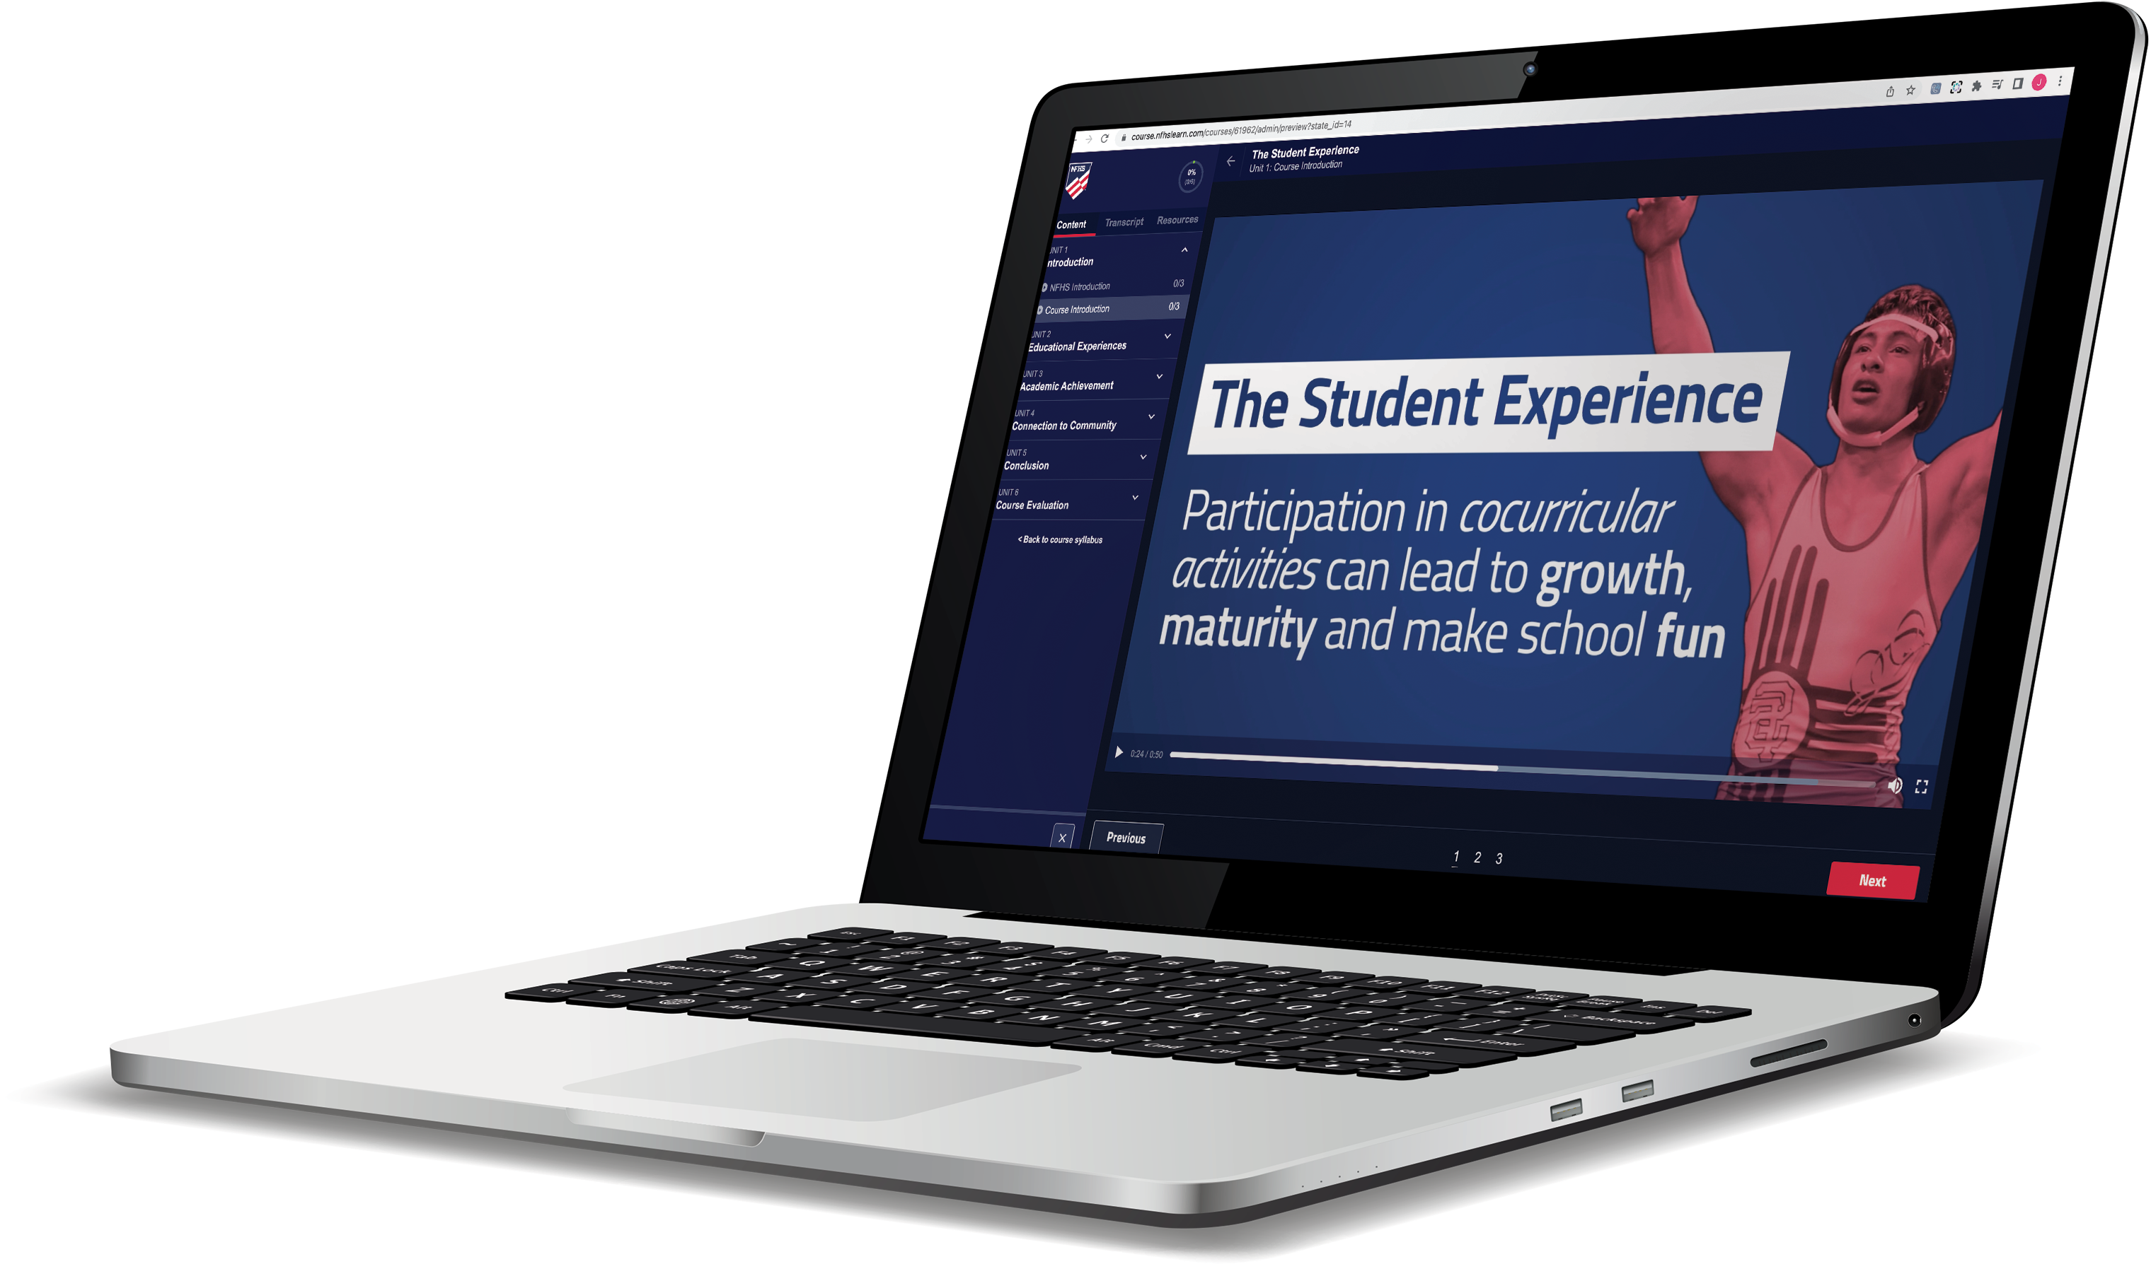
Over 29 million courses delivered!
Concussion in Sports – 9.2M+
Heat Illness Prevention – 3.6M+
Sudden Cardiac Arrest – 3.9M+
Concussion for Students – 2.1M+
The Collapsed Student (2020) – 108,000+
CPR & AED Training (2023) – 55,500+
Sportsmanship – 1.7M+
Fundamentals of Coaching – 1.1M+
First Aid, Health and Safety – 505,000+
Bullying, Hazing and Inappropriate Behaviors – 658,000+
Student Mental Health and Suicide Prevention – 460,000+
Coaching Mental Wellness (2025) – 37,750+
Emergency Action Planning for Afterschool Programs (2025) – 14,600+
Notes:
NFHS Learning Center:
See comments on slide.

Slide 68

NFHS NETWORK

Slide 69

NFHS Network
27 Different Sports and Activities.
By 2028, every high school event
in America will be streamed live.
The NFHS Network will be
THE DESTINATION for fans.
OUR NETWORK
www.NFHSnetwork.com
Notes:
NFHS Network:
The NFHS Network is a website and app where fans can watch live and replay high school sports and activities. It features 27 different sports and activities, and by 2028, every high school event in America will be streamed live—making the NFHS Network THE DESTINATION for fans.

Slide 70



Capture Your Memories –
Clip and Share
Allowing fans to capture and share their favorite moments
Notes:
NFHS Network:
The NFHS Network will broadcast over 750,000 live events this year. If your school is not a member of the NFHS Network School Broadcast Program, please contact us at Mark.Koski@NFHSnetwork.com

Slide 71



Automated Content Platform: Summary
Live Stream
+
VOD
VOD
Pixellot Camera
Coaching Platform
Game Breakdown
100%
Automated
Score, Team Stats,
Player Stats
Short Form Videos
Notes:
NFHS Network:
Pixellot captures the event and automatically sends live and VOD content to the NFHS Network.
VOD then flows into MaxPreps Advantage for coaching tools, game breakdowns, and team/player stats.
Content can also support MaxPreps and MaxPreps Sites through highlights and short-form video.
The key value is automation: one capture creates multiple uses across streaming, coaching, stats, and promotion.
This reduces manual work for schools while increasing content, visibility, and engagement.

Slide 72

Notes:
NFHS Network:
· The NFHS Network is the central platform for the high school fan experience.
· PlayOn, GoFan, NFHS Network, and MaxPreps each support a different part of the ecosystem: streaming, ticketing, content, stats, and school engagement.
· Together, these platforms create a connected experience for fans, families, schools, and communities.
· The goal is simple: make high school events easier to access, easier to follow, and more engaging before, during, and after the game.
· This partnership approach helps expand visibility for education-based athletics while strengthening the overall value of the NFHS Network.

Slide 73
Thank You
NFHS.org Phone # 317-972-6900 Email

