Slide 1


Addressing Bias Incidents in Athletics

Slide 2

Education-based athletics and activities should provide every student, coach, official, and spectator with an environment free from bias, discrimination, and harassment. Everyone deserves to feel safe, welcomed, respected, and valued so they can fully experience the educational benefits, positive relationships, and sense of belonging that interscholastic programs are intended to foster.
Notes:
The WHY

Slide 3
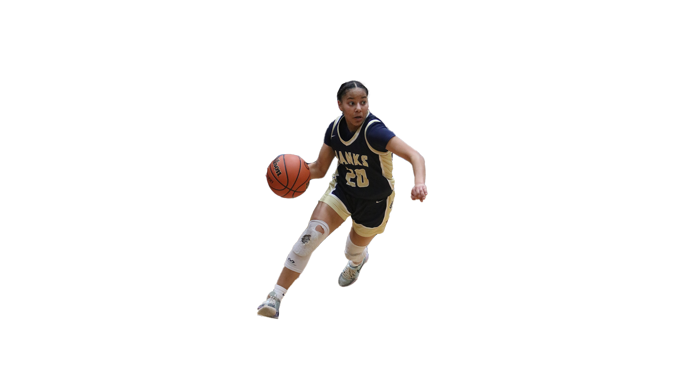
Sportsmanship Responsibility
(from the OSAA Handbook - Rule 3)
The high school administration, coach and other responsible officials of each member school shall take all reasonable measures to ensure that the school's coaches, players, students, and spectators maintain a sportsmanlike attitude at all events so that events may be conducted without unreasonable danger or disorder.
Defined as “any act that unreasonably differentiates treatment, intended or unintended, or any act that is fair in form but discriminatory in operation, either of which is based on age, disability, national origin, race, color, marital status, religion, sex, and sexual orientation.”
Discriminatory harassment and bullying behavior will not be tolerated.
This includes the use of, or engagement in, abusive verbal expression or physical conduct, especially if that conduct interferes with the performance of students, staff, event officials or sponsors of interscholastic activities.
Notes:
Language straight from the OSAA Handbook. Just meant to be a brief overview so they know where the policy is coming from.

Slide 4
Sportsmanship Violations/Penalties
(from the OSAA Handbook - Rule 3)
When the coaches, players, students, staff or spectators of any member school engage in unsportsmanlike conduct, discriminatory harassing behaviors, act in a manner disruptive to the school environment, or cause disorder or infliction of damage to persons or property in connection with any festival, meet, contest or championship sponsored by this Association, the Executive Board may treat such acts as a violation by the school of the Rules of the Association and the school shall be subject to penalty.
Penalties may vary depending on the actions taken by the school and/or school district during and after the event as it relates to trespassing spectators involved, removing players/coaches from the team for a period of time, requiring additional education/training, etc. Upon a ruling by the Executive Director or by the Executive Board the member school may be subject to probation, mandatory appearance before the Executive Board, required plan of action, forfeitures, fines, lack of institutional control penalties, suspension of membership or expulsion from the Association as determined by the Executive Board.
The Executive Director or the Executive Board may determine that no penalties are necessary when an incident has been handled appropriately and in a timely fashion by the school and/or district.
Notes:
Language straight from the OSAA Handbook. Just meant to be a brief overview so they know where the policy is coming from.

Slide 5
Contest Expectations

Slide 6
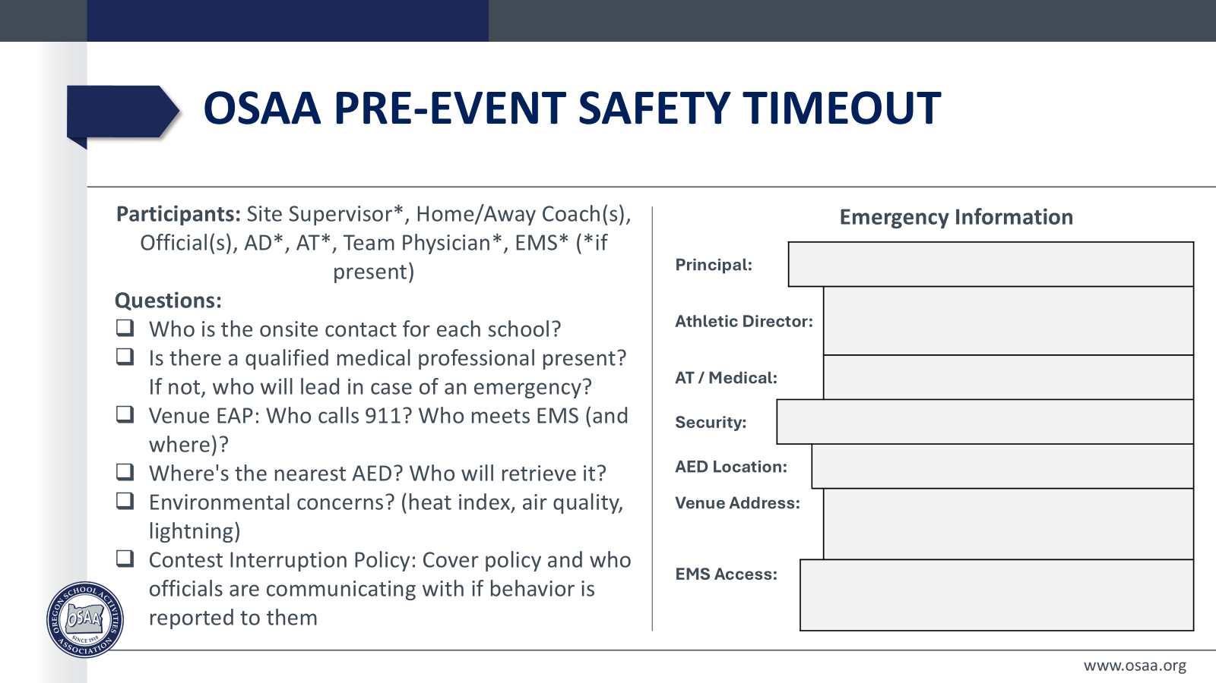
Notes:
Make sure that the Contest Interruption Policy during is discussed during the Pre-Event Safety Timeout. Ask the officials how and when they would like coaches to report any bias incidents to them if they happen during the contest. Remember, reporting bias incidents WILL NOT count as a timeout against your team.

Slide 7

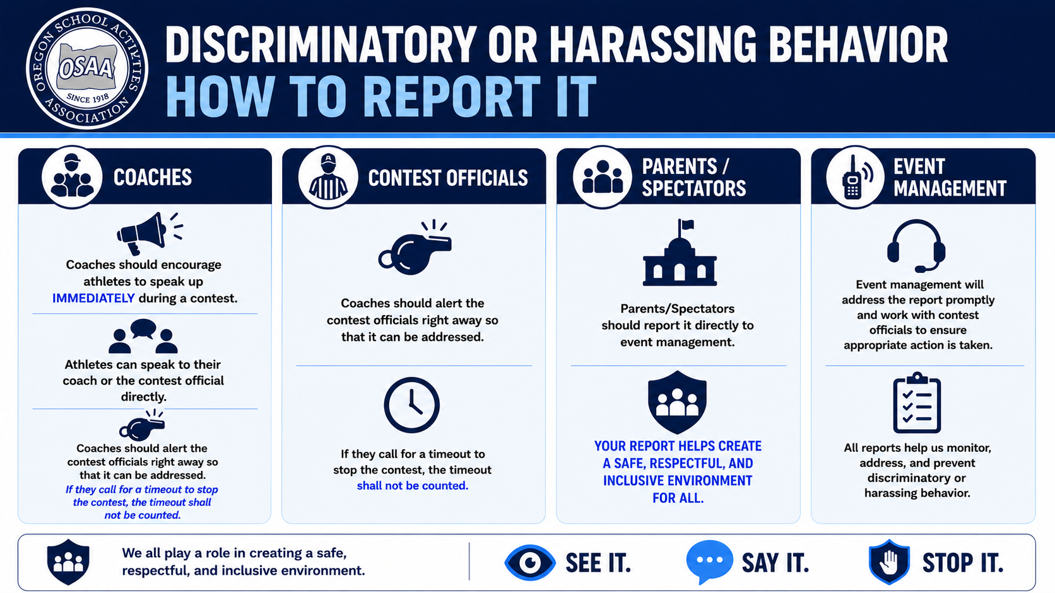
Notes:
Coaches should encourage athletes to speak up IMMEDIATELY during a contest. They can speak to their coach or the official directly.
Coaches should alert the game officials right away so that it can be addressed. If they call for a timeout to stop the contest, the timeout shall not be counted
Parents/Spectators should report it directly to event management.

Slide 8
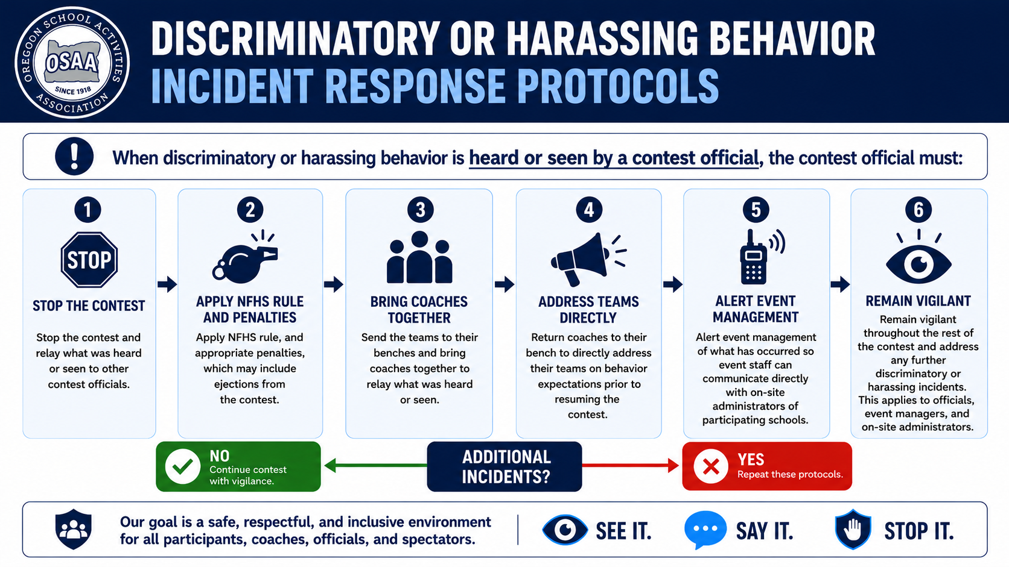
Notes:
Discriminatory or Harassing Behavior - Incident Response Protocols
When discriminatory or harassing behavior is heard or seen by an official, the official must:
Stop the contest and relay what was heard or seen to other contest officials.
Apply NFHS rule, and appropriate penalties, which may include ejections from the contest.
Send the teams to their benches and bring coaches together to relay what was heard or seen.
Return coaches to their bench to immediately address their teams on behavior expectations prior to resuming the contest.
Alert event management of what has occurred so event staff can communicate directly with on-site administrators of participating schools.
Remain vigilant throughout the rest of the contest and address any further discriminatory or harassing incidents. This applies to officials, event managers, and on-site administrators.
For any additional incidents, these protocols must be repeated.

Slide 9
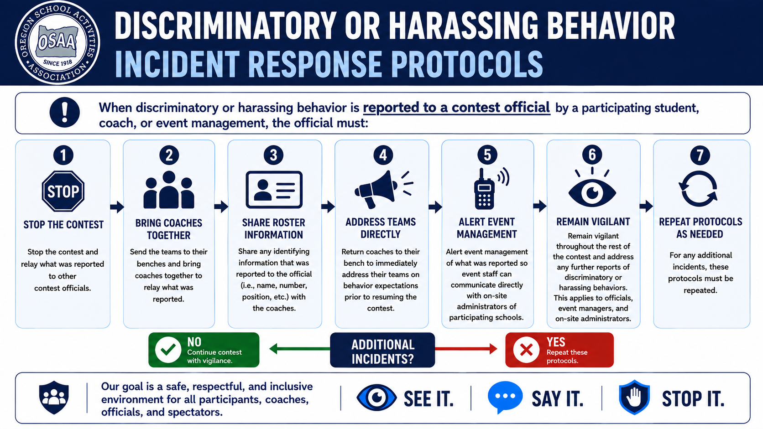
Notes:
Discriminatory or Harassing Behavior - Incident Response Protocols Cont.
When discriminatory or harassing behavior is reported to an official by a participating student, coach, or event management, the official must:
Stop the contest and relay what was reported to other contest officials.
Send the teams to their benches and bring coaches together to relay what was reported.
Share any identifying information that was reported to the official (i.e., name, number, position, etc.) with the coaches.
Return coaches to their bench to immediately address their teams on behavior expectations prior to resuming the contest.
Alert event management of what was reported so event staff can communicate directly with onsite administrators of participating schools.
Remain vigilant throughout the rest of the contest and address any further reports of discriminatory or harassing behaviors. This applies to officials, event managers, and on-site administrators.
For any additional incidents, these protocols must be repeated.

Slide 10
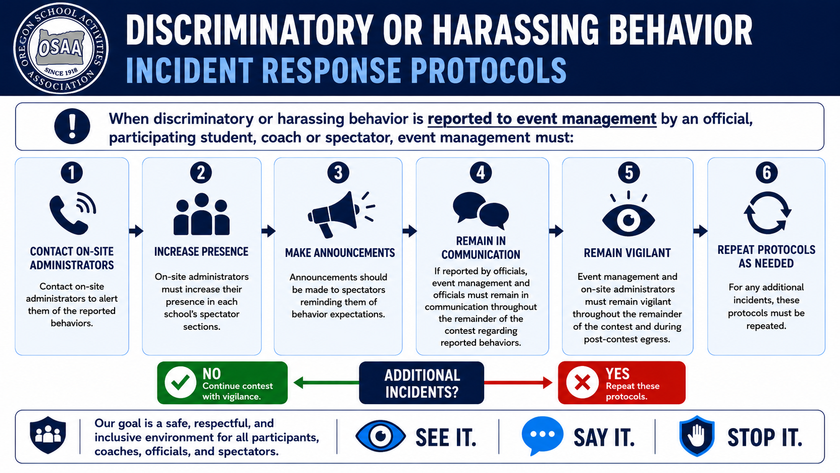
Notes:
Discriminatory or Harassing Behavior - Incident Response Protocols Cont.
When discriminatory or harassing behavior is reported to event management by an official, participating student, coach or spectator, event management must:
Contact on-site administrators to alert them of the reported behaviors.
On-site administrators must increase their presence in each school’s spectator sections.
Announcements should be made to spectators reminding them of behavior expectations.
If reported by officials, event management and officials must remain in communication throughout the remainder of the contest regarding reported behaviors.
Event management and on-site administrators must remain vigilant throughout the remainder of the contest and during post-contest egress.
For any additional incidents, these protocols must be repeated.

Slide 11
Responding After an Incident
Notes:
The next section can apply to incidents that occur within a school/program/team or during a contest with another school. The idea remains the same; interrupt and follow up.

Slide 12
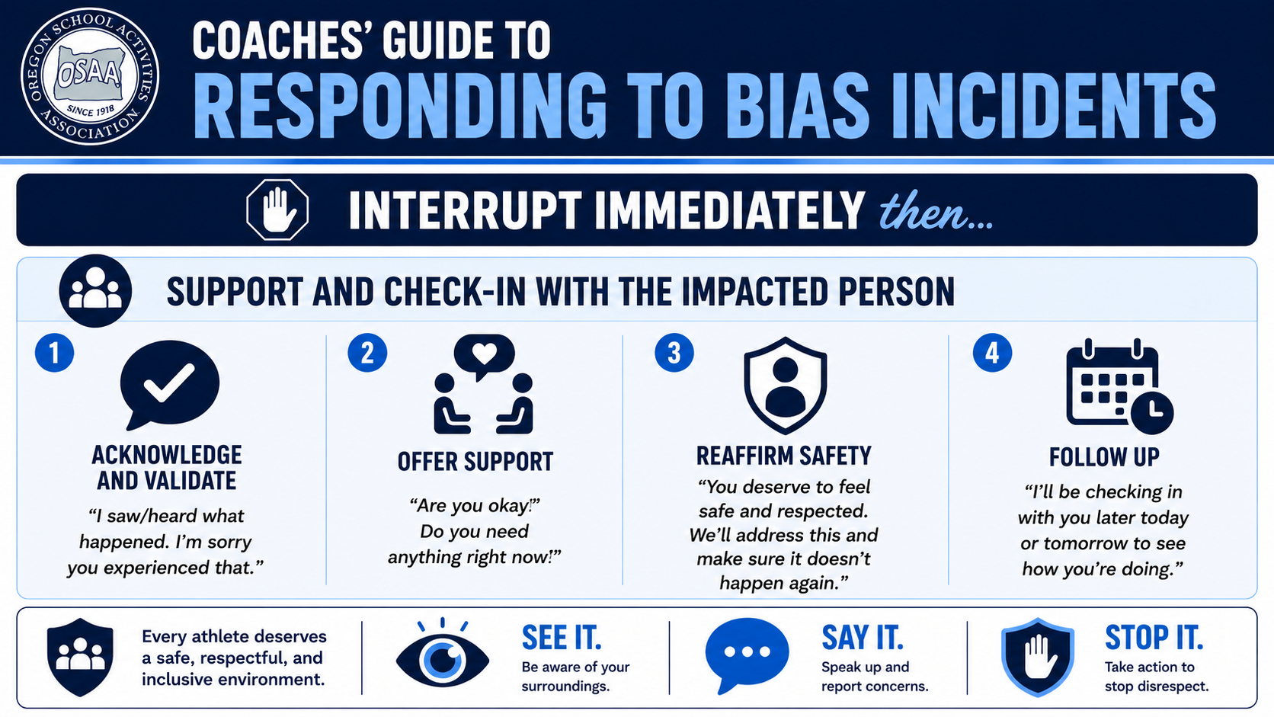
Notes:
Interrupt Immediately then...
Support and Check-in with the Impacted Person
Acknowledge and Validate: “I saw/heard what happened. I'm sorry you experienced that.”
Offer Support: “Are you okay? Do you need anything right now?”
Reaffirm Safety: “You deserve to feel safe and respected. We'll address this and make sure it doesn't happen again.”
Follow Up: “I'll be checking in with you later today or tomorrow to see how you’re doing.”

Slide 13
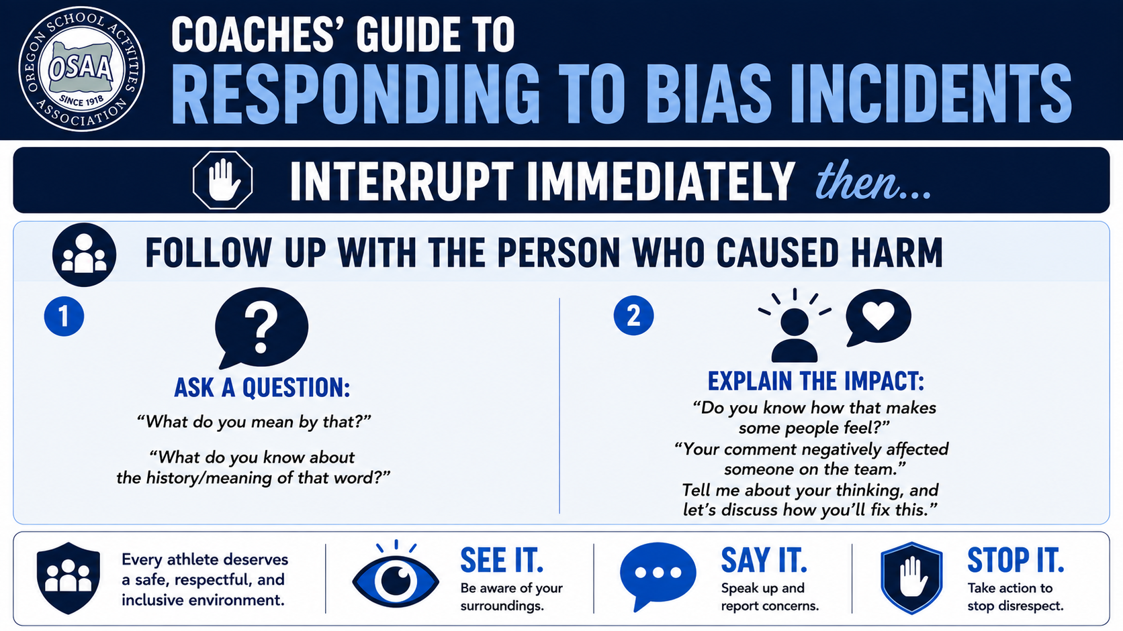
Notes:
Interrupt Immediately then...
Follow up With the Person Who Caused Harm
Ask a question: “What do you mean by that?” “What do you know about the history/meaning of that word?”
Explain the impact: “Do you know how that makes some people feel?” “Your comment negatively affected someone on the team. Tell me about your thinking, and let’s discuss how you'll fix this.”

Slide 14
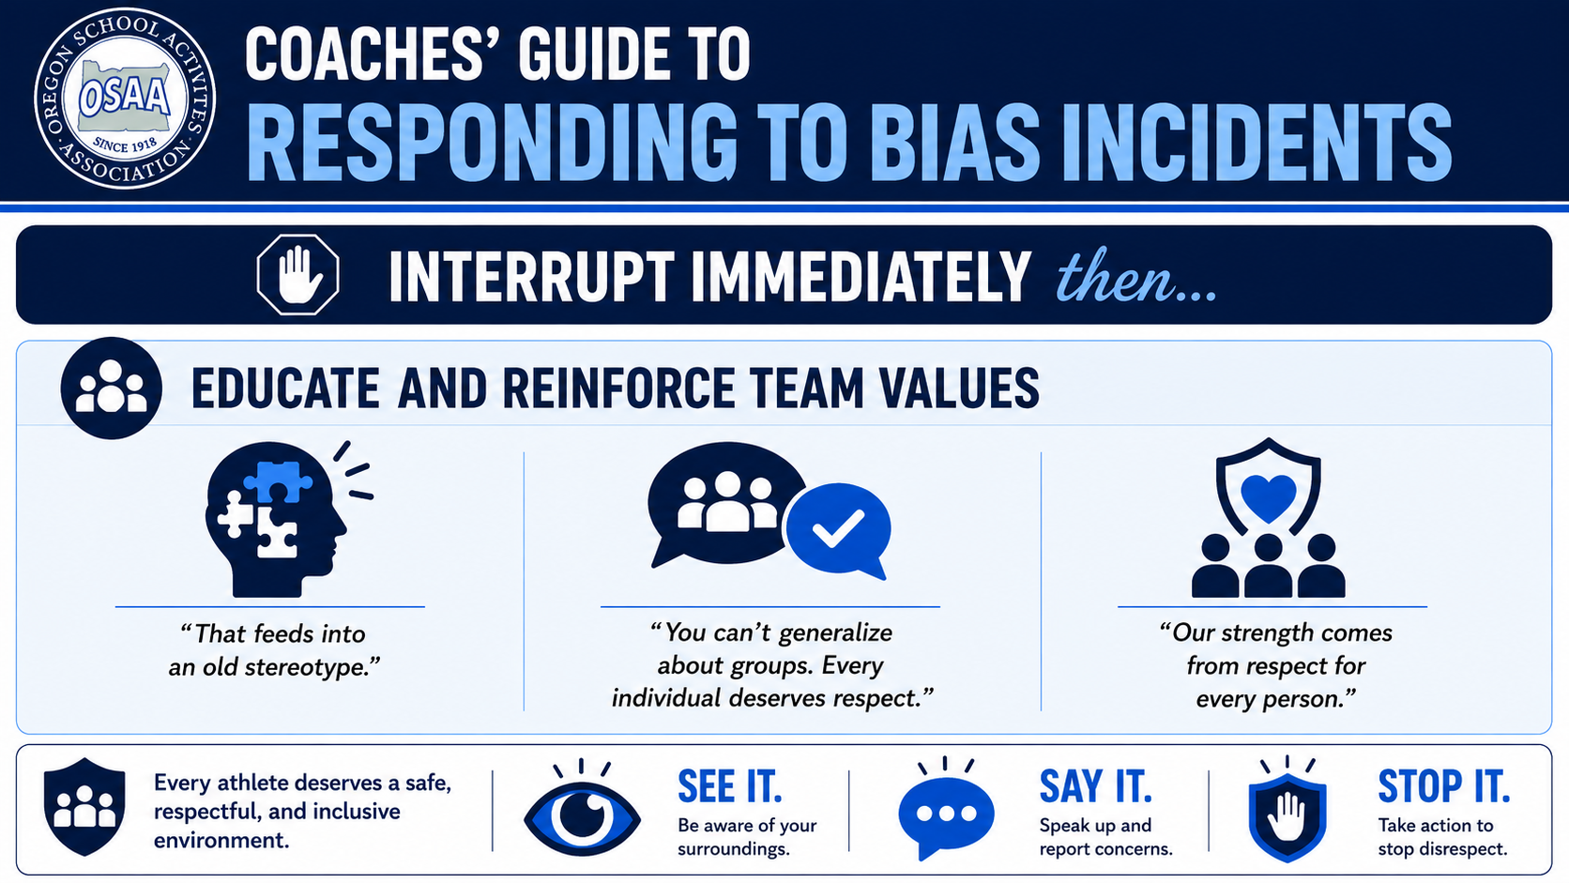
Notes:
Interrupt Immediately then...
Educate and Reinforce Team Values
“That feeds into an old stereotype.”
“You can't generalize about groups. Every individual deserves respect.”
“Our strength comes from respect for every person.”

Slide 15
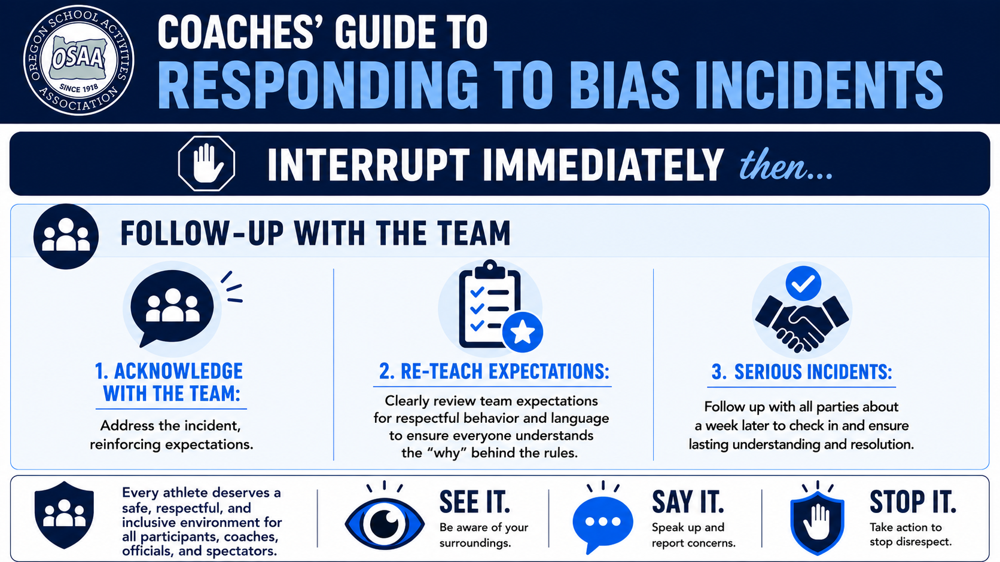
Notes:
Interrupt Immediately then...
Follow-Up with the Team
Acknowledge with the Team: Address the incident, reinforcing expectations.
Re-teach Expectations: Clearly review team expectations for respectful behavior and language to ensure everyone understands the “why” behind the rules.
Serious Incidents: Follow up with all parties about a week later to check in and ensure lasting understanding and resolution.

Slide 16
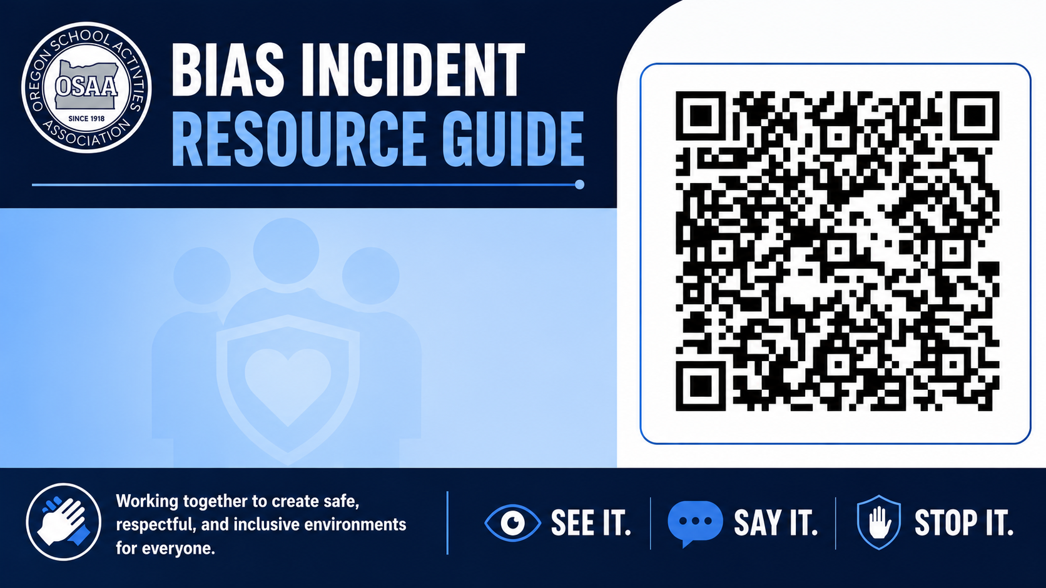
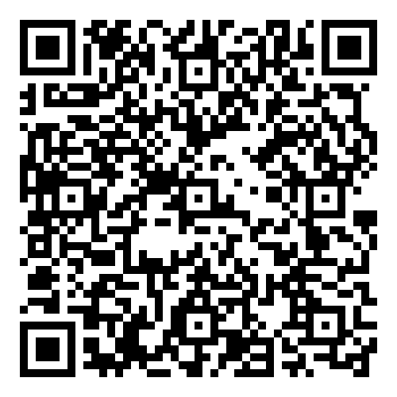
Bias Incident Resource Guide
OSAA/COSA Bias Incident Resource Guide
Notes:
OSAA/COSA Bias Incident Resource Guide

